Slide 1
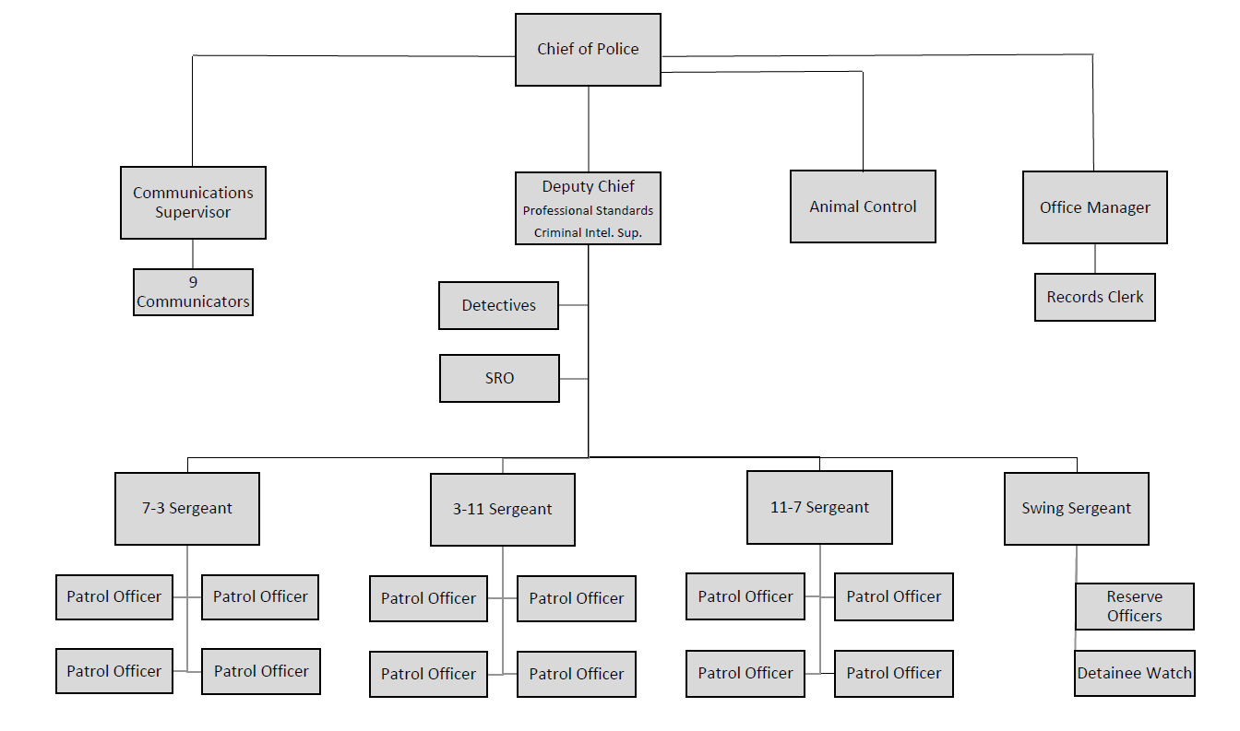
Warrant Article 3
Administrative Sergeant
Our Current Organization Design
Notes:
Current Organization Chart ***WHEN FULLY STAFFED***
20 Sworn Officers
10 Communications
2 Admin Staff
1 Animal Control
1 Detainee Watch

Slide 2
Warrant Article 3
Administrative Sergeant
Activity Statistics 2017 - 2022
Notes:
Arrest
Trending Up
Higher than pre-pandemic

Slide 3
Warrant Article 3
Administrative Sergeant
Activity Statistics 2017 - 2022
Notes:
Incidents
Trending level (though inclining last 2 years)
Criminal Application to Court
From Incidents (arrests are separate)
Those are trending higher
Doesn’t mean more crime, means higher solvabilty

Slide 4
Warrant Article 3
Administrative Sergeant
Activity Statistics 2017 - 2022
Notes:
Possible correlation?

Slide 5
Warrant Article 3
Administrative Sergeant
The Need for Adding Administrative Sergeant
Massachusetts Police Reform Mandates (Chapter 253 of the Acts of 2020)
Many New Requirements in the Way Police Departments Conduct Business
Most of the Changes are Administrative Function Requirements
Massachusetts Police Accreditation Commission (APD Accredited 2022)
A commitment to delivering an exemplary level of police service to the community
Maintaining Accreditation Status is an On-Going Process and Mostly Administrative
Ayer Population Growth
2010: 7,427
2020: 8,479
Recent Retirements
46% of Patrol Officers Have Under 2 Years Experience at Ayer PD
Notes:
Police Reform
Policy Maintenance and Updates
Hiring
Training
Complaint Investigation / Resolution
Recertification
Accreditation
This is something that we as an agency voluntarily began the process for achieving in 2019 and were awarded the prestigious status in 2022
As a proactive agency we are following state and national professional standards / best practices
This ensures that the Ayer PD is offering the highest level of professional services to the community
Population Growth
Ayer Population only part of the story, growth in general area has increased traffic
Over and above population growth, there is the Commercial and Industrial growth in the area
Retirements
Since 2020, retirements have skyrocketed. (5 Retirements, 1 Transfer)
Not systematic to Ayer
In 2021 I became Police Chief, along with over 150 other Police Chiefs (huge impact to profession)… and it continues
At all levels, massive retirements or resignations

Slide 6
Warrant Article 3
Administrative Sergeant
The Need Grows
Massachusetts Police Reform Mandates (Chapter 253 of the Acts of 2020)
On-Going and Continued
Massachusetts Police Accreditation Commission (APD Accredited 2022)
Continued Maintenance and Transition to Latest Accreditation Standards
Ayer Population Growth
Expected Continued Growth
Continued Retirements
On July1, 2023 57% of Patrol Officers Have Under 2 Years Experience at Ayer PD
Adoption of Body Worn Camera’s
Management, Preservation, Redaction, and Release of Recordings
Notes:
POST
Yearly certification of officers
Maintenance of complaint system
Maintenance of Training Requirements
Policy Development and Maintenance
Accreditation
Moving from Version 5 (10 year old Professional Standards) to Version 6 (2022 Professional Strandards)
Maintenance of either version are full time initiatives
Right now, several members of agency do various parts of Maintenance
Deputy will be moving the Department to next version over next 2 ½ years
Population Growth
Several Large Residential Developments in Various Stages
The Commercial and Industrial growth is expected to continune in the area
Retirements
8 out of 14
Supervision of young officers will be crucial
BWC
Statewide shift to BWC usage
Expect management of this program to be substantially extensive

Slide 7
Warrant Article 3
Administrative Sergeant
Administrative Sergeant = Adding Efficiencies
Allow the Day Shift Sgt. to Properly Supervise and be Readily Available out in the Field;
Day Shift Sgt. Would Add to Active Patrol Force in the Field;
Would Free Up Other Personnel to Focus on Primary Responsibilities;
Would Help Ensure that Police Reform Mandates & Accreditation Requirements are Met.
Notes:
The business of policing has become highly technical and administrative
By adding an Administratively Focused Sgt, it is my strong belief that the Ayer Police Department will be in a better position to offer the highest level of professional police services to the community
Proper Supervision / Accountability
- This is crucial for the Agency, the Employees and the Town as a whole
- Right now the Day Shift Sergeant doesn’t have the time to supervise in the field
Day Patrol Force Increase
- This is kind of a misnomer, was always considered part of the patrol force.
- by having patrol Sgt out on the road, it would be like gaining another officer on patrol
Free Up Other Personnel
As mandates and requirements unfolded over the last several years, certain duties had been assigned to different personnel
We would be able to delegate those duties awy form some so as to focus on their primary responsibilities
Ensure Police Reform Mandates and Accreditation Requirements are met
Next to achieving proper supervision, but just as important (but also goes hand in hand with), is ensuring that the police reform mandates and accreditation requirements are met
Both Police Reform Mandates and Accreditation Requirements not only ensure a a high level of professional police services, but it also instills high levels of confidence from within the community
Though being and accredited agency is voluntary, it is highly recommended by Police Reform Mandates and by insurance policies.

Slide 8
Warrant Article 3
Administrative Sergeant
Organization Design With Administrative Sergeant
Administrative
Sergeant
Notes:
Current Organization Chart
Administrative Sgt In Org Chart
Tentative Placement

Slide 9
Warrant Article 3
Administrative Sergeant
Thank You
Notes:
Current Organization Chart
Administrative Sgt In Org Chart
Tentative Placement

