Slide 1
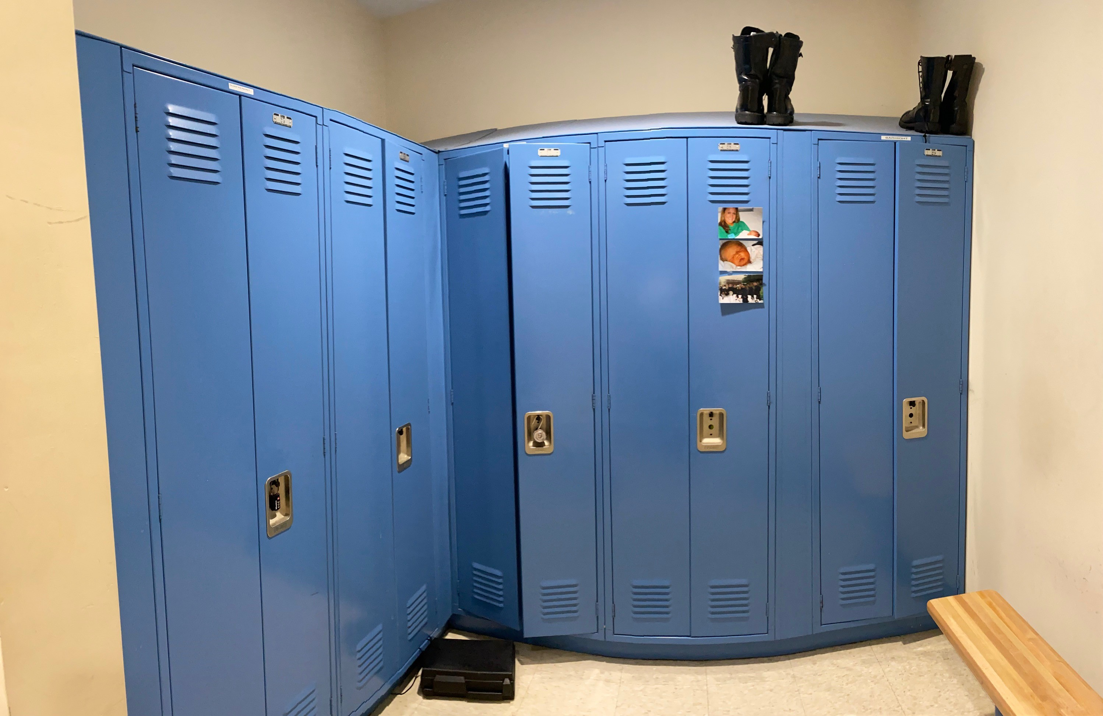
Warrant Article 10
Capital Budget Request
Update Locker Room Storage
Male Locker Room
Female Locker Room

Slide 2
Warrant Article 10
Capital Budget Request
Update Locker Room Storage
Circa 1997 (26 Years Ago)
Failing Components
Hanging Bar
Locking / Latching Mechanisms
Handles
Unchanged Locker Space
24” Double Door Lockers
Passive Ventilation
No / Inadequate Boot, Vest, Damp Gear Storage
No Equipment Charging Capabilities
Center Bench (Male)
Small Bench (Female)
Male Locker Room
Female Locker Room

Slide 3
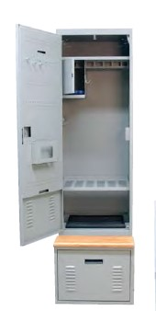
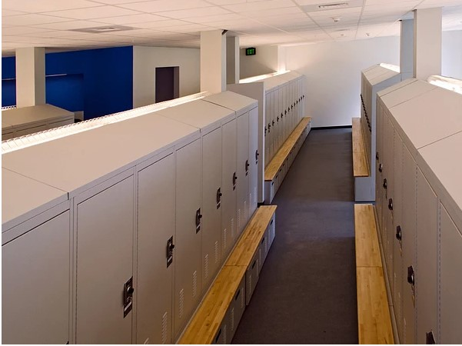
Warrant Article 10
Capital Budget Request
Update Locker Room Storage
Proposed Redesign of Room
24” Single Door
Designed for LE Gear and Equipment
HVAC Integrated Ventilation
Larger Bulk Item Storage
Integrated Electric Charging Outlets
Bench Space for Each Locker

Slide 4
Warrant Article 10
Capital Budget Request
Update Locker Room Storage
Thank You
Notes:
Current Organization Chart
Administrative Sgt In Org Chart
Tentative Placement

