Slide 1
Article 10 – Capital Budget Requests
Highway and Stormwater
Road Paving
Storm Drain Upgrades
Storm Culvert Improvements

Slide 2
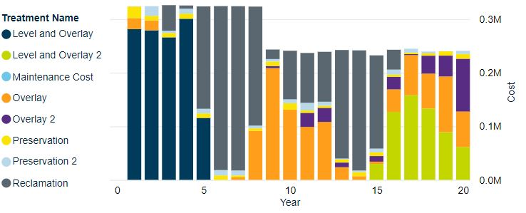
Road Paving $85,000
Road Paving funding is currently from MassDOT Chapter 90 and Town Capital Appropriation
Annual Chapter 90 amount ≈ $240K
Ayer Pavement Management Model (Predictor)
  Town wide PCI = 72 (out of 100)
  Predictor Pavement Model indicates a budget of $325,000 will raise PCI to 80 (acceptable) after 8 years and then likely maintain via Chapter 90
Additional funding allows DPW to keep up with the Town’s needs

Slide 3
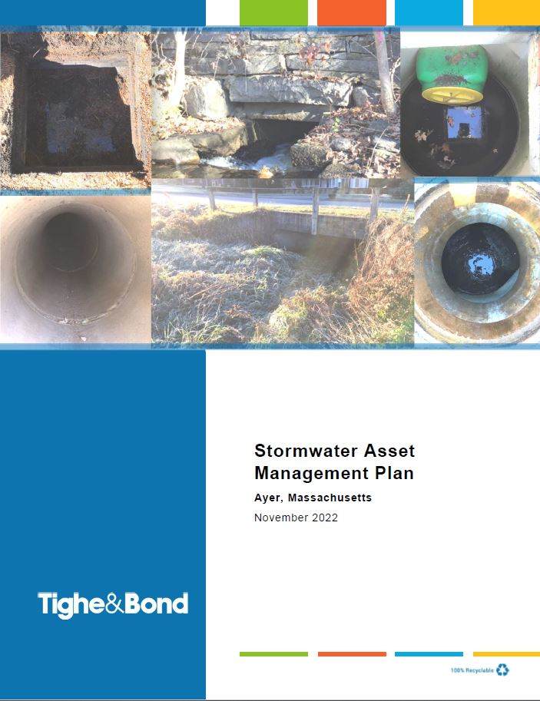
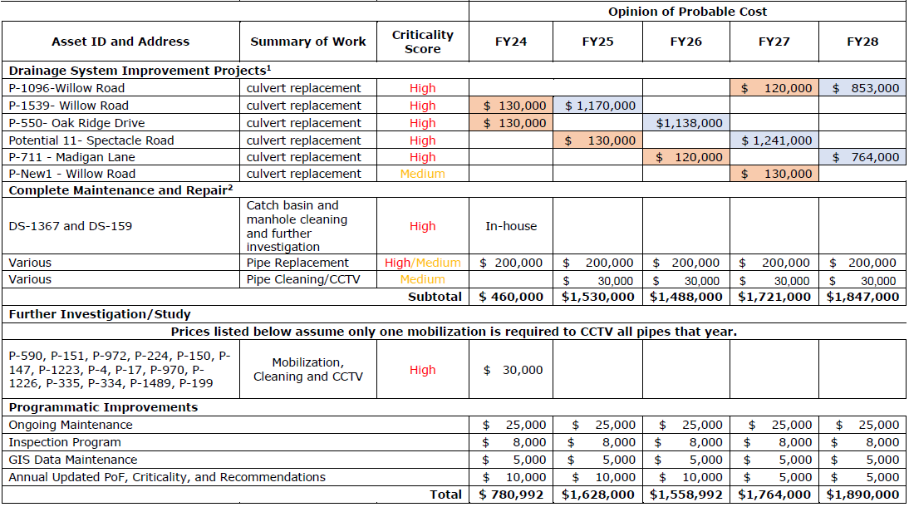
Storm Drain Upgrades and Culvert Improvements
Implementing Stormwater Asset Management Plan which has prioritized drainage and culvert improvements
Funds are also used to address drainage prior to road paving

Slide 4
Article 10 – Capital Budget Requests
Water
Annual Water Main Rehabilitation
Washington Street Water Tank Painting
Grove Pond Greensand Valve Replacement

Slide 5
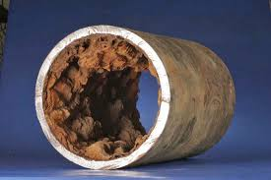
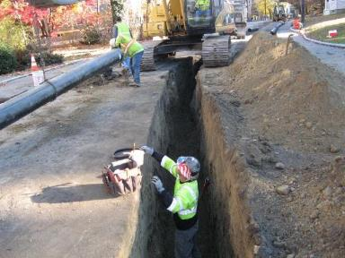
Annual Water Main Rehabilitation
Annual Capital request to replace aging water mains with poor rating
In-house engineering to maximize pipe replacement value
Continue to apply for grant funding and explore rehabilitation options

Slide 6
Washington St Water Tank Painting
1.5 Million Gallon Ground Storage Tank
Constructed in 1995
Coatings generally last 15-20 years
Inspection of Tank in November 2022
  Structurally sound
  Generally, very good condition
  Corrosion rehabilitation and painting required
Surface protection as part of routine tank maintenance (both interior and exterior)

Slide 7
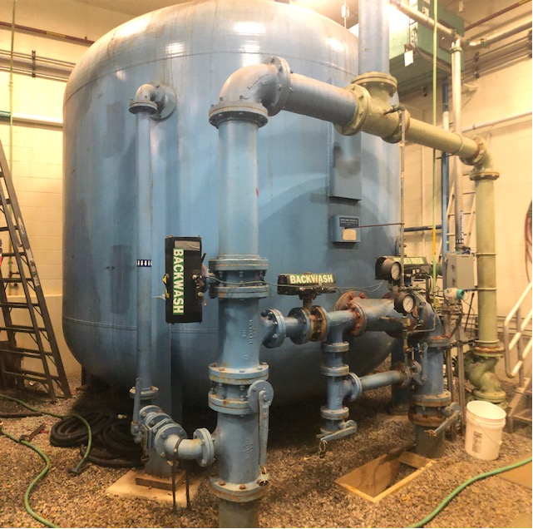
Grove Pond Greensand Valve Replacements
All operating and controlling valves are original to the plant, 1996
30 valves in total of various sizes; 3”-8”
Replacing in a stepped approach shall ensure proper maintenance and control of the Greensand Filter Vessels.

Slide 8
Article 10 – Capital Budget Requests
Sewer Enterprise
Inflow/Infiltration Repairs
Replace WWTP Boilers

Slide 9
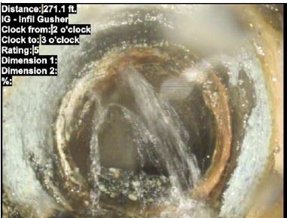
Inflow / Infiltration Repairs
I/I is rainwater or groundwater entering sewer system
2018 I/I investigation evaluated most of the pipes in the system
    Problems include high inflow, roots, structural damage
I/I can add over 1 million gallons of flow to WWTP
Sandy Pond Road trunk sewer main is the next phased section to be rehabbed
  Pipe showed significant internal corrosion due to hydrogen sulfide sewer gas
  Pipe is immediately downstream of the Westford Road sewer main which required replacement due to poor condition
  Flow is between 150,000 and 220,000 gallons per day
Sandy Pond Road

Slide 10
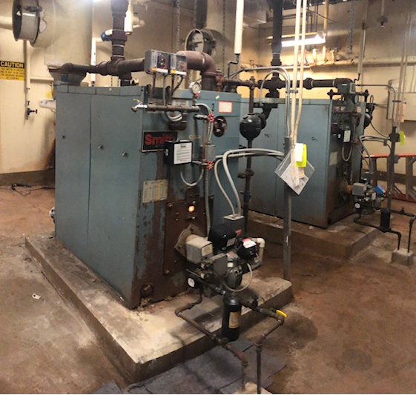
Replace WWTP Boilers
Boilers are original to the building (1982) and have exceeded their useful life expectancy
Repairs have become costly over the years

