Slide 1
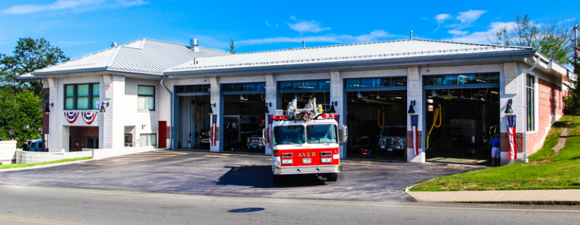
Ayer Fire Station Fire Station HVAC Repairs
Ayer Facilities Department FY24 Capital Request

Slide 2
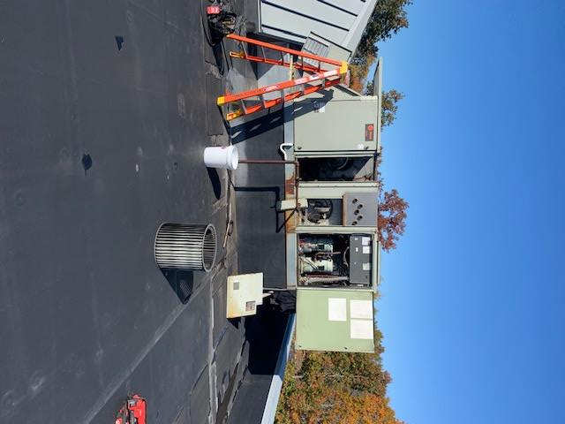

Slide 3
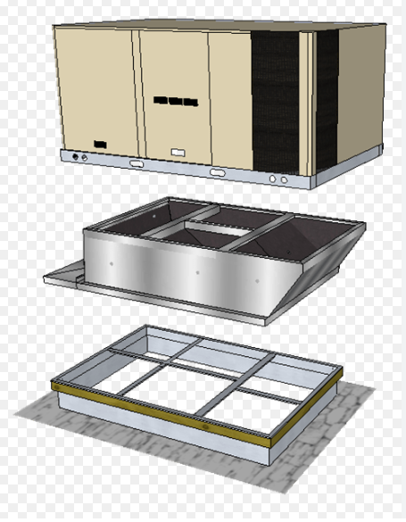
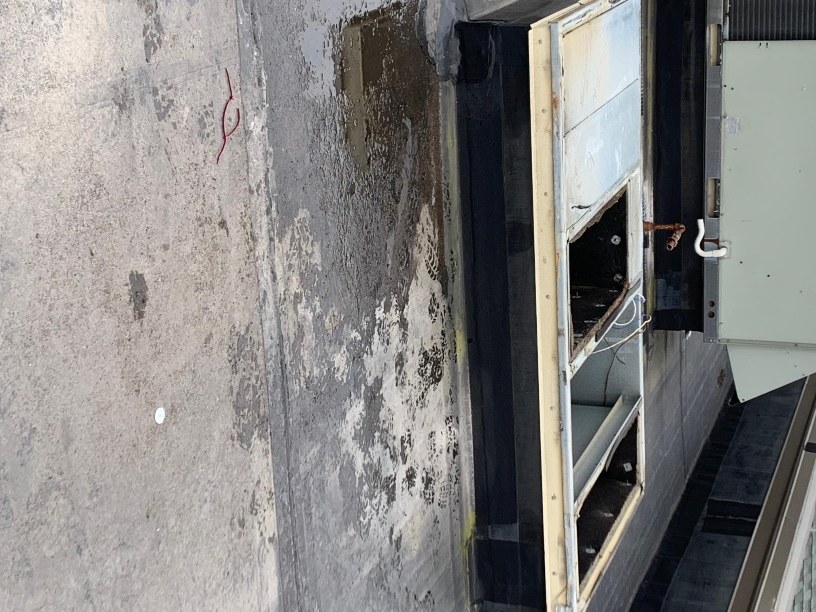
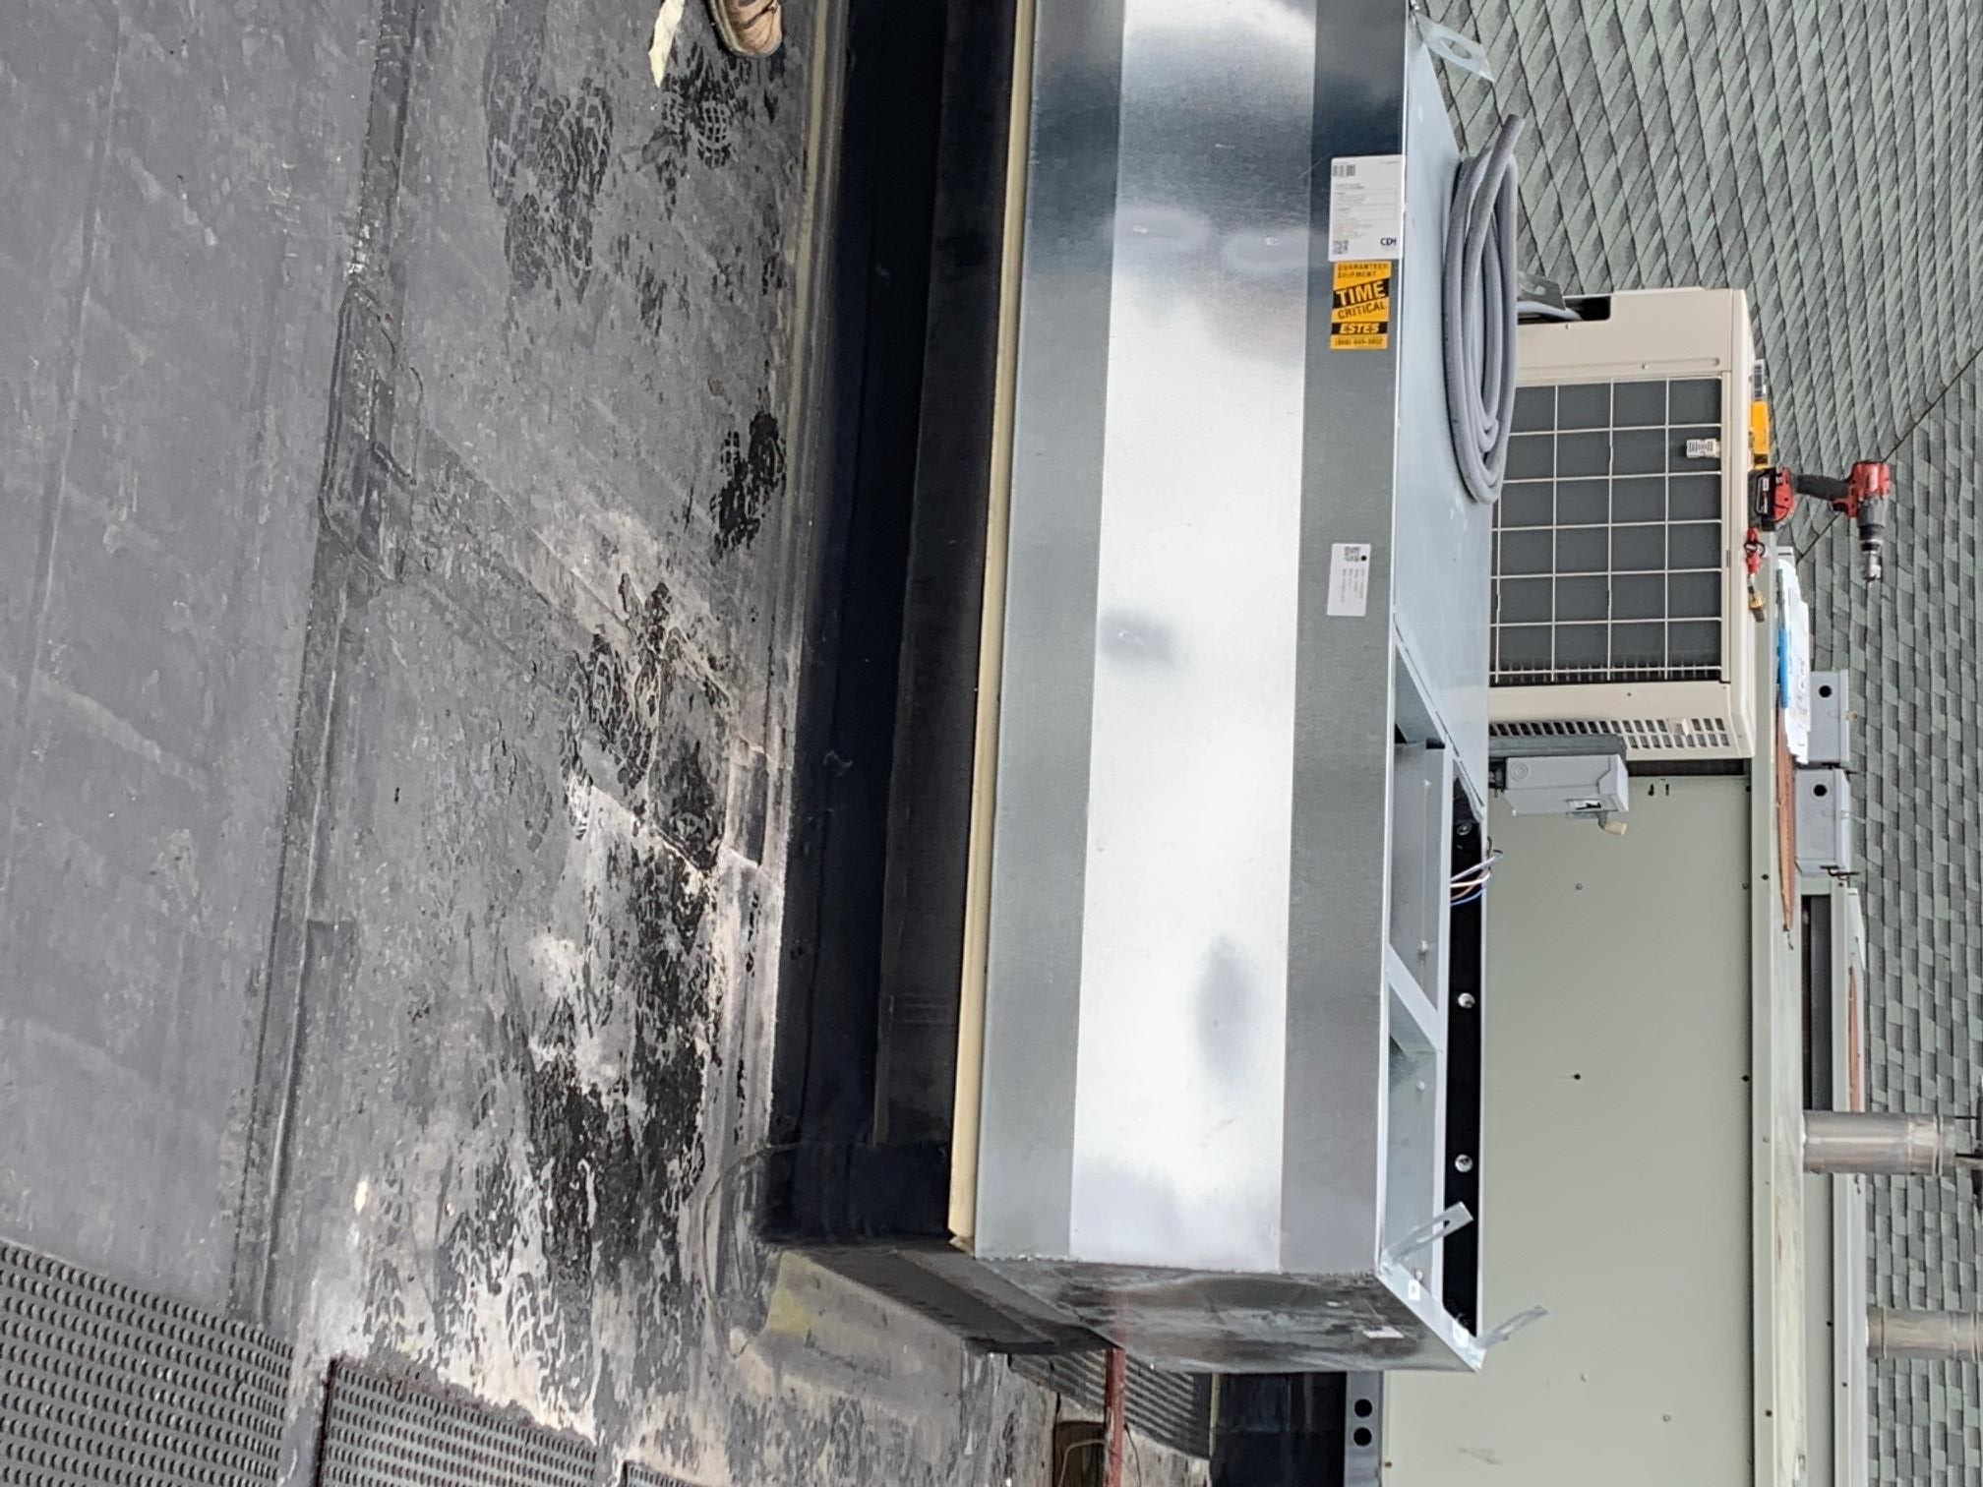
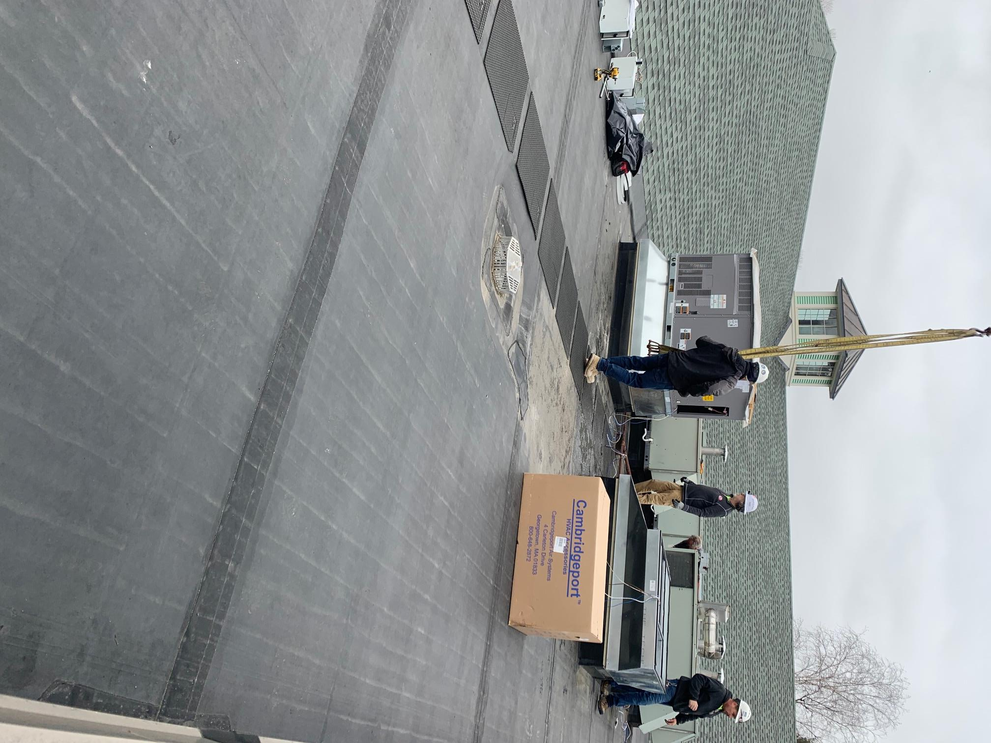

Slide 4
Funding Request / Cost Break Down
LINE | ITEM | sub- contractor | Quote - Pricing | QTY | LOCATION | UNIT COST | EXT COST | NOTES
1 | 20-Ton Packaged Gas / Electric RTU | Trane | a1-179727-1 | 1 | Fire Station | $30,000.00 | $30,000.00 | # per Trane FOB
2 | Rigging | N.E Rigging | DOC G703 | 1 | Fire Station | $5,000.00 | $5,000.00 | 2 quotes from Riggers
3 | Demo and Removal | TBD | 423-2 | 1 | Fire Station | $7,000.00 | $7,000.00 | Pricing est. for PD RTU replacement 6/5/22
4 | Control Work | Trane | Tie-in BAS Controls | 1 | Fire Station | $10,000.00 | $10,000.00 | # per Trane Controls
5 | Bond - Insurance - over head | TBD | DOC G703 | 1 | Fire Station | $10,500.00 | $10,500.00 | Pricing est. for PD RTU replacement 6/5/22
6 | Labor | TBD | DOC G703 | 1 | Fire Station | $9,700.00 | $9,700.00 | Pricing est. for PD RTU replacement 6/5/22
7 | Start-up - O&M - Shop Drawing | TBD | DOC G703 | 1 | Fire Station | $4,000.00 | $4,000.00 | Pricing est. for PD RTU replacement 6/5/22
8 | Engineering for curbing - change orders | TDB | TDB | 1 | Fire Station | $8,000.00 | $8,000.00 | # per HVAC repair verbal
9 | Electrical - Gas Piping | TBD | DOC G703 | 1 | Fire Station | $3,900.00 | $3,900.00 | Pricing est. for PD RTU replacement 6/5/22
 |  |  |  |  |  | Product Total | $88,100.00
 |  |  |  |  |  | Sales Tax | $-00
 |  |  |  |  |  | Freight | $-00
 |  |  |  |  |  | Delivery and Installation | included
 |  |  |  | Project Total |  |  | $88,100.00
Procurement Status
1 | New RTU | Quoted pricing for RTU by Trane |  |  |  |  |  | MGL 30B / 149A - IFB
2 | Control Work | Quoted pricing for Control work by Trane Controls |  |  |  |  |  | MGL 30B / 149A - IFB
3 | Labor / installation / insurance | Used 40 - 50% of the PD RTU replacement project for the best estimation of these cost |  |  |  |  |  | MGL 30B / 149A - IFB
4 | Curbing | Verbal quote from HVAC repair company |  |  |  |  |  | MGL 30B / 149A - IFB

