Slide 1
PIRONE PARK PLAYGROUND
Budget to Date
Appropriations | Amount | Expenses | Amount
2020 ATM - Remediation Study | $ 20,000.00 | Proposal Work (BETA)
CPC Spring 2022 Town Meeting | $ 400,000.00 | Task 1 Prelim Remediation Design and Cost Est | $ 19,980.00
Capital Spring 2022 Town Meeting | $ 320,000.00 | Task 2 Concept Plaground Design and Cost Est
Earmark | $ 100,000.00
 |  | Phase 1 Design & LSP Services (BETA)
 |  | Task 1 MassDEP Reporting | $ 3,300.00
 |  | Task 2 Plans and Specs | $ 7,000.00
 |  | Task 3 Oversight of Demo and Remediation | $ 10,000.00
 |  | Task 4 Permanent Solution Statement | $ 6,700.00
 |  | Temp Fence | $ 1,495.00
 |  | February 2022 through October 2022 | $ 891.00
 |  | Phase 1 Demo Construction (Brighter Horizons) | $ 173,000.00
 |  | Phase 2 Design of Playground (BETA) | $ 65,600.00
Total Appropriations | $ 840,000.00 | Total Expenses | $ 287,966.00
 |  | Available for Playground Construction* | $ 552,034.00
 |  | *Note: no contingency included in the above expenses,
 |  | overruns could reduce the available funds for the new playground

Slide 2
PIRONE PARK PLAYGROUND
Estimates
Item Description | 1st BETA Cost Estimate Full Build | Ajusted Estimate Full Build | Adjusted Estimate w/o Add Alts | Add Alt Nature Play Area
MOBILIZATION | $75,614.19 | $62,349.94 | $62,349.94
DRIPLINE TREE PROTECTION | $2,047.50 | $2,047.50 | $2,047.50
SITE PREPARATION | $17,650.00 | $17,650.00 | $17,650.00
EARTH EXCAVATION | $21,875.00 | $21,875.00 | $21,875.00
TRIMMING AND FINE GRADING | $19,181.25 | $19,181.25 | $19,181.25
COMPOST FILTER | $4,887.50 | $4,887.50 | $4,887.50
GRAVEL BORROW BASE COURSE | $19,575.00 | $19,575.00 | $19,575.00
ASPHALT BERM | $11,875.00 | $11,875.00 |  | $11,875.00
ASPHALT PATH | $31,570.00 | $31,570.00 |  | $31,570.00
R&D ASPHALT PAVING | $7,402.50 | $7,402.50 |  | $7,402.50
CONCRETE WALKS | $32,100.00 | $32,100.00
NEW PARK SIGN * | $9,375.00 | $1,500.00 | $1,500.00
NATURE & ADVENTURE PLAY SURFACE | $17,560.00 | $17,560.00 |  | $17,560.00
POUR-IN-PLACE PLAY SURFACE | $292,800.00 | $292,800.00 | $292,800.00
4' BLACK VINYL CHAINLINK FENCE | $26,100.00 | $26,100.00 | $26,100.00
PLANTING SOIL * | $11,475.00 | $1,500.00 | $1,500.00
LOAM BORROW | $30,600.00 | $30,600.00 | $30,600.00
SEEDING * | $8,497.50 | $1,000.00 | $1,000.00
PLAY EQUIPMENT | $815,750.00 | $645,750.00 | $645,750.00
NATURE & ADVENTURE PLAY EQUIPMENT | $65,750.00 | $65,750.00 |  | $65,750.00
BENCHES * | $22,500.00 | $2,500.00 | $2,500.00
BIKE RACK WITH CONCRETE PAD * | $9,510.00 | $1,000.00 | $1,000.00
TRASH RECEPTACLES * | $6,400.00 | $1,000.00 | $1,000.00
LANDSCAPE PLANTINGS * | $23,450.00 | $3,000.00 | $3,000.00
TREES * | $24,050.00 | $0.00 | $0.00
SUBTOTAL | $1,607,595.44 | $1,320,573.69 | $1,154,316.19 | $134,157.50
PLUS 15% CONTINGENCY | $241,139.32 | $198,086.05 | $173,147.43 | $20,123.63
TOTAL ESTIMATED COST | $1,848,734.76 | $1,518,659.74 | $1,327,463.62 | $154,281.13
AVAILABLE FUNDS | ($552,034.00) | ($552,034.00) | ($552,034.00)
TOTAL FUNDING NEEDED | $1,296,700.76 | $966,625.74 | $775,429.62 | $154,281.13
* Work to be done by Town of Ayer

Slide 3
PIRONE PARK PLAYGROUND
Funding Sources
 | CPA Fund | Other Sources | Total
Personnel | - | - | -
Equipment | $717,000 |  | $717,000
Supplies | $33,000 | $47,000 (Phase 1 Carryover) | $80,000
Contractual | - | - | -
Construction | - | $220,000 (Capital) $303,000 (Phase 1 Carryover) | $523,000
15% Contingency | - | $198,000 (Phase 1 Carryover) | $198,000
TOTAL | $750,000 | $768,000 | $1,518,000

Slide 4
PIRONE PARK PLAYGROUND
Timeline
Winter 2023: Complete planning through BETA for the rebuilding of the playground.
April 2023: Secure funding for the project at Town Meeting.
April 2023: Put the project out to bid (possibly in two components).
May 2023: Accept bid(s) for the project.
June 2023: Begin construction.
September 2023: Complete project.

Slide 5
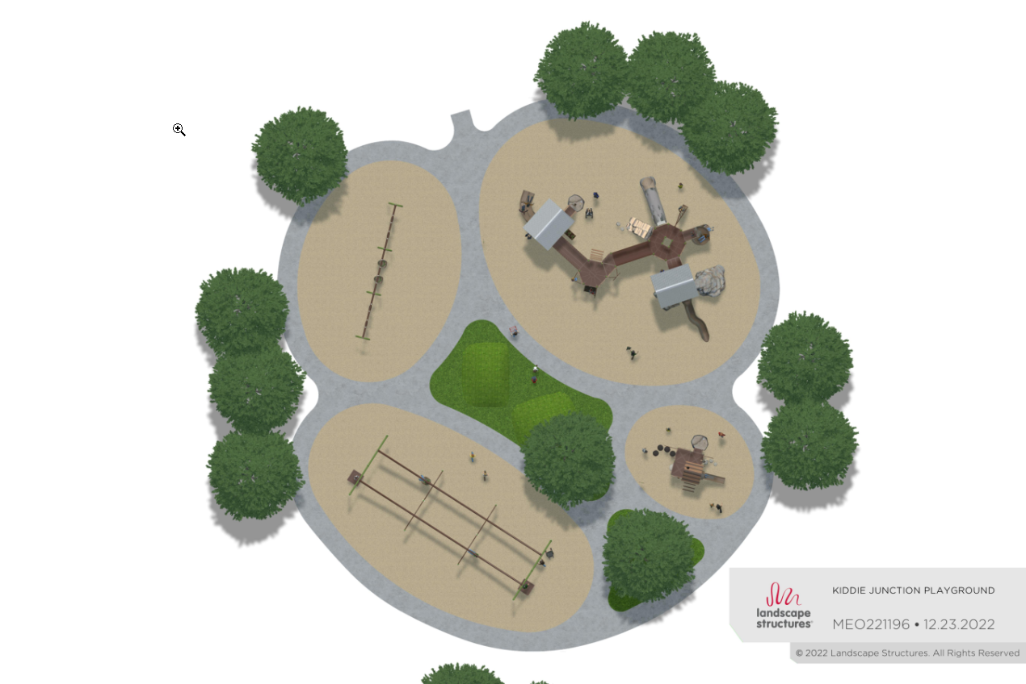
PIRONE PARK PLAYGROUND

Slide 6
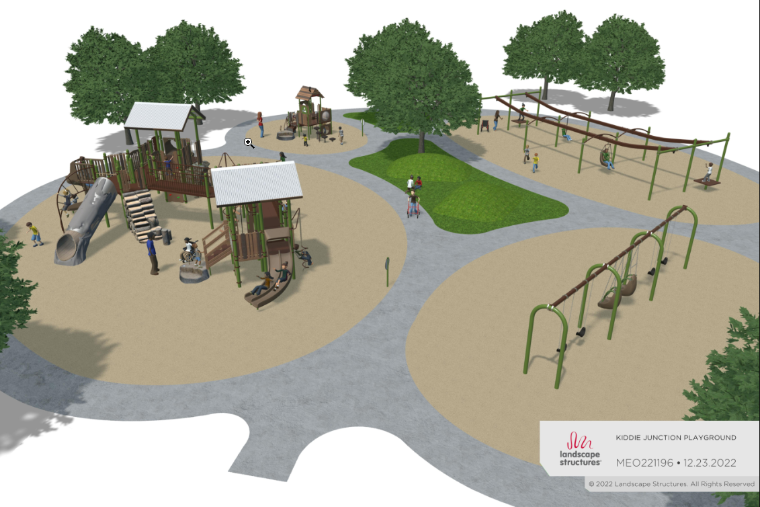
PIRONE PARK PLAYGROUND

Slide 7
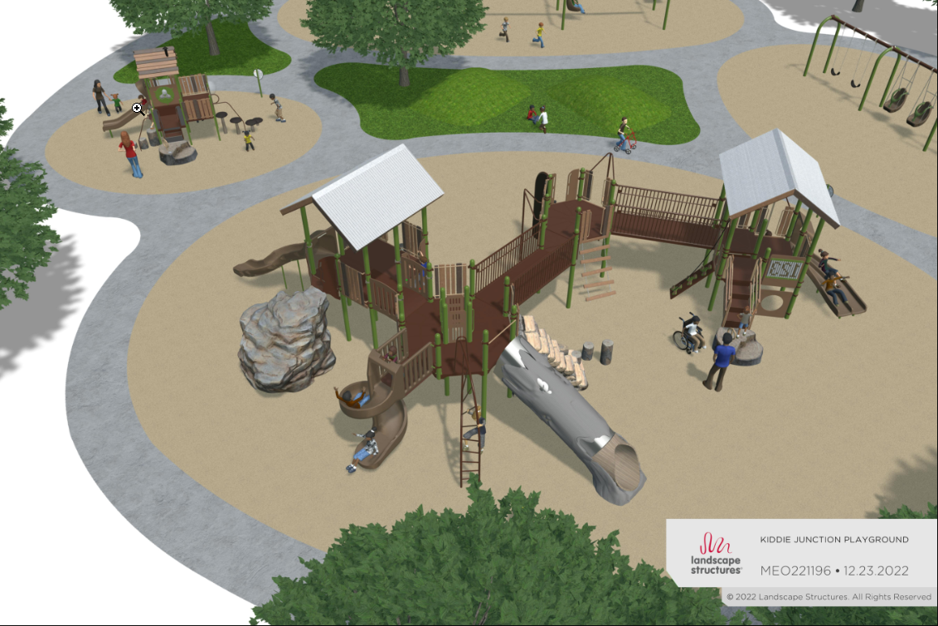
PIRONE PARK PLAYGROUND

Slide 8
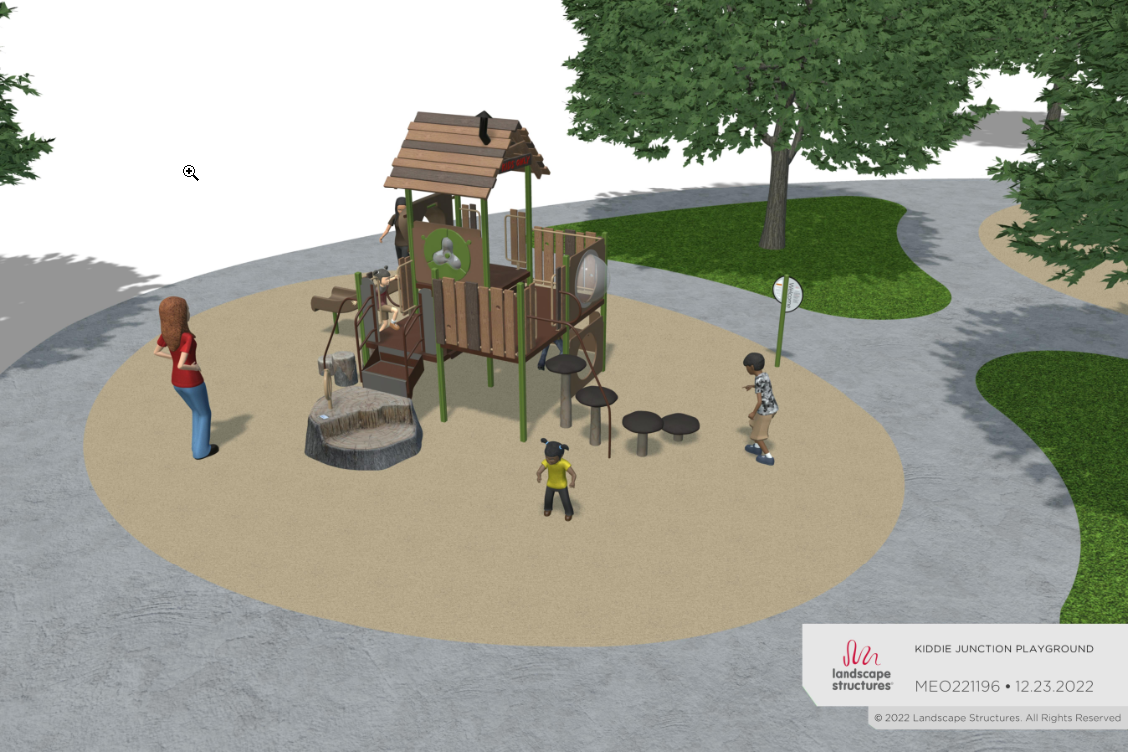
PIRONE PARK PLAYGROUND

