Slide 1
Article 11 – Capital Budget Requests
Highway and Stormwater
Road Paving
Municipal Tractor/Sidewalk Snowblower
Storm Drain Upgrades
Culvert Improvements

Slide 2
Road Paving $95,000
Road Paving funding is currently from MassDOT Chapter 90 and Town Capital Appropriation
Annual Chapt 90 amount = $240K
Ayer Pavement Management Model (Predictor)
  Town wide PCI = 72 (out of 100)
  Predictor Pavement Model indicates a budget of $325,000 will raise PCI to 80 (acceptable) by 2029 and then likely maintain via Chapter 90
Additional funding will allow us to keep up with the Town needs
Paving/preservation projects include Third St, West Main Street, Shaker Road, Barnum Road

Slide 3
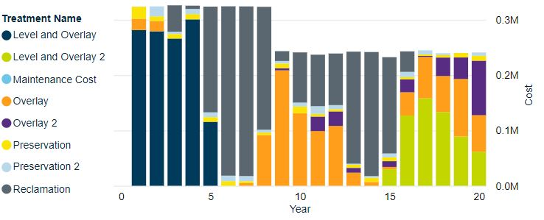
Road Paving $95,000

Slide 4

Municipal Tractor / Sidewalk Snow Blower
DPW has two (2) municipal “tractors” that are used for mowing, sidewalk plowing/blowing, and sidewalk sweeping.
The equipment includes:
• 2009 M-B MSV (Multi Service Vehicle)
• 2017 Trackless MT-7
These tractors get a lot of use in the summer and winter. Unfortunately, M-B stopped producing their sidewalk equipment and no longer produces parts for the M-B MSV, therefore, any significant part failure will likely cause the M-B to no longer be useable.

Slide 5
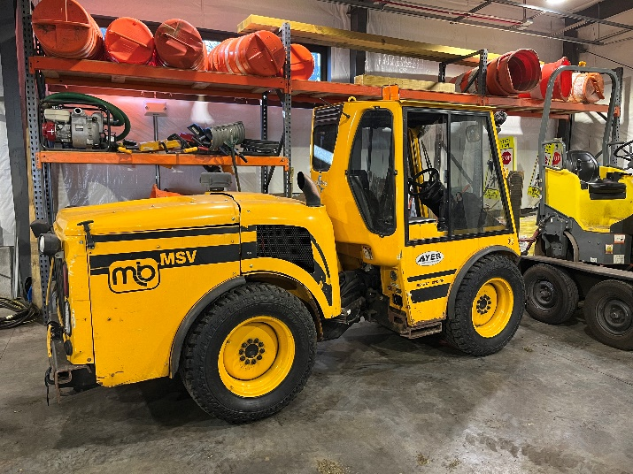
Municipal Tractor / Sidewalk Snow Blower
Maintain level of service and speed at which sidewalks are cleared after snow. Have redundancy.
Also used for sweeping and flail mowing, removing snow from parking lanes and widening roadways narrowed by snowbanks
Price based on quotations

Slide 6
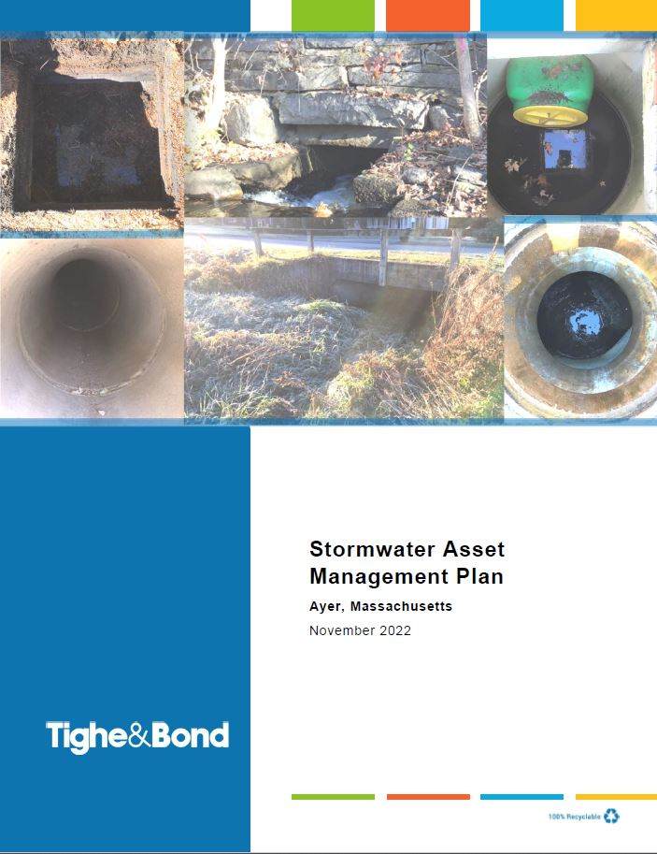
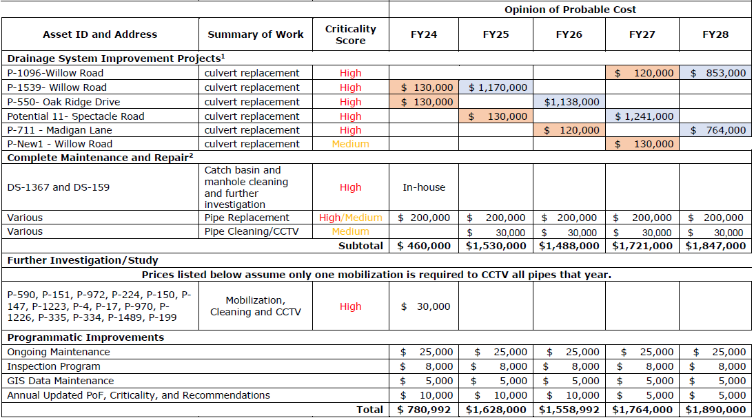
Storm Drain Upgrades and Culvert Improvements
Implementing Stormwater Asset Management Plan which has prioritized drainage and culvert improvements
  Design, routine maintenance, annual CCTV and cleaning
Funds are also used to address drainage prior to road paving

Slide 7
Article 11 – Capital Budget Requests
Wastewater Enterprise
Wastewater Treatment Plant Upgrades
Inflow/Infiltration Repairs
Wastewater Pump Station Upgrades
Wastewater Pump Station Generator Connections

Slide 8
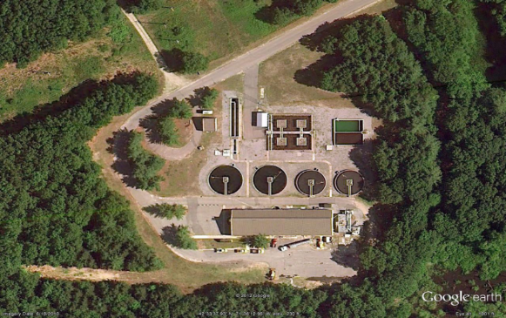
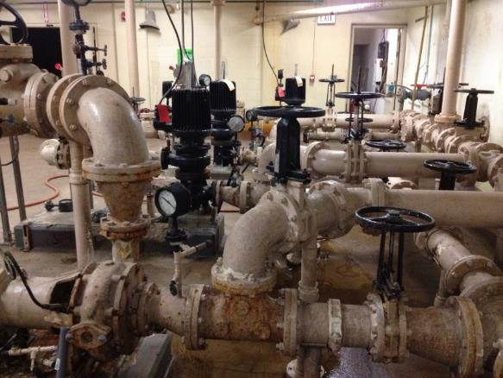
Wastewater Treatment Plant Upgrades
Plant constructed in 1982, process upgrades in 1996 and 2007
CDM-Smith completed detailed evaluation of WWTP and 5-year Capital Improvement Plan (CIP) in 2018
  Facility condition
  Process equipment condition
  NPDES Permit compliance
  Operational efficiency
Building systems need replacements/ repairs
Process / equipment needs upgrades for reliability and permit

Slide 9
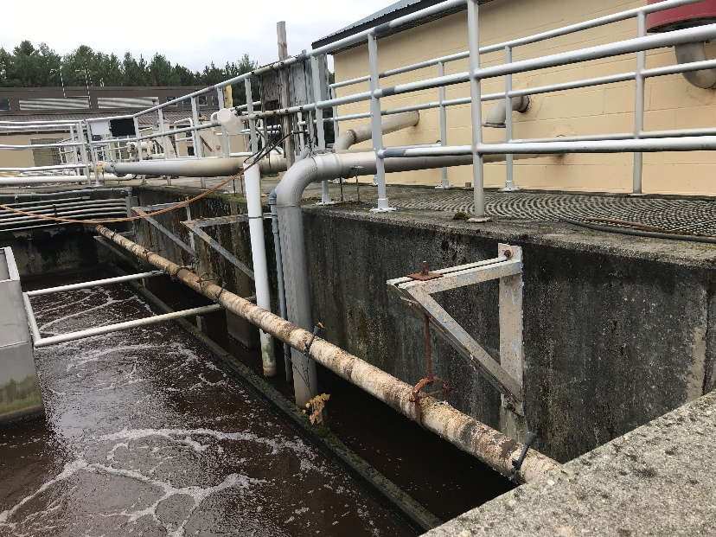
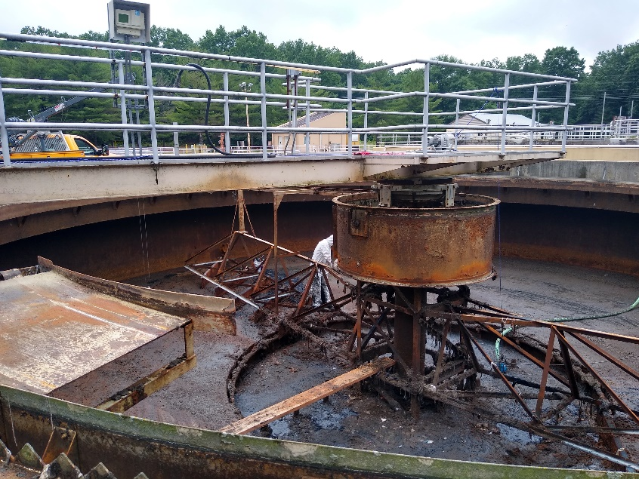
Wastewater Treatment Plant Upgrades
5-year CIP spread out over ~8 years
Phase 3 (Solids Handling) nearly complete.
  Gravity Belt Thickener, Polymer System, Plant Water System, Aeration Blowers, WAS/PS/TWAS pumps, Basement HVAC, SCADA Upgrades
Phase 4: Significant Process Upgrades:
    RAS Pumps, Scum Box Mixer, Replace Diffusers, Replace Secondary Clarifier Mechanisms, Add Aeration to Aeration Tank (AT) Effluent Channels, AT Effluent Gate, Sandblast and Coat Primary Clarithickener Mechanisms, SCADA Upgrades

Slide 10
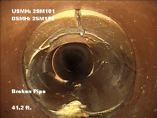
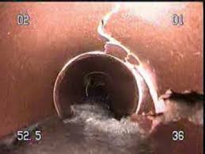
Inflow / Infiltration Repairs
2018 I/I investigation evaluated most of the pipes in the system
Problems included high inflow, roots, structural damage
I/I can add over 1 million gallons of flow to WWTP
The EPA NPDES permit for the Town has requirements to reduce I/I
Next critical areas to be addressed are sections of West Main St., Main St., and Central Ave.

Slide 11
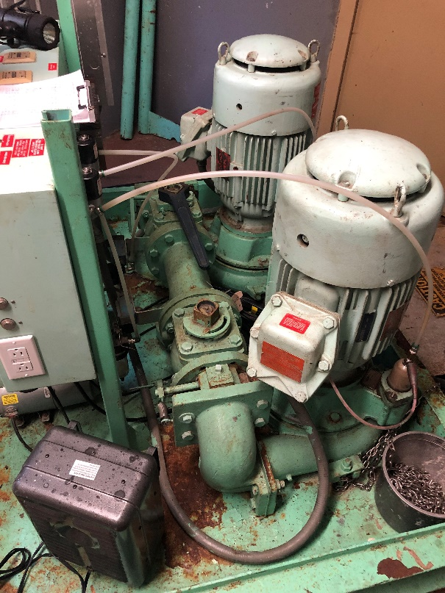
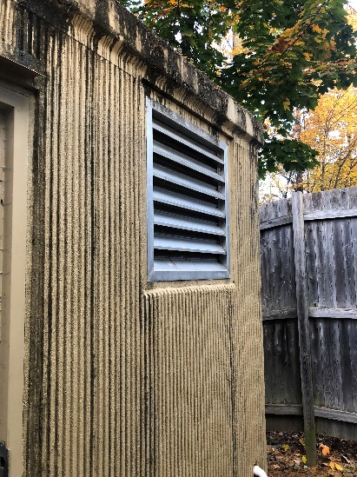
Sewer Pumping Station Upgrades
Ayer has 20 Wastewater Pump Stations of various sizes and designs.
Pictured is Bennetts Brook Pump Station that is in need of equipment upgrades.
Wright Way Pump Station is in urgent need of replacement. Some money has been allocated but recent engineering estimates have determined that additional funds are needed.
Upgrades are needed to keep wastewater moving and prevent health and safety issues.

Slide 12
Pump Station Generator Connections
A new Trailor Mounted Generator has been purchased, the cost being split between Water and Sewer.
The next step is to install Connections for the Generator to plug into. However, the cost is high and the DPW recommends a phased approach.
The two assets that are most critical are Wastewater’s Main and Central Pump Stations. The current generators have the highest risk of failure and redundancy is important.

Slide 13
Article 11 – Capital Budget Requests
Water
Spectacle Pond Well #3 Pumping Station and Transmission Main
Annual Water Main Rehabilitation
Grove Pond Spectacle Pond GAC Media Replacement
6-Wheel Dump Truck
Spectacle Pond Plant Chlorine Chemical Skid

Slide 14
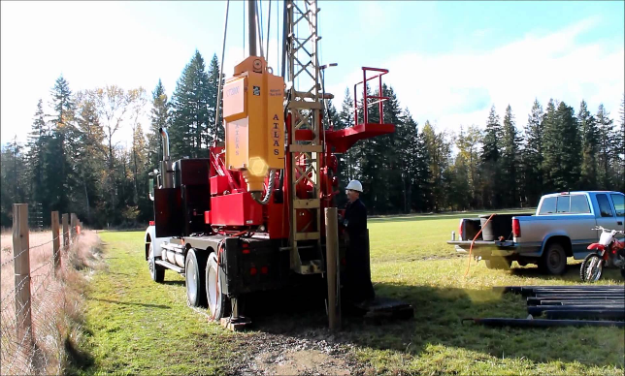
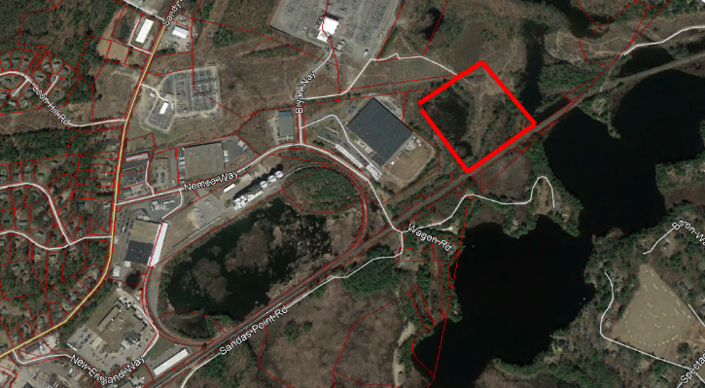

Spec Pond Well 3 Pumping Station and Transmission Main
Following the New Source Approval in land area owned by DPW
Next steps is design and construct a pumping station and Transmission main to Spectacle Pond Treatment Facility

Slide 15
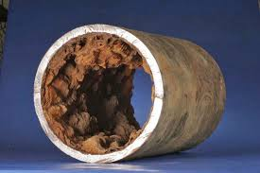
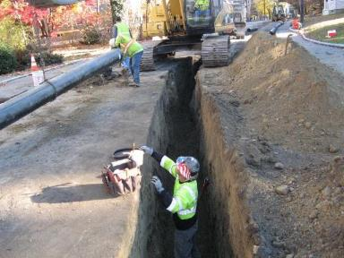
Annual Water Main Replacements
Annual Capital request to replace aging water mains with poor rating
Budget for $300K per year (approx. 2000 ft.)
FY25 projects include Cambridge St.
In-house engineering to maximize pipe replacement value
Continue to apply for grant funding and explore rehabilitation options

Slide 16
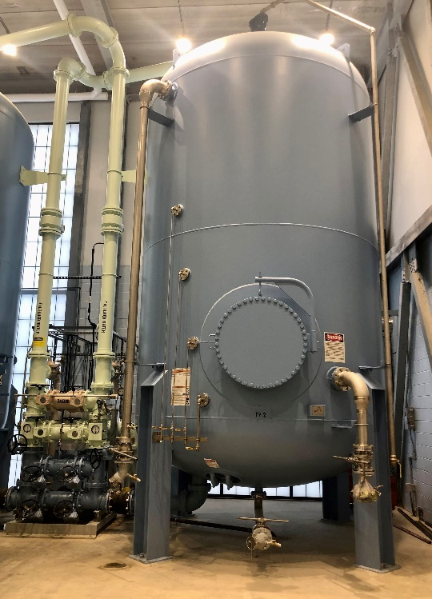
Spec Pond GAC Media Replacement
GAC treatment for PFAS compounds has been working since activation in 2022.
Two Vessels operate in series; first vessel handles the majority of the contamination and the second vessel “polishes.”
Media is becoming spent; evidence is PFAS detections between vessels. Finished water after Vessel 2 is still Non-Detect.

Slide 17
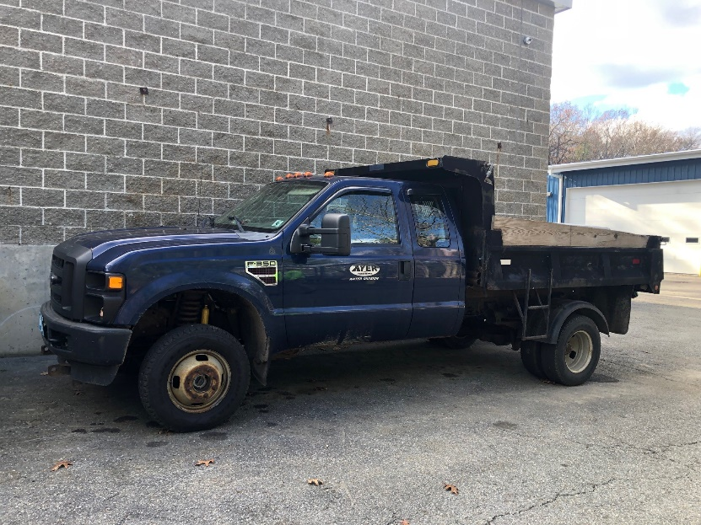
6-Wheel Dump Truck
Replaces a 2008 Ford F350 6-Wheel Dump Truck with 72,000 miles.
Recent repairs:
Complete exhaust, dump motor, lots of welding, front end parts, power steering pump lines, body control module (whole electrical system was rotted).
Used for Water Construction and Snow Operations.

Slide 18
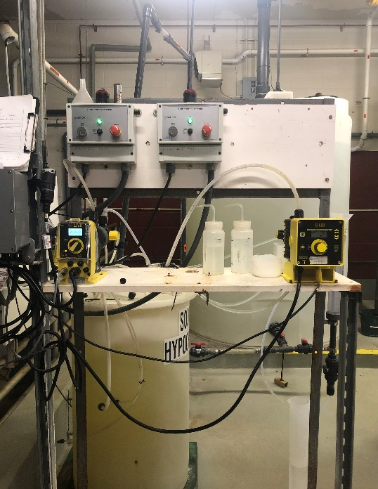
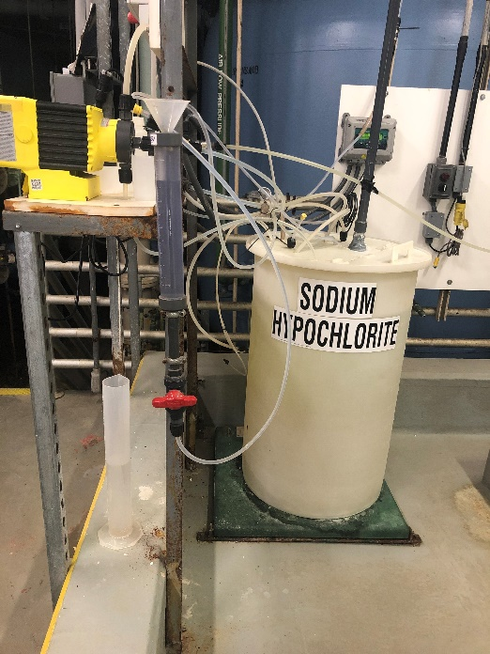
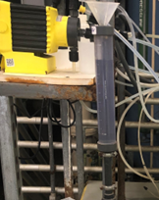
Spec Pond Chemical Skid
Replaces components of the chlorine chemical feed system that pumps chlorine into the treatment system.
Last done in 2011
Preventative maintenance

