Slide 1
Ambulance 2 Replacement
Purchased in 2016
10 Year Life Cycle
New ambulance delivery is about 24 months
Includes new cot, cot loader, and radios
$550,000 project cost

Slide 2
Cardiac Monitor Life Pak 15
Purchased in 2014
10 Year Life Cycle
Required ALS equipment on each ambulance
$55,600 project cost

Slide 3
IV Pumps Sapphire Pumps
New equipment for the ambulances
10 Year Life Cycle
Preferred method of medication delivery
Required by OEMS protocol for some medications
Provide 2 pumps per ambulance
$12,700 project cost

Slide 4
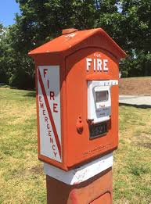
TRX50 Fire Alarm Receiver SIGCOM
Existing system in service since 2006
System is no longer being manufactured
Difficulty in repairs and Maintenance
New receiver is compliant with NFPA 72
$94,550 project cost

