Slide 1
Fire Department Budget FY2024

Slide 2
Ayer Ladder 1

Slide 3
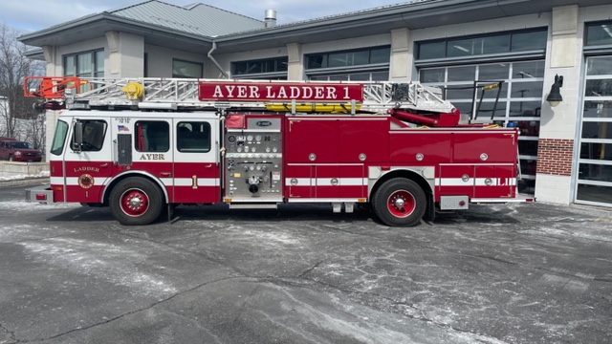
Ayer Ladder 1
1996 E-One Quint
75’ aerial ladder
1250 GPM pump
Pre-piped waterway
Exterior ground ladders
Single Axle
Refurbished FY17 $249,000 (5–10-year life)

Slide 4
Ayer Ladder 1
L-1 is27 years old
NFPA recommends replacement apparatus over 25 years old
24 – 30 month build time
Inspection, certification, & repairs totaled more than $30,000 in FY22 /23
Parts and repairs are becoming more difficult
Photo by Scott LaPrade
Connecticut Fire Photographers Association

Slide 5
Ayer Ladder 1

Slide 6
Ayer Ladder 1

Slide 7
Ayer Ladder 1

Slide 8
Tax Rate Impact
The truck is not expect for 24 Months, borrowing will not occur until the truck arrives.

