Slide 1
Article 12 – Capital Budget Request Stormwater
Stormwater Biofiltration/Outfall Improvements

Slide 2
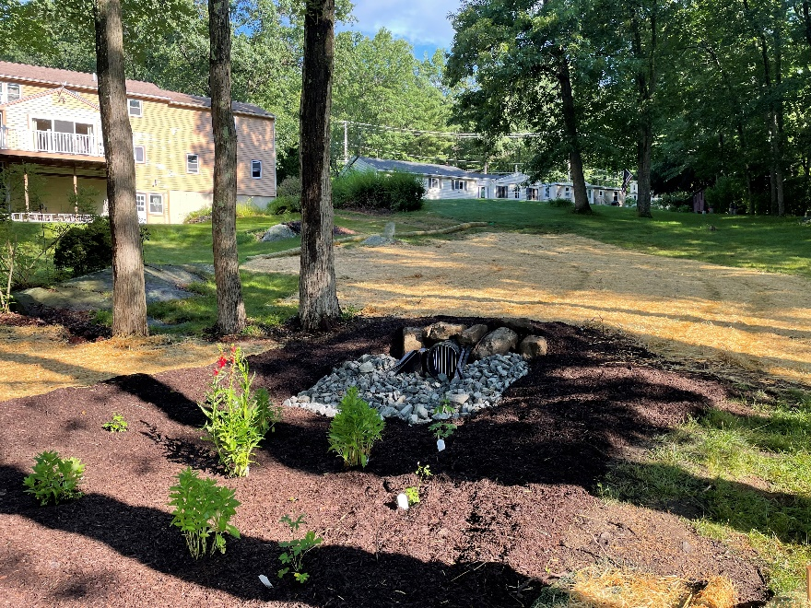
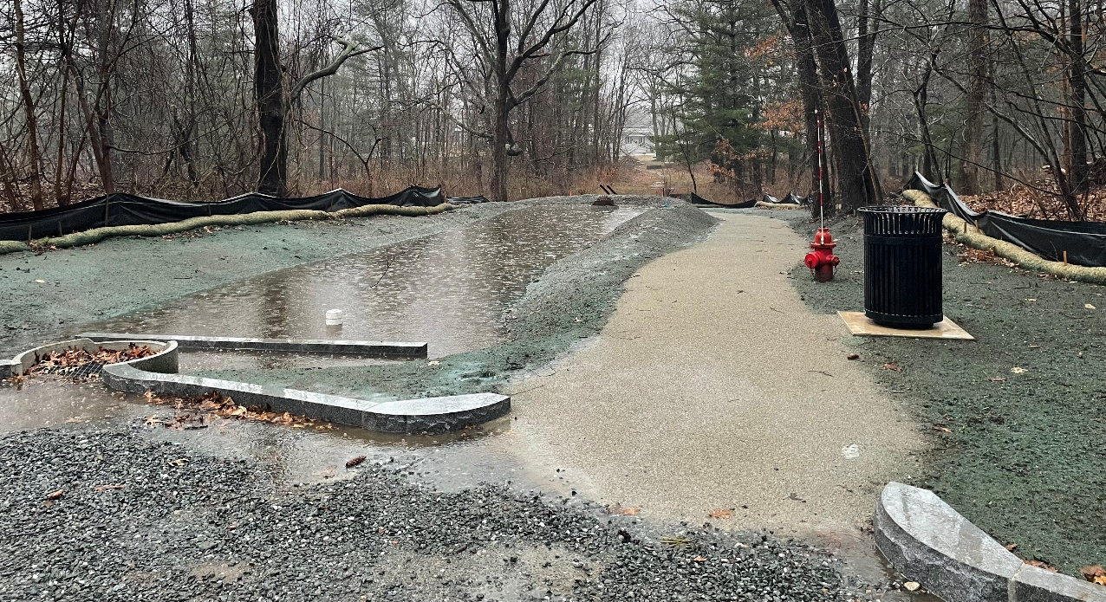
Stormwater Biofiltration/Outfall Improvements
Installation of stormwater treatment BMPs to improve water quality of Ayer’s waterbodies
Meets requirements of MS4 Permit and recommendations of Biological Survey, Assessment and Management Recommendations for Ayer’s Ponds (Geosyntec 2016)

