Slide 1
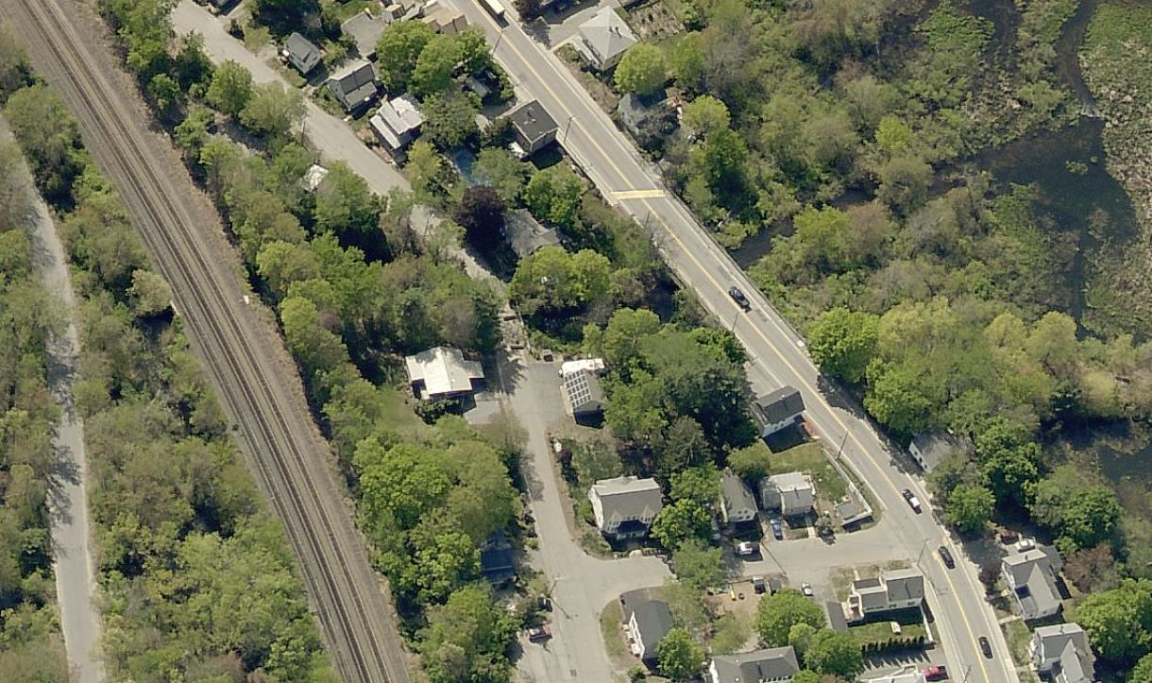
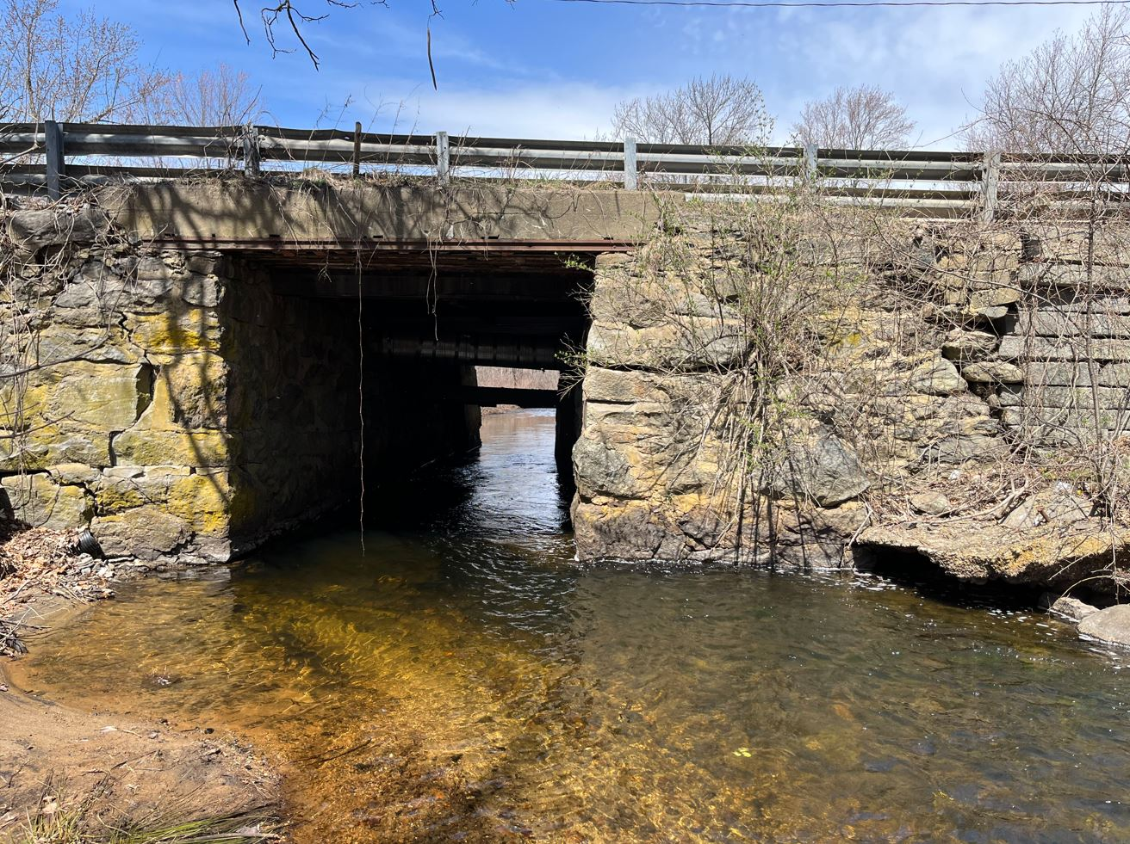
Article 12 – Authorization for Debt Exclusion – West Main Street Bridge Replacement
West Main St BRI

Slide 2
West Main St Bridge
Project Scope: Replace existing stone bridge on West Main Street over Nonacoicus Brook
Original bridge construction estimated late 1800s
Replacement required; rehabilitation not viable
Severe loss, cracking, deterioration of concrete
Separation of walls
Settlement
Approximately 8,000 vehicles per day

Slide 3
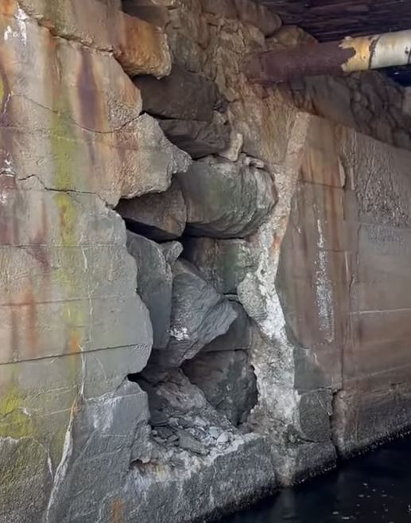
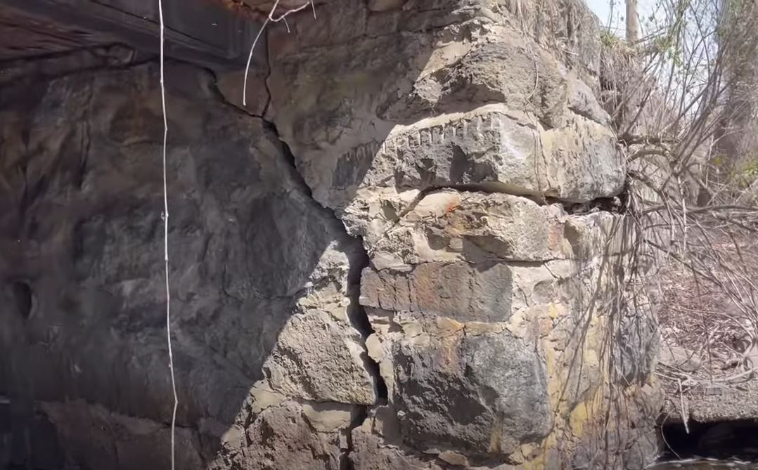
West Main St Bridge

Slide 4
West Main St Bridge
History in brief:
Shirley Street Bridge closed due to spot collapses; West Main Street inspected because it’s similar construction
Project funded by Town Meeting for $1.23M and Town obtained $500,000 Small Bridge Grant from MassDOT
Complete design/permitting/MassDOT Ch85 review, bid project and results greater than $1M over budget
Since bidding: Working with MassDOT, bridge consultants, state representatives, other advisors to seek gap funding and evaluate alternatives

Slide 5
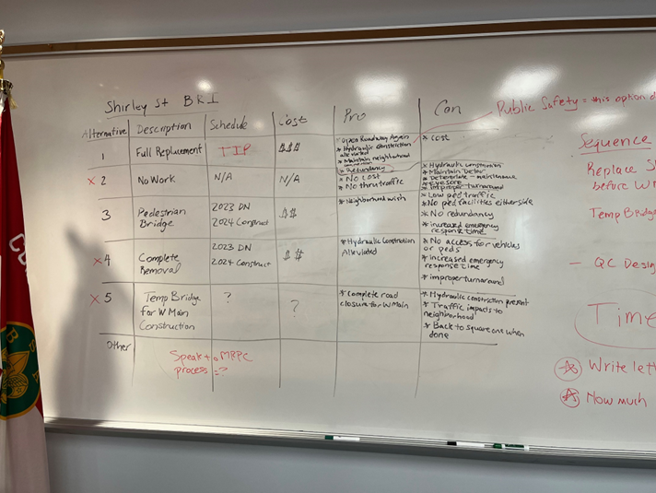
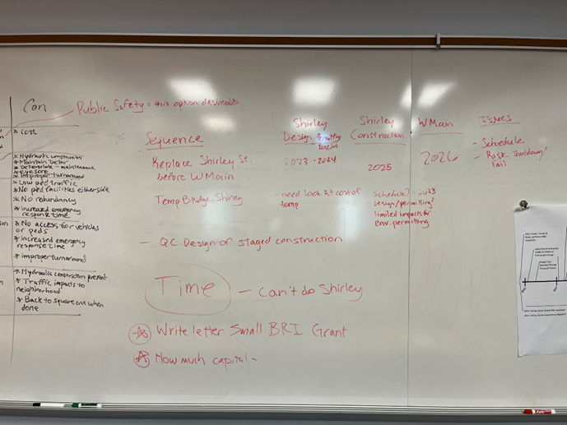
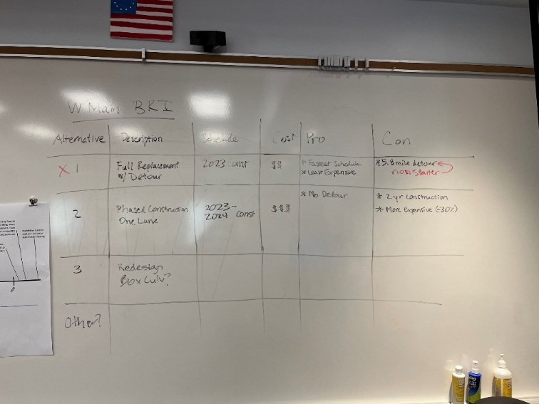
West Main St Bridge
In 2022, DPW convenes meeting with various stakeholders and advisors to discuss project
Consensus is to replace bridge expeditiously as already designed and permitted
Main factors include high potential for bridge closure and 5.8-mile detour route causes disconnection of regional access (including emergency response and school buses)
Notes:
At meeting includes
Fire, Police, DPW, Town Manager’s Office, 2 Senior Bridge Engineering Consultants, MassDOT D3 Asst Bridge Engineer
Alternatives evaluated include:
PRINT MATRIX
Not able to utilize Shirley Street as a detour
Would take time, even a temp bridge requires design, permitting and procurement. Prolonging risk of West Main Street BRI closure.
Local roads used as detour for 8,000 vehicles per day not recommended

Slide 6
West Main St Bridge
Funding in brief:
Cost Estimate (includes construction, soft costs, and contingency): $4,500,000
Current Available Funding:
Remaining from local appropriation: $1,000,000
Reinstated Small Bridge Grant: $500,000
Funding Required:
$3,000,000
Please note, the Town continues to seek alternative funding sources. Alternative funding sources would be used to reduce the local funding utilized for the project.
Notes:
Current Funding and Prospective Funding:
BIL has not had eligibility (BRI) - Bridge Formula Program or Bridge Investment Program not likely to change anytime soon, if ever
Federal Culvert AOP Grant – Not eligible, main reason is requirement for anadromous fish passage requirement (e.g. salmon)
Federal Bridge Investment Program – Not eligible, needs to be NBI
RAISE Grant – Reviewing potential for application, some issues are urbanized area and project minimum $ not met, also need to determine if West Main BRI would be highly competitive
Bridge Formula Program (through State) needs to be NBI – requirement not likely to change
PROTECT funding – may be eligible but low confidence (vulnerability requirement and competitive), no NOFO yet
TIP funding is potential – major challenges are it is not a typical project, would likely be in a queue of project, and will require further efforts to meet Federal requirements of a TIP project (Right-of-Way, further design effort)
MassWorks potential – schedule and likelihood a concern (would not know until October if obtain grant)

Slide 7
West Main St Bridge
Impact on average residential tax:
The funding request at $3.0M would add $63 to the average FY2024 residential tax bill in Ayer
Schedule if approved by Town Meeting and ballot:
Already reestablishing any expired permits
After permits reestablished, begin bidding process
Aim to begin construction before end of 2023, majority of work 2024 (big variable = supplies / fabrication of bridge)

