Slide 1
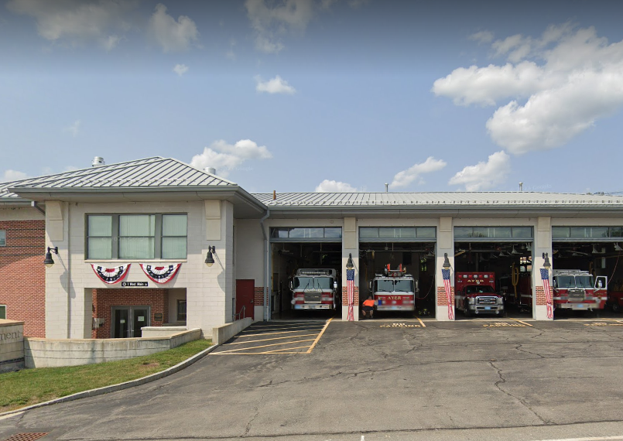
FY25 Facilities Department Capital Request
Fire Station & Police Station parking lot repairs
The Facilities Department is requesting the sum of $43,000 to add asphalt paving in two locations at the Fire Station, including the rear parking lot trailer storage and the failing section of asphalt in front of the garage bays.
Crack filled, seal coat, and strip the entire Police Station and Fire Station parking lots.
Repair the expansion joint fillers between the Police Station granite curbing and sidewalks.
Complete all necessary repairs needed to the parking lots to helps prevent the asphalt from being damaged by oxidization and the elements. If we leave the cracks unfilled, cracks will allow rain and moisture to flow through pavement and erode base materials ultimately resulting in potholes and pavement failure.

Slide 2
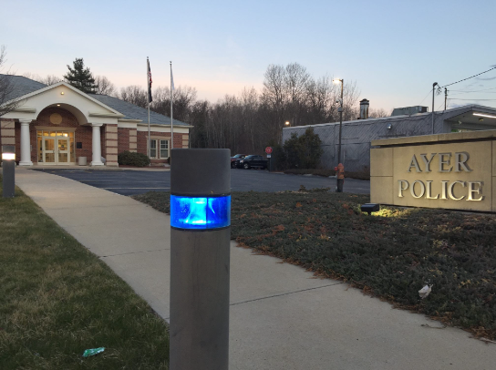
Budget
(1) Police Station Seal Coating, Crack Repair, Stripping : $9,500.00
(2) Fire Station Seal Coating, Crack Repair, Stripping: $10,500.00
(3) Fire Station Back Lot Regrade & 3in Asphalt: $9,500.00
(4) Fire Station Bay Repairs: $7,500.00
(5) Sidewalk Repairs: $4,500.00
(6) Unforeseen / Change Orders: $1,500.00
Total Cost: $43,000.00

