Slide 1
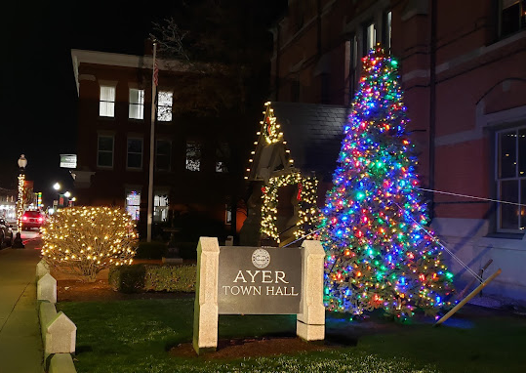
FY25 Facilities Department Capital Request
Town Hall Building Envelope Repairs & Panic System
Repair failing paint sealant around the window frames on the Main Street and Columbia Street sides of the building.
Replacing the failing left post supporting the Columbia Street portico.
Resetting the Columbia Street brick walk-way.
Installing a wireless panic button system at multiple locations at the Town Hall that will tie into our Fire Alarm.
Repair multiple concerns on the building envelope.
No historical changes will be made within this request only the restoration of what is already in place.

Slide 2
Proposed funding Schedule
Replacement of Columbia Street portico post $10,000.00
Window sealant / Painting / lift $25,000.00
Resetting Columbia Street brick work $3,200.00
Wireless panic button system $6,800.00
Total: $45,000.00

Slide 3
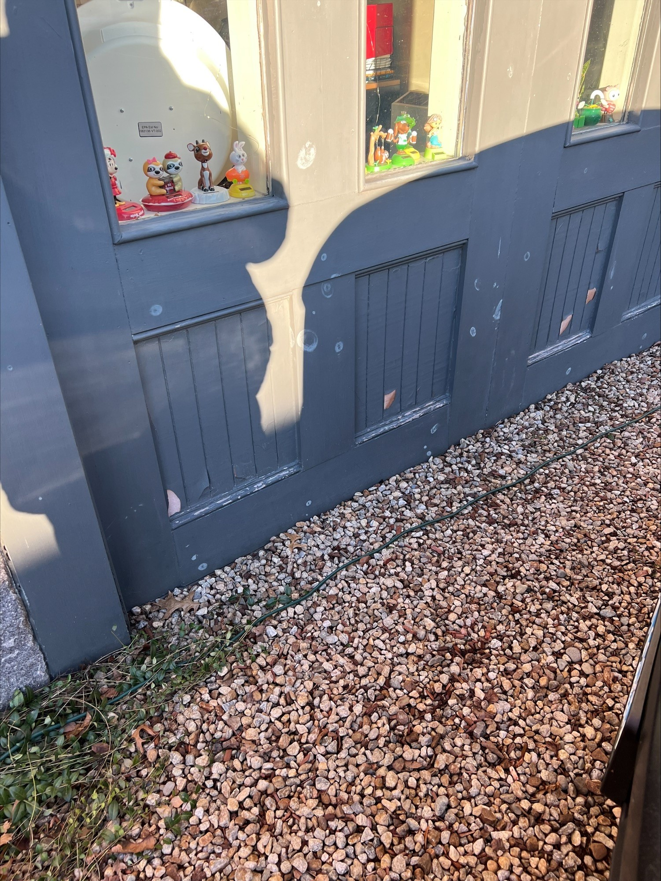
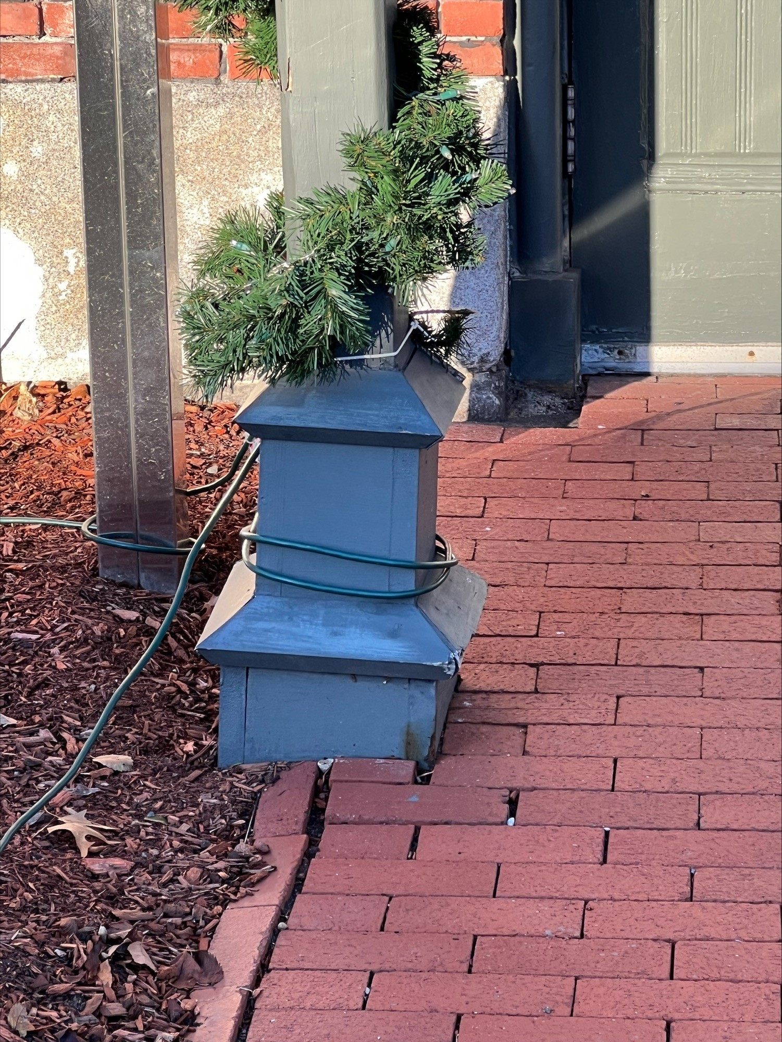
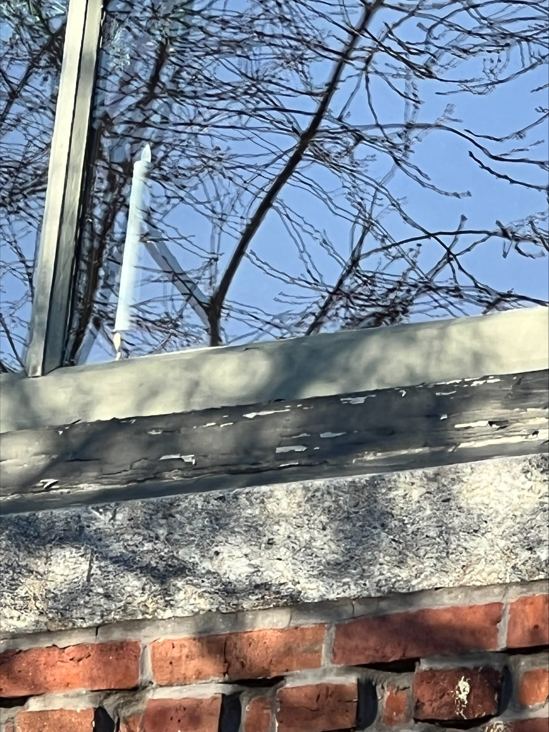
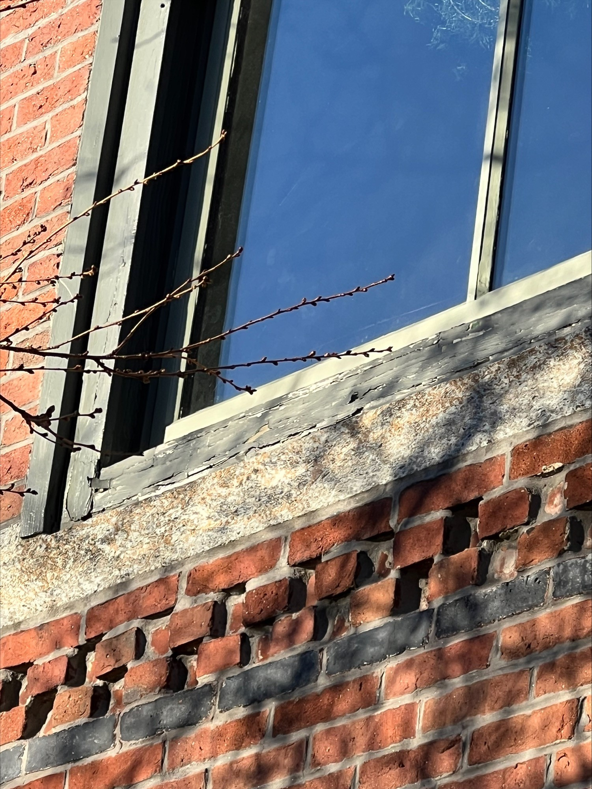
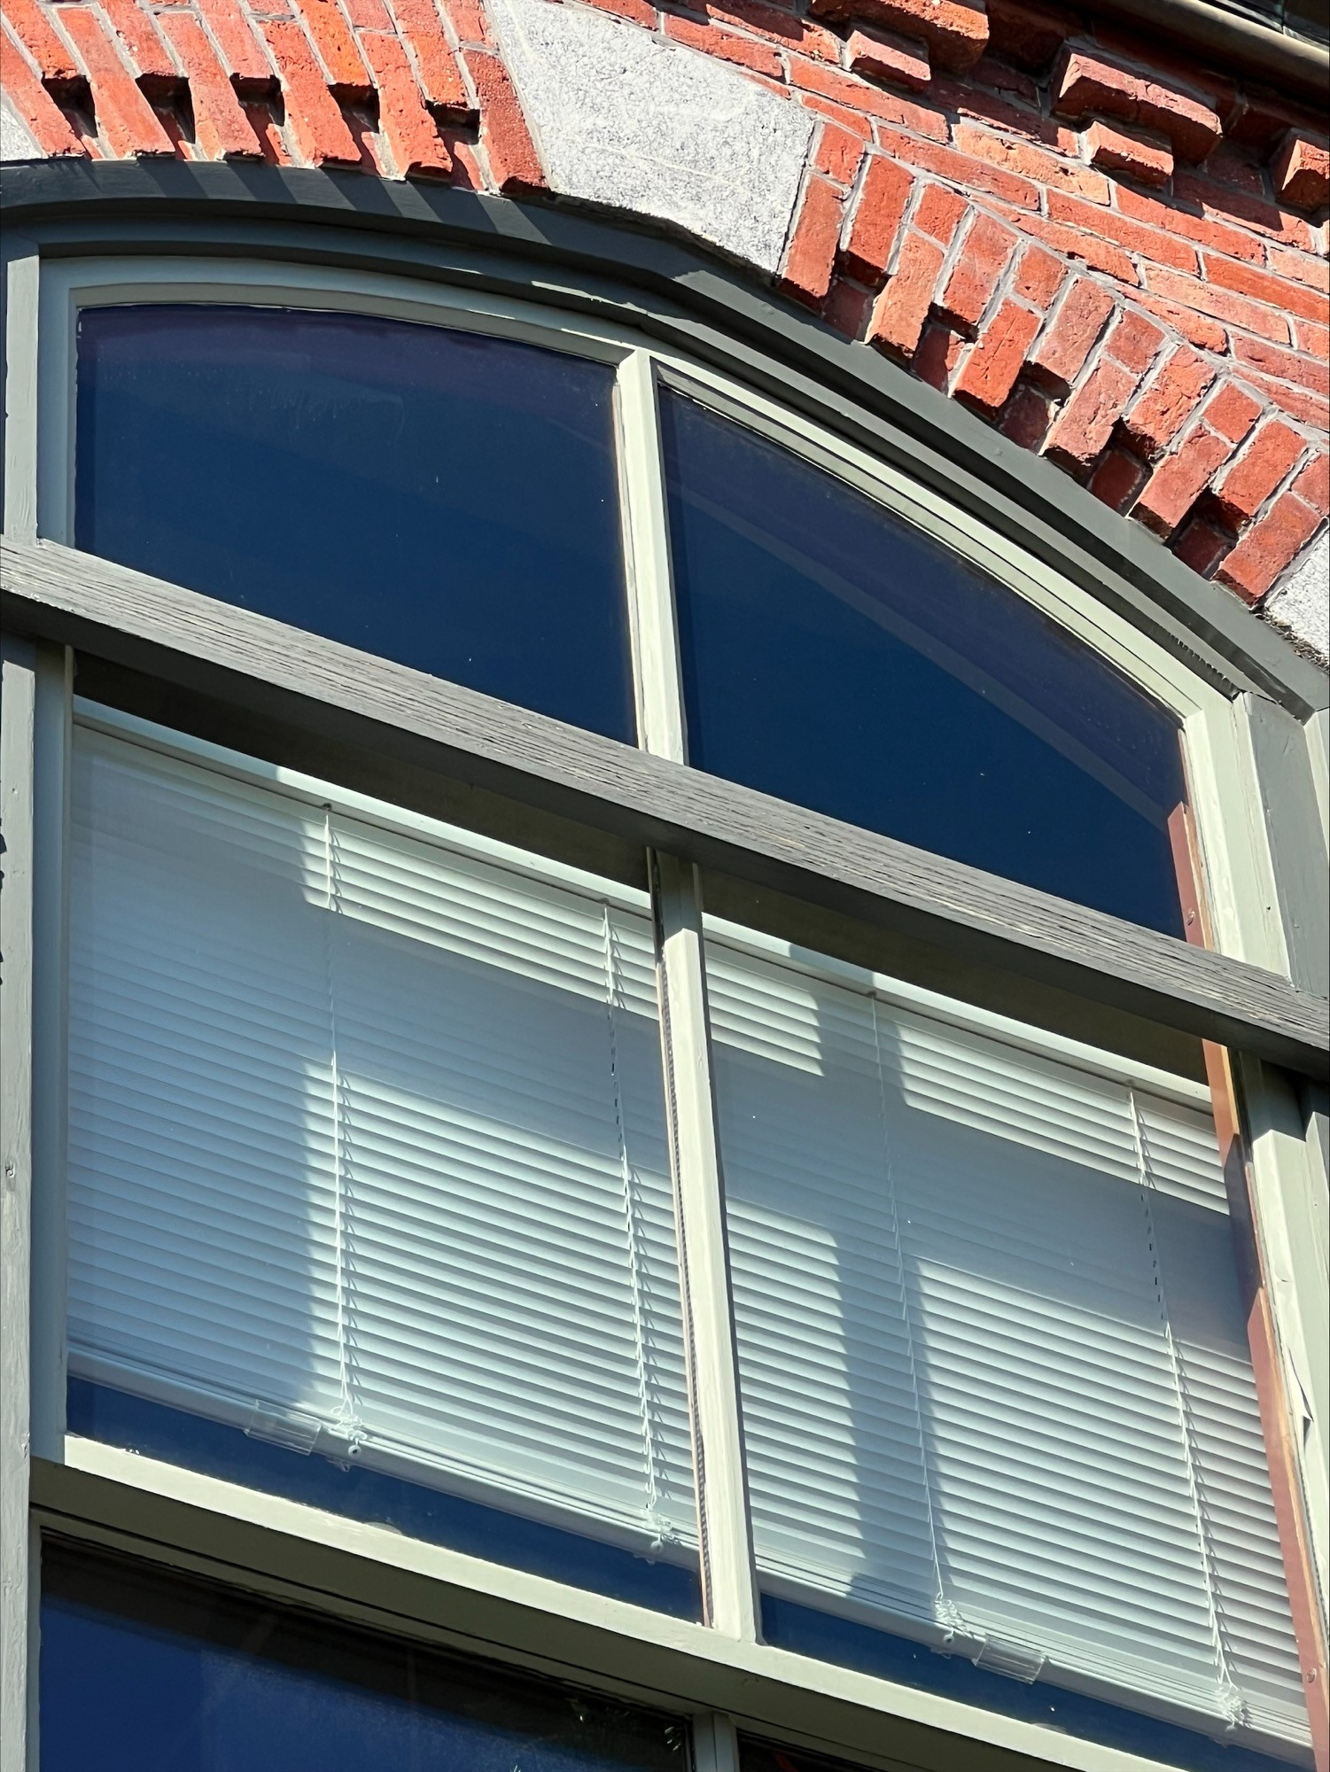
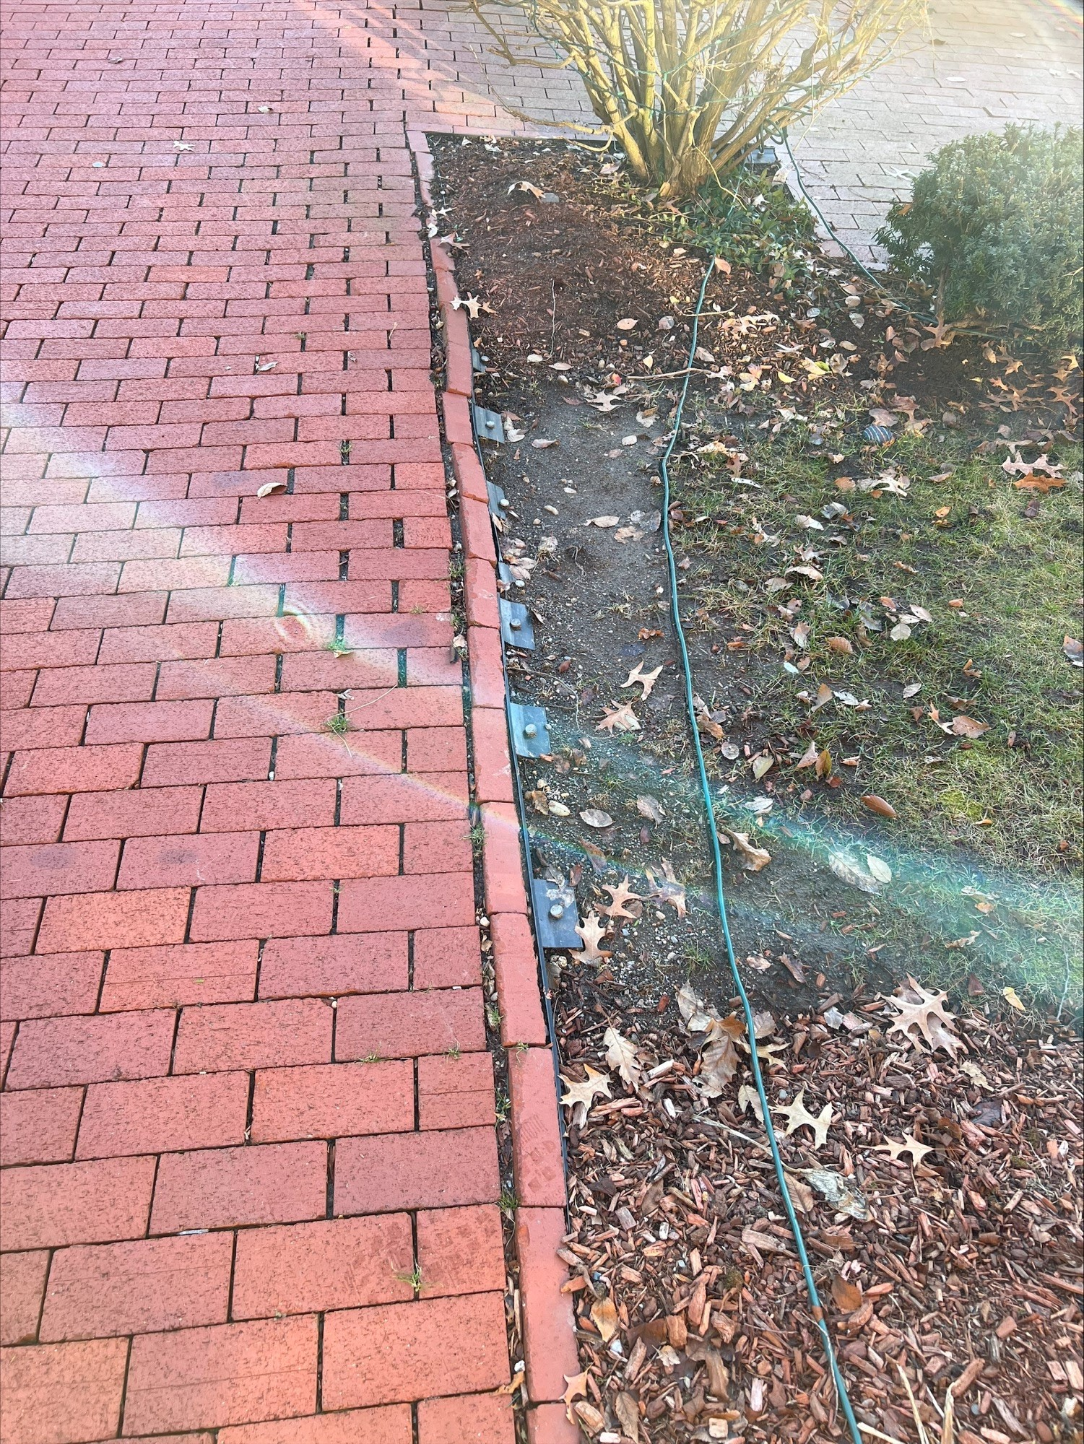
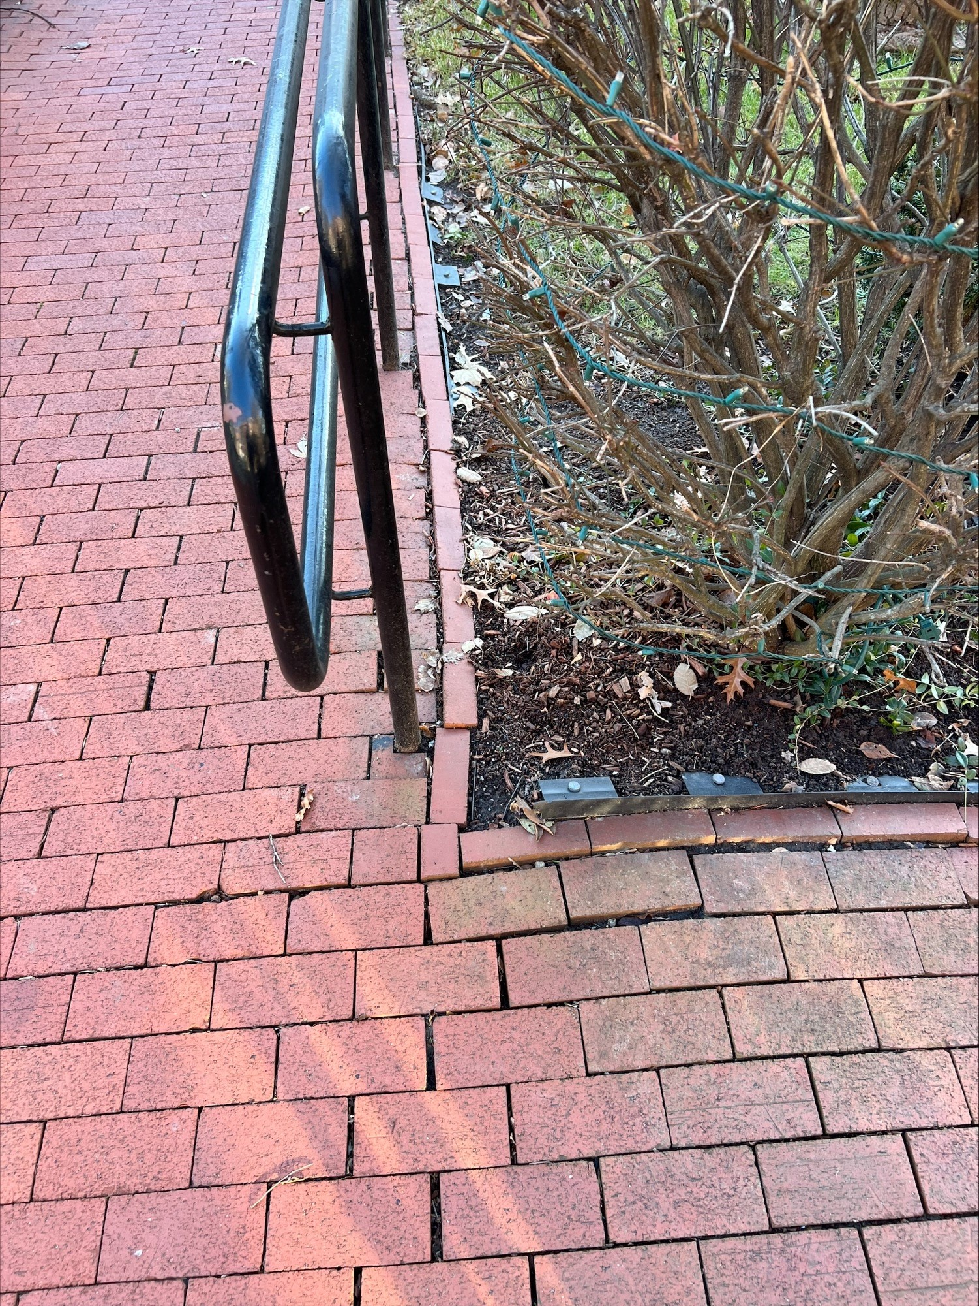
Goals:
Restoring the paint sealant before moisture causes irreversible damage to the woodwork.
Replacing the failing post before it causes structural damage to the portico.
Repairing the brick walkway before it needs a complete rebuild.
Resolving the concerns while they are minor repairs. If we allow the paint to deteriorate, bricks to separate, and post to weaken. Major restorations may be needed.
Areas of Concerns

