Slide 1
TOWN OF AYER
Conversion to Assesspro AP5/Patriot Properties
April 24, 2023

Slide 2
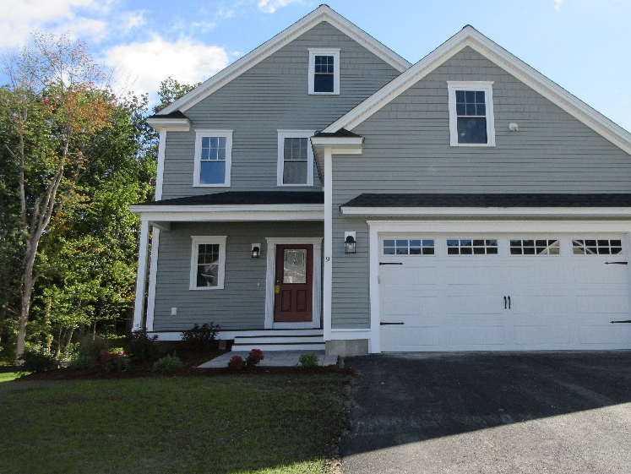
FY2023 Properties in Ayer
Residential Properties: 2,926 parcels
Commercial & Industrial Properties: 318 parcels
Total Real Properties: 3,244 Parcels

Slide 3
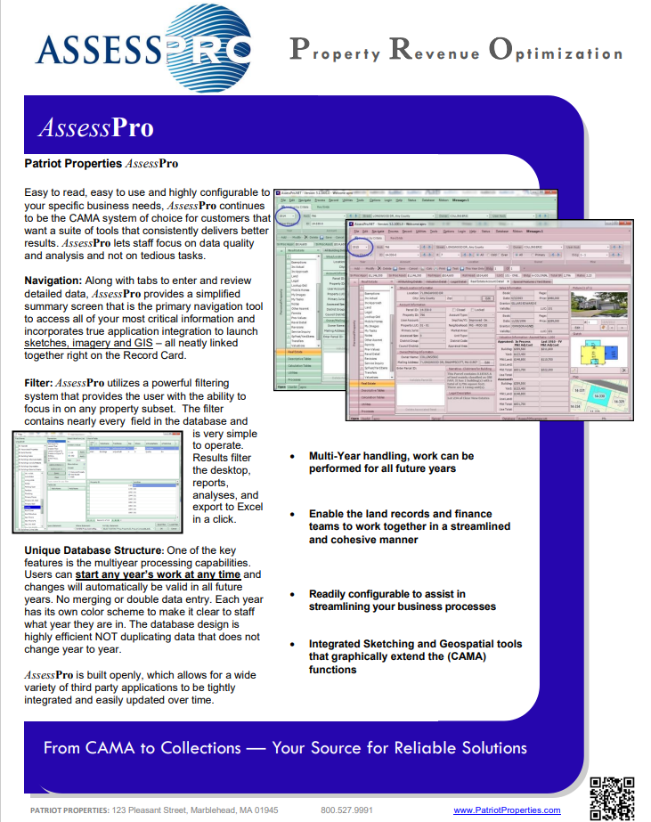
Benefits of Conversion to Assesspro AP5-Patriot Properties
Widely used by other communities in Massachusetts.
Provides all years of real estate valuation in one database.
Allows entry of information easily and assigns multiple parcel activities in one task.
Will eliminate redundancy of entry of information in multiple fields.
Assesspro property card is more easily understandable for public use.

Slide 5
CURRENT PROPERTY RECORD CARD-PAGE 1

Slide 6
CURRENT PROPERTY RECORD CARD - PAGE 2

Slide 7
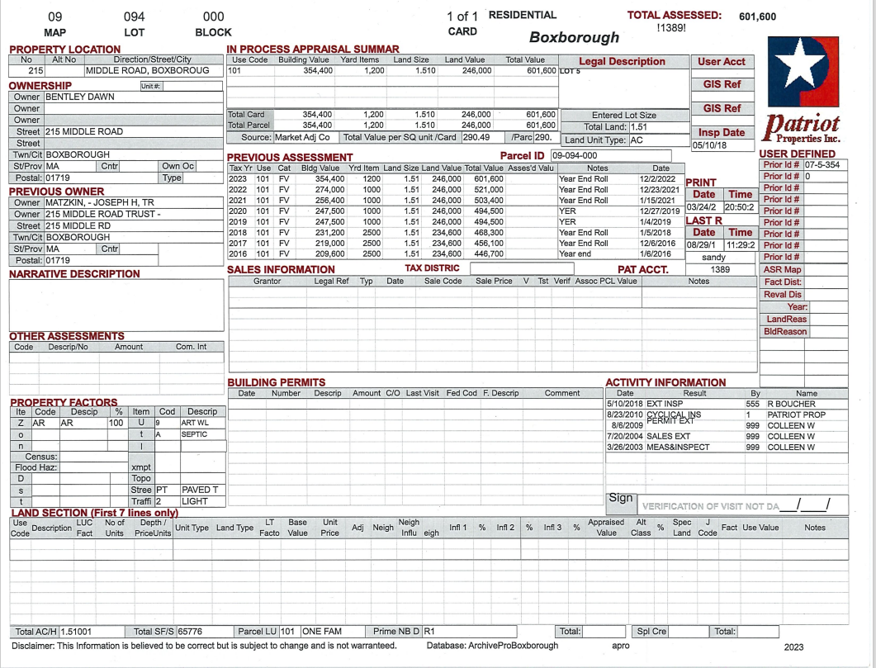
PATRIOT PROPERTY RECORD-PAGE 1

Slide 8
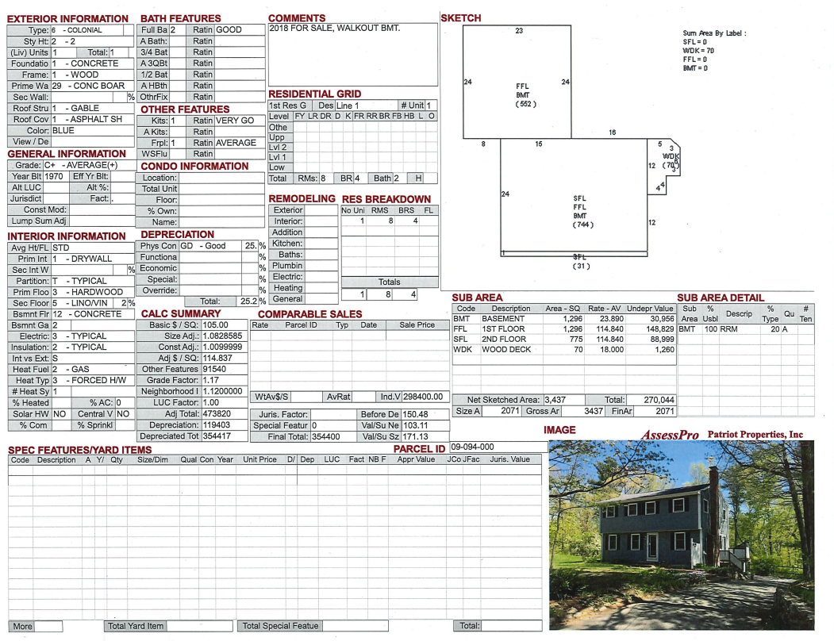
PATRIOT PROPERTY RECORD - PAGE 2

Slide 9
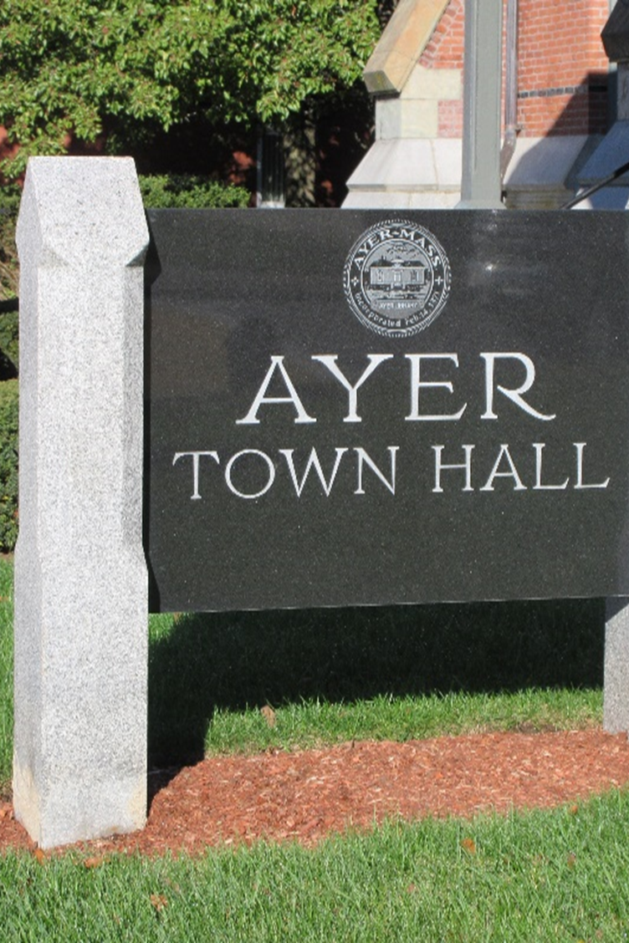
SUMMARY
Current database is cumbersome to both the assessors office for data entry and the public for interpretation of data
Will be a considerable effort to make the transition effort to upgrade the database by the assessing office, but the benefits outweigh the cons.
Assessors office will need to check the quality of the database after transfer and review 3,244 records.
Keep old database active until transfer and quality check for new database are complete.
End result is to provide a quality database with ease of use and eliminate extra steps in data entry.
Public will easily be able to access and understand property record card.

Slide 10
Any questions? Contact lmcquade@ayer.ma.us Thank You! Ayer Board of Assessors

