Slide 1
Article 13 – Capital Budget Requests Solid Waste
Paving Lower Access Driveway

Slide 2
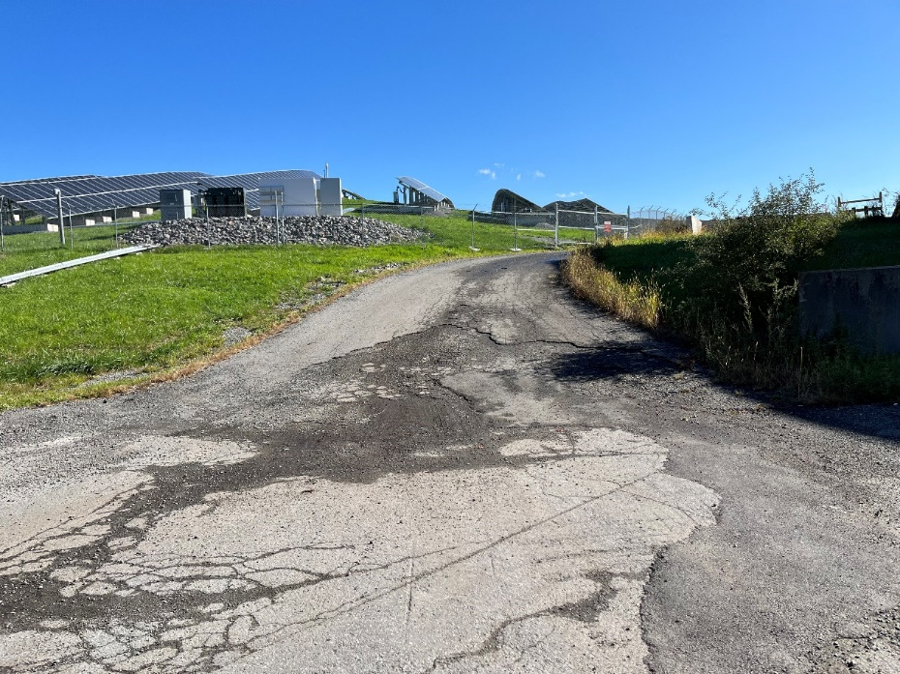
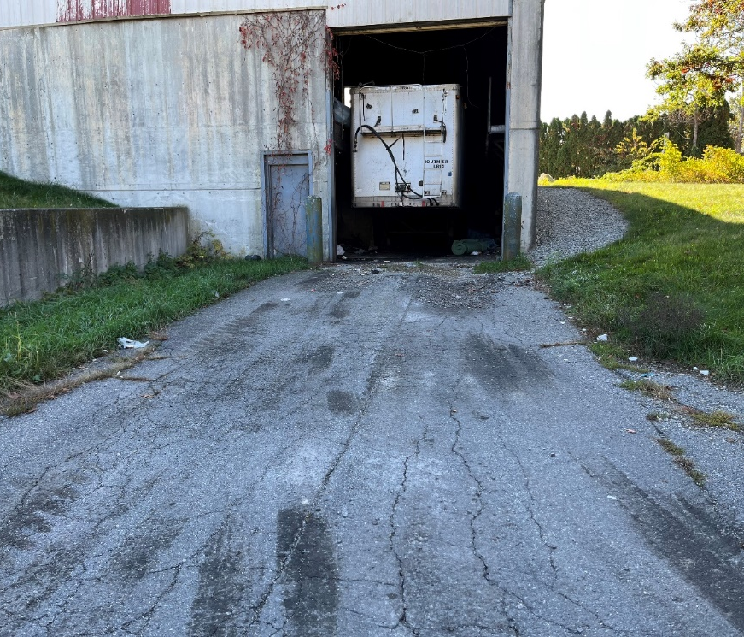
Solid Waste Capital – Paving Lower Access Driveway
Driveways/Accessways are in poor condition with alligator cracking, missing pavement, settlement, and stormwater ponding
Select portions of the access driveway would be paved
Price based on estimate developed by DPW from similar projects

Slide 3
Article 13 – Capital Budget Requests Stormwater
Upper Flannagan Pond Dam Repairs

Slide 4
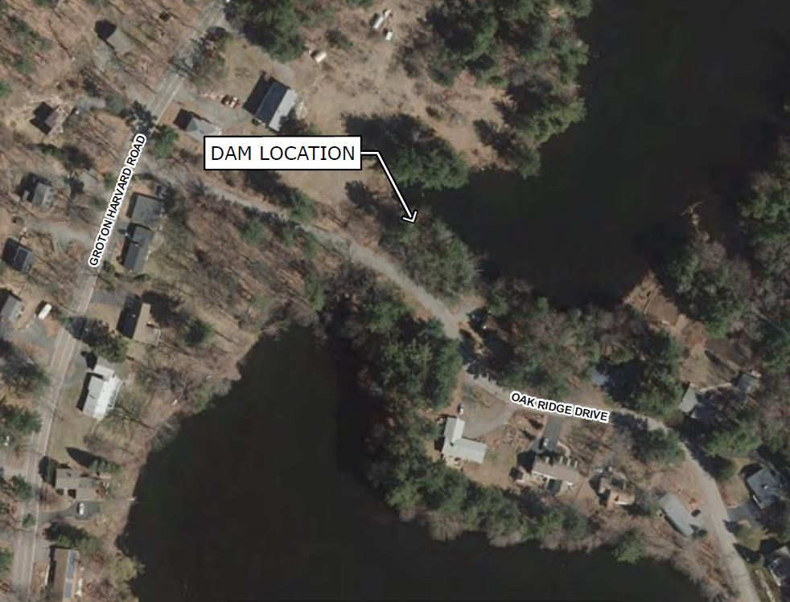
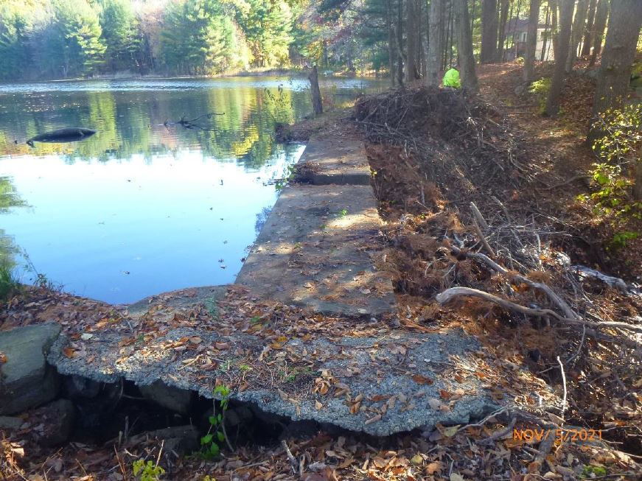
Stormwater Capital – Upper Flannagan Pond Dam Repairs
UFP Dam Phase I inspection identified repairs
Next step is Phase II Inspection and design of repairs – these are regulatory requirements of a Dam Safety Order

Slide 5
Article 13 and 22 – Capital Budget Requests Administration
DPW Security Gate Upgrade (Note: Articles 13 and 22 related to this project)

Slide 6
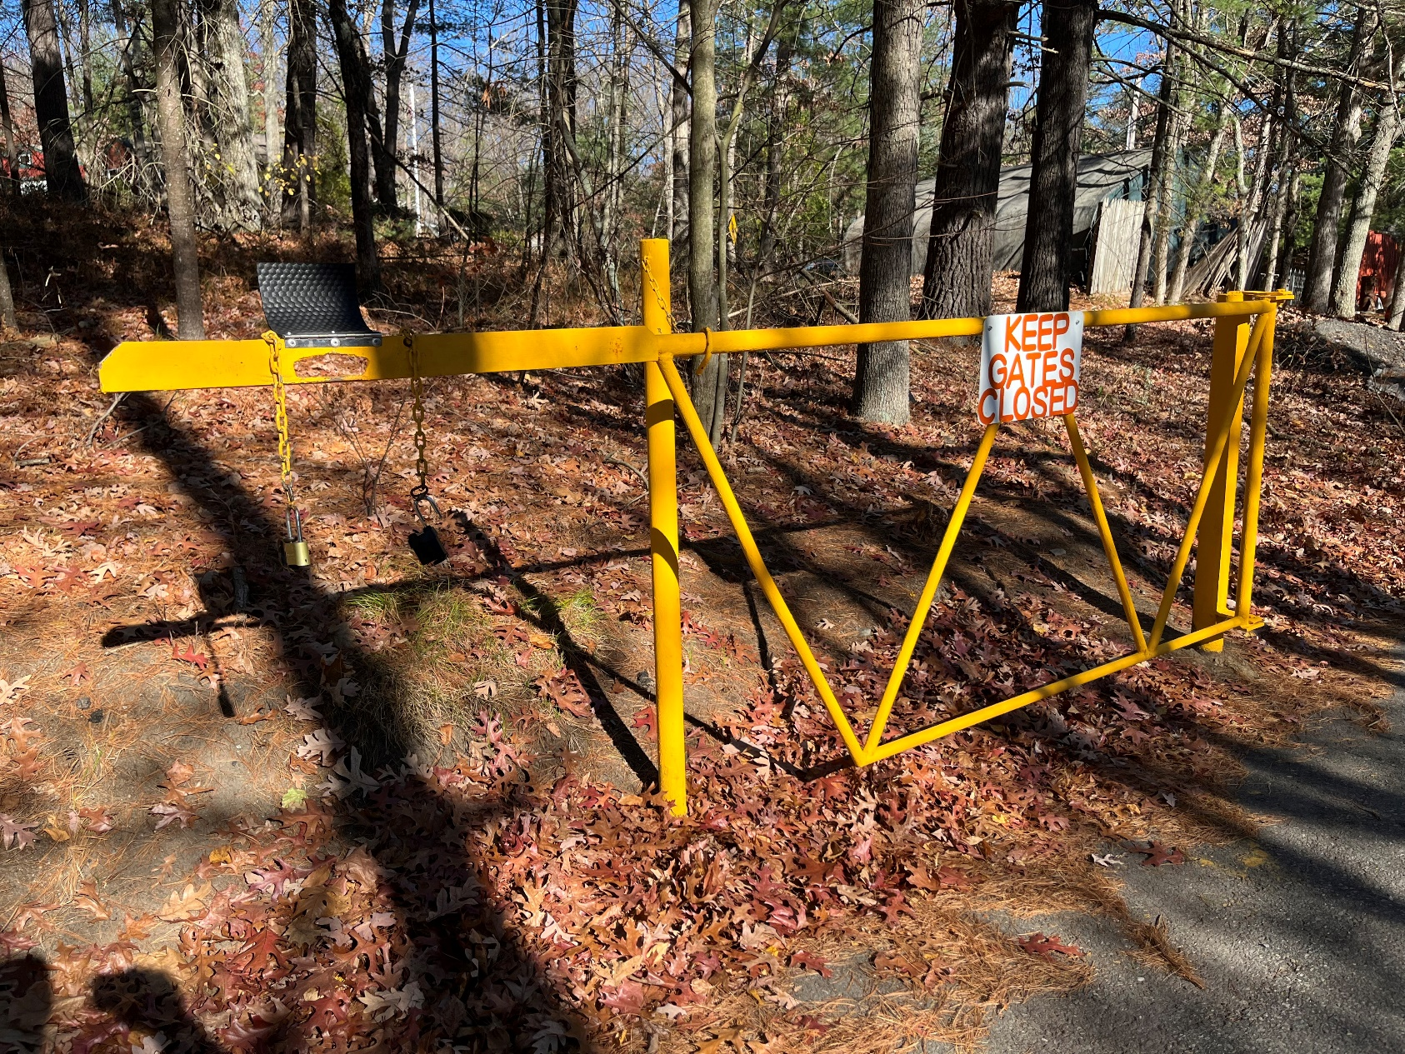
DPW Security Gate Upgrade - $20,000

Slide 7
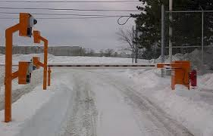
DPW Security Gate Upgrade
Current gate requires manual operation, safety issues
Used by all Departments who access fuel station (DPW, Police, Fire, Building, Facilities, Ayer Housing Authority, Parks)
Industry standard to have automated secure entrance with entrant tracking off-business hours
DPW provides excavation and backfill
Project includes but not limited to
Furnish and install gate, pedestals, in-ground exit and safety loops, electric connection for power, equipment for keycard access, connection to Town Hall keycard system, programming

