Slide 1
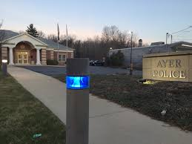
Ayer Police Station Fence and Trim Replacement
Ayer Facilities Department
FY24 Capital Request

Slide 2
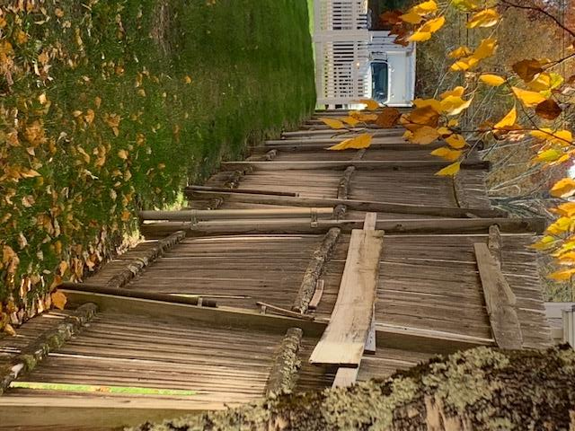
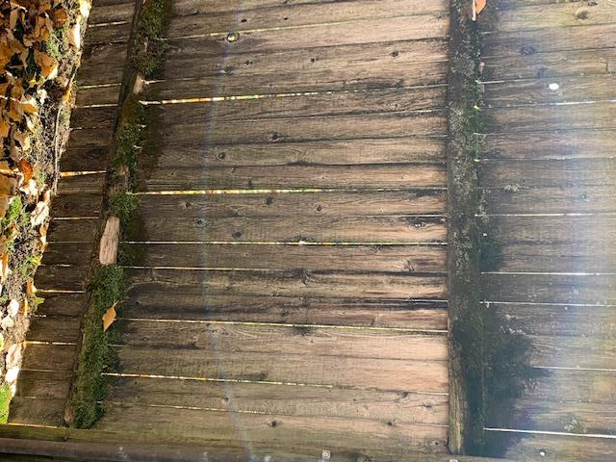

Slide 3
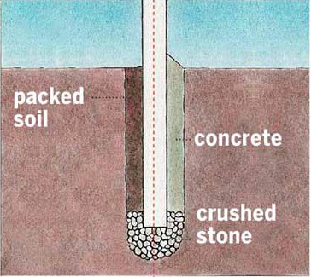
Purchase Description Fencing
Property Line
180 Feet
8 Ft Commercial grade white vinyl privacy panels
8 Ft white post reinforced with an interior 4x4 P.T post
All Posts need to be secured with at least 240 pounds of concrete
Dumpster Area
32 Feet
8 Ft Commercial grade cedar stockade privacy panels
8 Ft 4x4 cedar post
All Post needs to be secured with at least 240 pounds of concrete

Slide 4
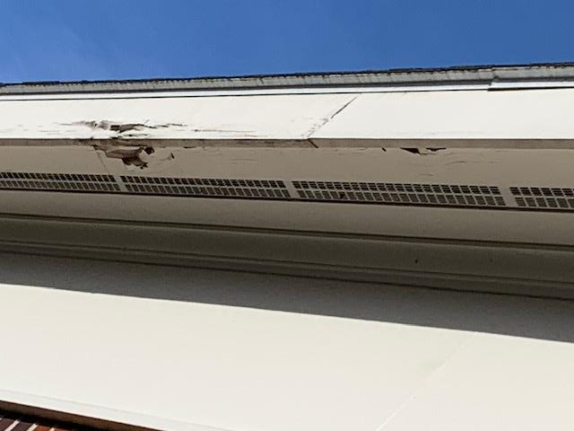
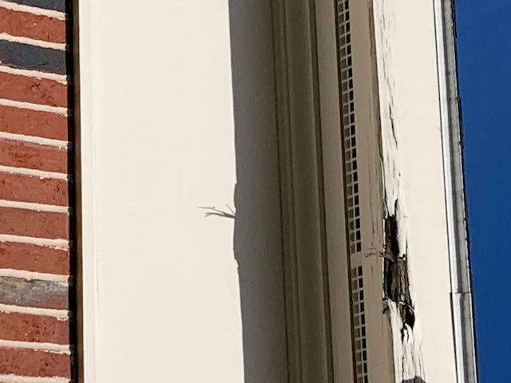
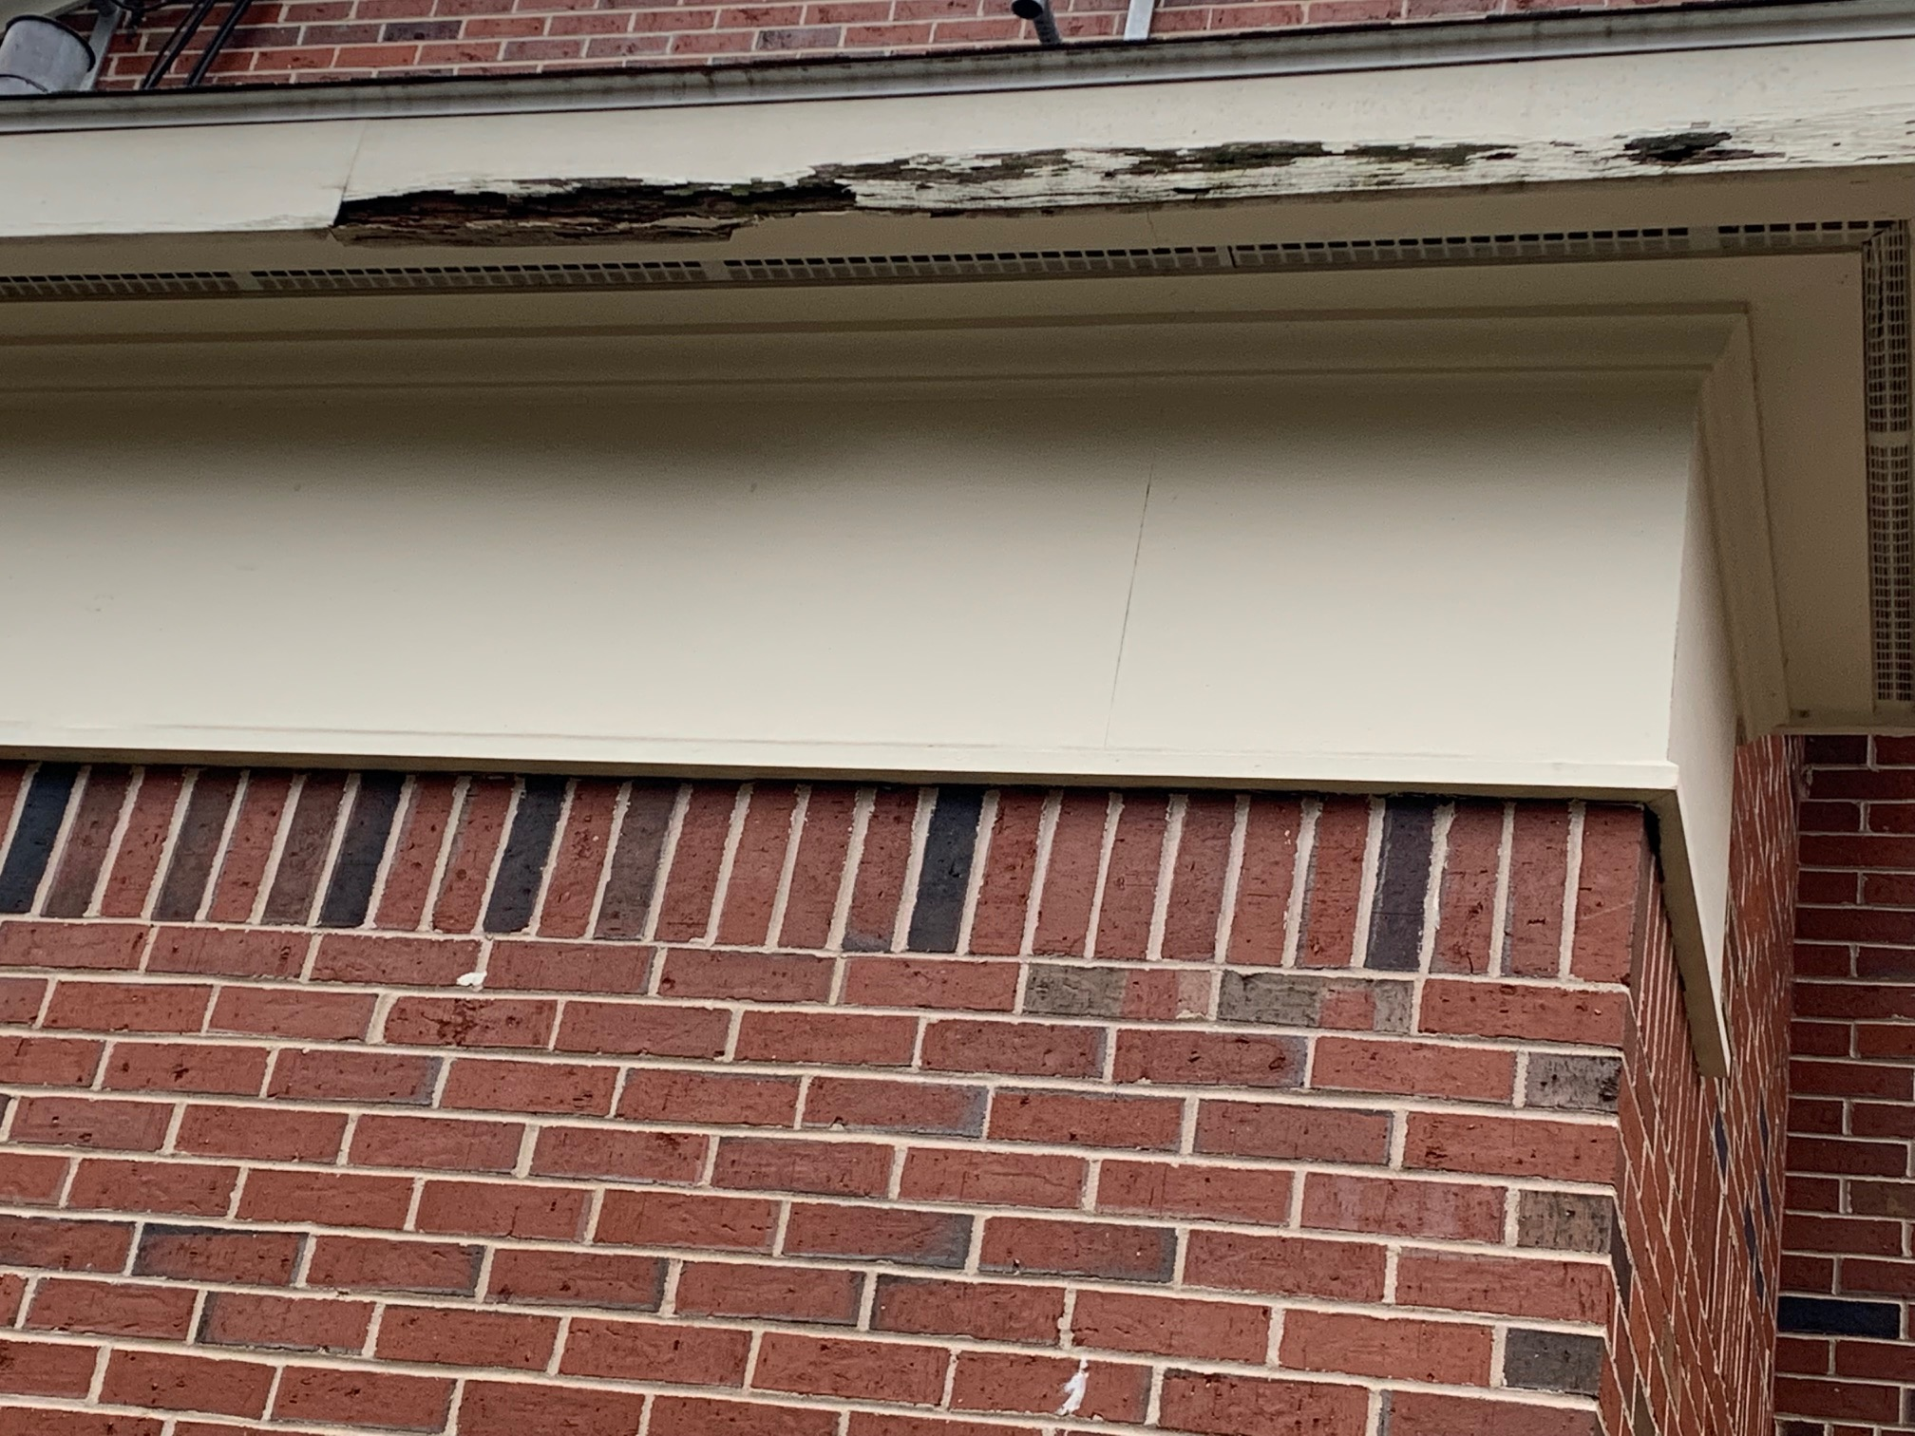

Slide 5
Funding Request / Cost Break Down
LINE | ITEM | sub- contractor | Quote # | QTY | LOCATION | UNIT COST | EXT COST | NOTES
1 | 180ft of 8ft white privacy fencing | mutiple quotes | 2 QUOTES / 1 VERBAL | 1 | Police Station | $24,000.00 | $24,000.00 | Jans / Reliable / Camblin Fence companies
2 | 35ft of 8ft wooden stockade fencing | mutiple quotes | 2 QUOTES / 1 VERBAL | 1 | Police Station | $5,000.00 | $5,000.00 | Jans / Reliable / Camblin Fence companies
3 | 135ft white 1/6 pvc trim | Classic Construction | VERBAL | 1 | Police Station | $10,000.00 | $10,000.00 | Verbal received pricing
5 | Removal and Disposal | Mutiple quotes | 2 QUOTES / 1 VERBAL | 1 | Police Station | $4,000.00 | $4,000.00 | Jans / Reliable / Camblin Fence companies
 |  |  |  |  |  | Product Total | $43,000.00
 |  |  |  |  |  | Sales Tax | $-00
 |  |  |  |  |  | Freight | $-00
 |  |  |  |  |  | Delivery and Installation | included
 |  |  |  | Project Total |  |  | $43,000.00
Procurement Status
1 | Fencing | Received 3 Quotes for the new fencing including all work |  |  |  |  |  | MGL 30B / 149A
2 | Trim Work | Received a verbal quote to replace the facia trim / construction cost to votatile to formal quote a year in advance |  |  |  |  |  | MGL 30B / 149A
Notes for Trim work:
$10,000.00 is only going to fund replacing extremely damaged areas
If the Town replaced all 180 Ft of fascia and soffit trim on the Northeast side of the building, it would cost over $40,000.00 (verbal quote)
Depending on the fence cost and the amount of trim damage. There might be a phase 2 request in FY25
Notes for Fence work:
The requested $33,000.00 is expected to cover a complete replace of the old fence with a new vinyl fence (2 Written and 1 Verbal quote procured to determine funding request)
If construction supply cost continues to balloons. The Facilities Department will use the trim funding to help cover the cost of the fence replacement. Then repair as much trim as possible with remaining funding
The normal 5-10% change order cost line was not added to this project to help keep the funding request at a minimum

