Slide 1
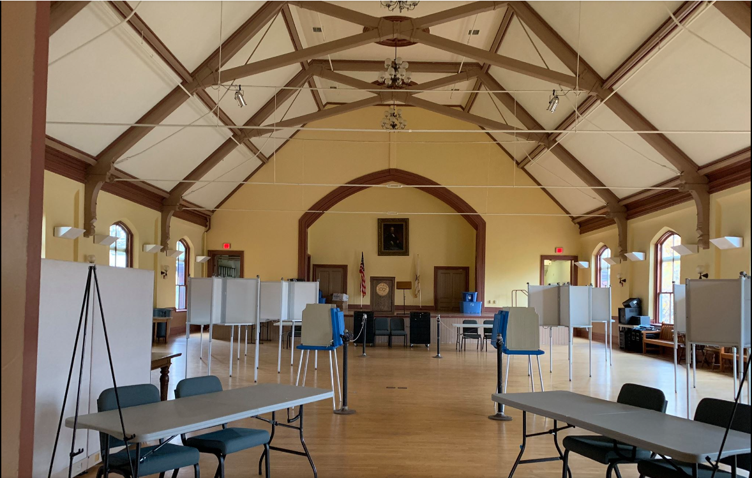
Ayer Town Hall
Office Renovations / Repairs / Acoustics
Ayer Facilities Department FY24 Capital Request

Slide 2
Funding Request / Cost Break Down

Slide 3
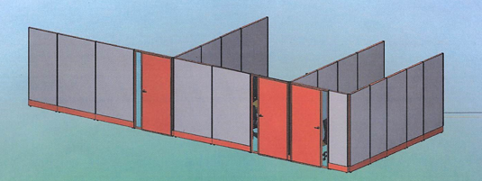
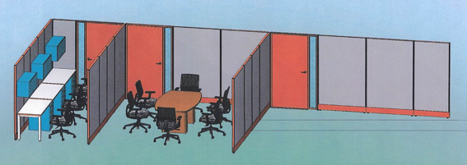
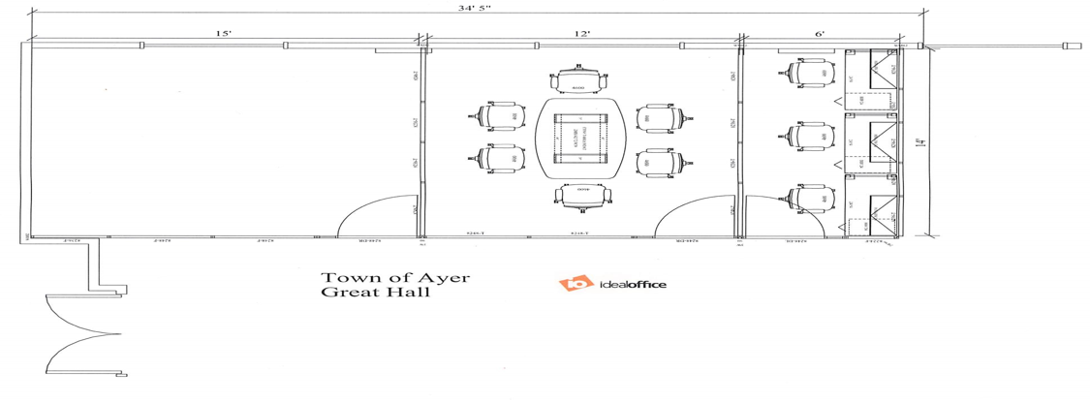

Slide 4
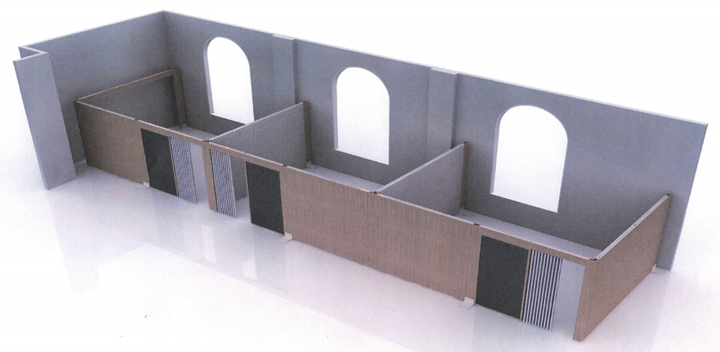
Option 2
Add $40,000.00 to funding request

Slide 5
Repairs
As a continuation of a successful FY23 Phase 1 Gutter and Roof repair request, this funding request will be used to continue the work to repair the interior wall damage
After completing inspections and repairs to the slate roof and gutters. It was found that a Phase 2 Gutter and Roof repair request is not needed at this time. Another funding request will be made in FY27 to continue the much-needed preventive maintenance
Within the $30,000.00 FY23 budget, Specialized Roofing was able to replace all the leaking, broken, and problematic pieces of slate. Add two new copper downspouts to resolve our water pooling issues. Seal the broken solder joints with elastomeric polyurethane silicone
The repair budget within this funding request will repair the three most damaged interior walls (Great Hall Columbia Street front corner, Bottom of the staircase bank side exit, and the Columbia Street wall in the Great Hall). These walls moisture readings are extremely low since gutter and slate roof repairs.
Additional funding will be needed for wall damage repairs throughout the Town Hall, but the Facilities Department is not ready to execute this repairs in FY24.

Slide 6
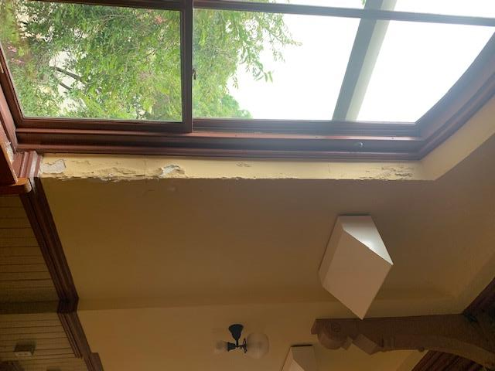
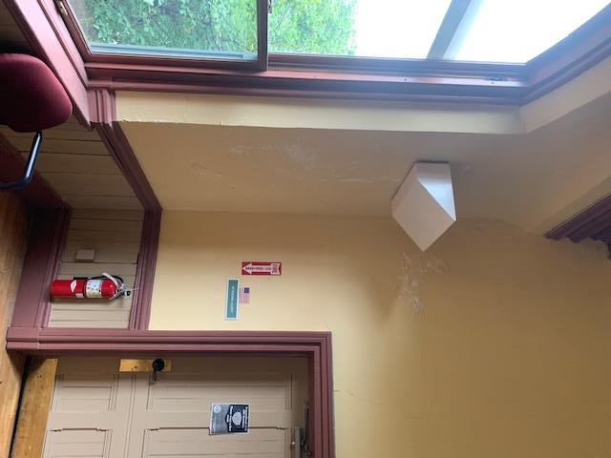

Slide 7
Acoustics
Four Step Process
We are current working on step 1
This funding request will allow us to work on step two in FY24

