Slide 1
Ayer Community Preservation Committee
Annual Town Meeting, April 22, 2024
7 PM
Ayer-Shirley Regional High School Auditorium

Slide 2
Warrant Article 21
CPA Fund Disbursements for FY 25
Town Surcharge Estimate + State Match = $969,090
5% for Administrative = $48,454
Like appraisals, legal notices, public forums, etc.
10% for Open Space = $96,909
10% for Community Housing = $96,909
10% for Historic Resources = $96,909
~70% remainder Undesignated Fund Balance =$629,907

Slide 3
Warrant Article 22
Transfer of Unexpended Funds from Old Fire Station Project
$150,000 transferred back to Community Housing
$ 40,000 transferred back to Historic Resources

Slide 4
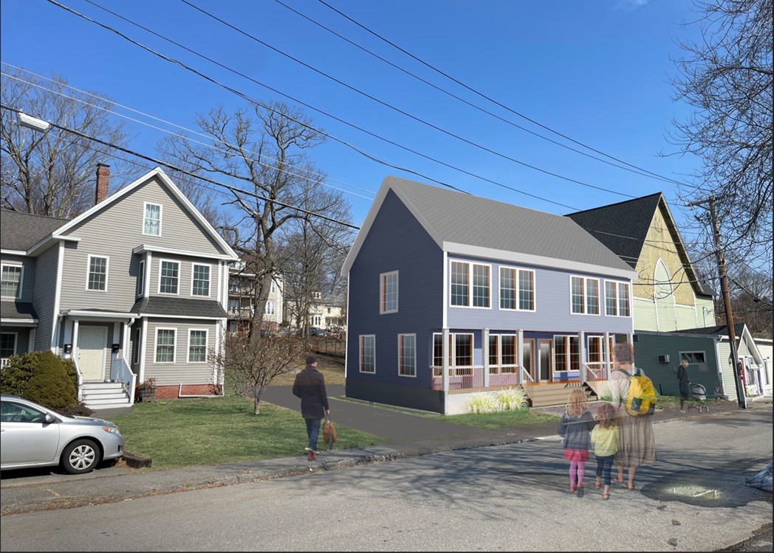
Warrant Article 23
Habitat for Humanity – 12 Newton St. Project
$150,000 requested for a duplex style house

Slide 5
Warrant Article 24
Funding for 71 Sandy Pond Rd Acquisition
With Town approval of acquisition
$350,000 of CPA Funds requested to help pay for acquisition

Slide 6
THANK YOU
Janet Providakes – Chair/Ayer Housing Authority
Julie Murray – Vice Chair/Planning Board
Jess Gugino – Clerk/Conservation Commission
Barry Schwarzel – Member/Historical Commission
Jason Mayo – Member/Parks & Recreations
Beth Suedmeyer – At-Large Member/Open Space & Rec
Colleen Krieser – At-Large Member/Affordable Housing Trust

