Slide 1
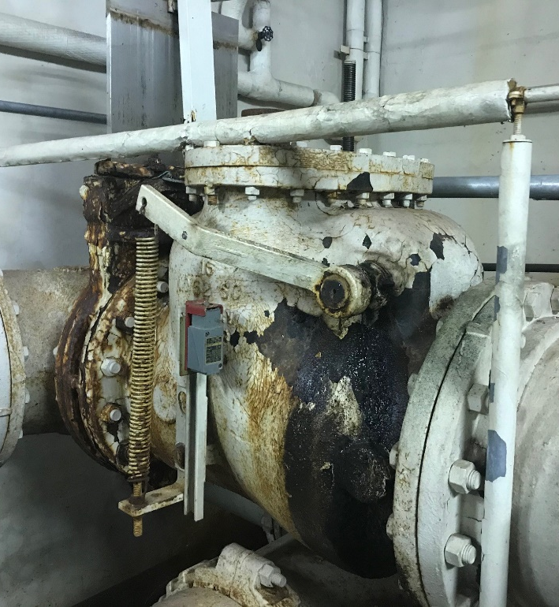
Article 23 – Transfer Request Main and Central Valve Project
Main Pump Station (PS) processes all of Town’s sewage flow, Central Ave PS the eastern half of town
Pumping Stations have several large “check Valves that are reaching the end of useful life (leaking)
Valves have been procured, bids for replacement were over budget and require additional funds

