Slide 1
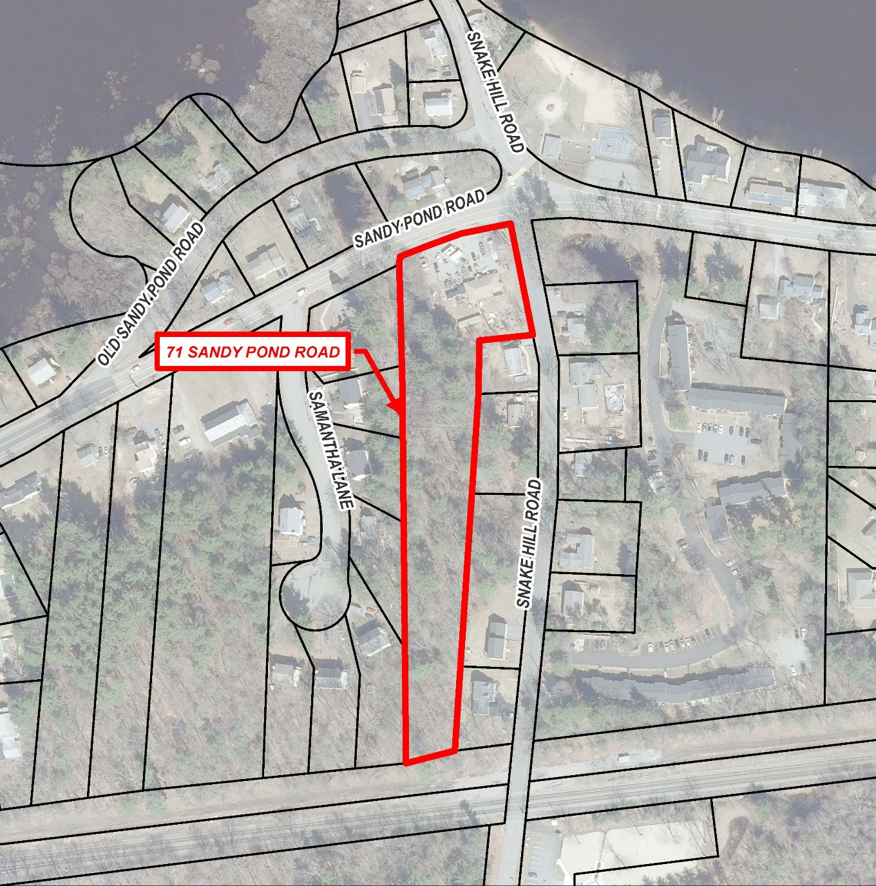
Article 24: Acquisition By Purchase of 71 Sandy Pond Road
April 22, 2024

Slide 2
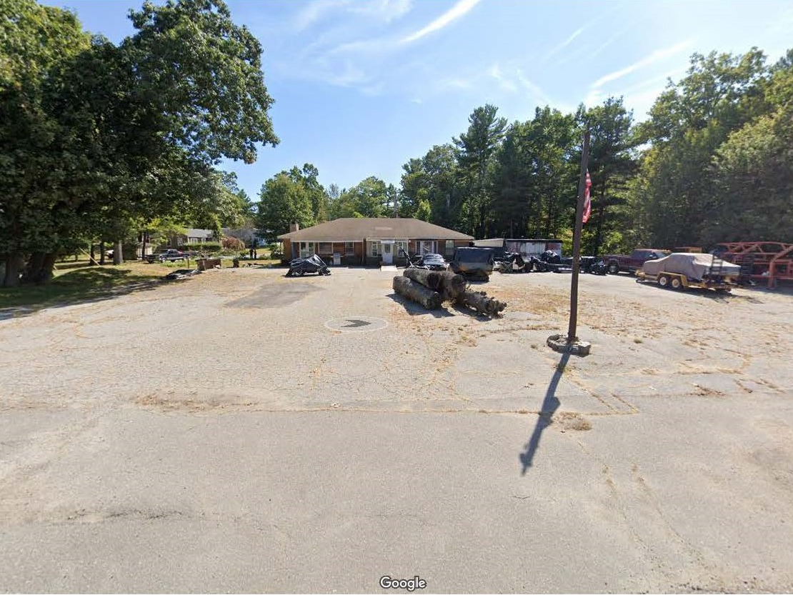
71 Sandy Pond Road (Before Demo)

Slide 3
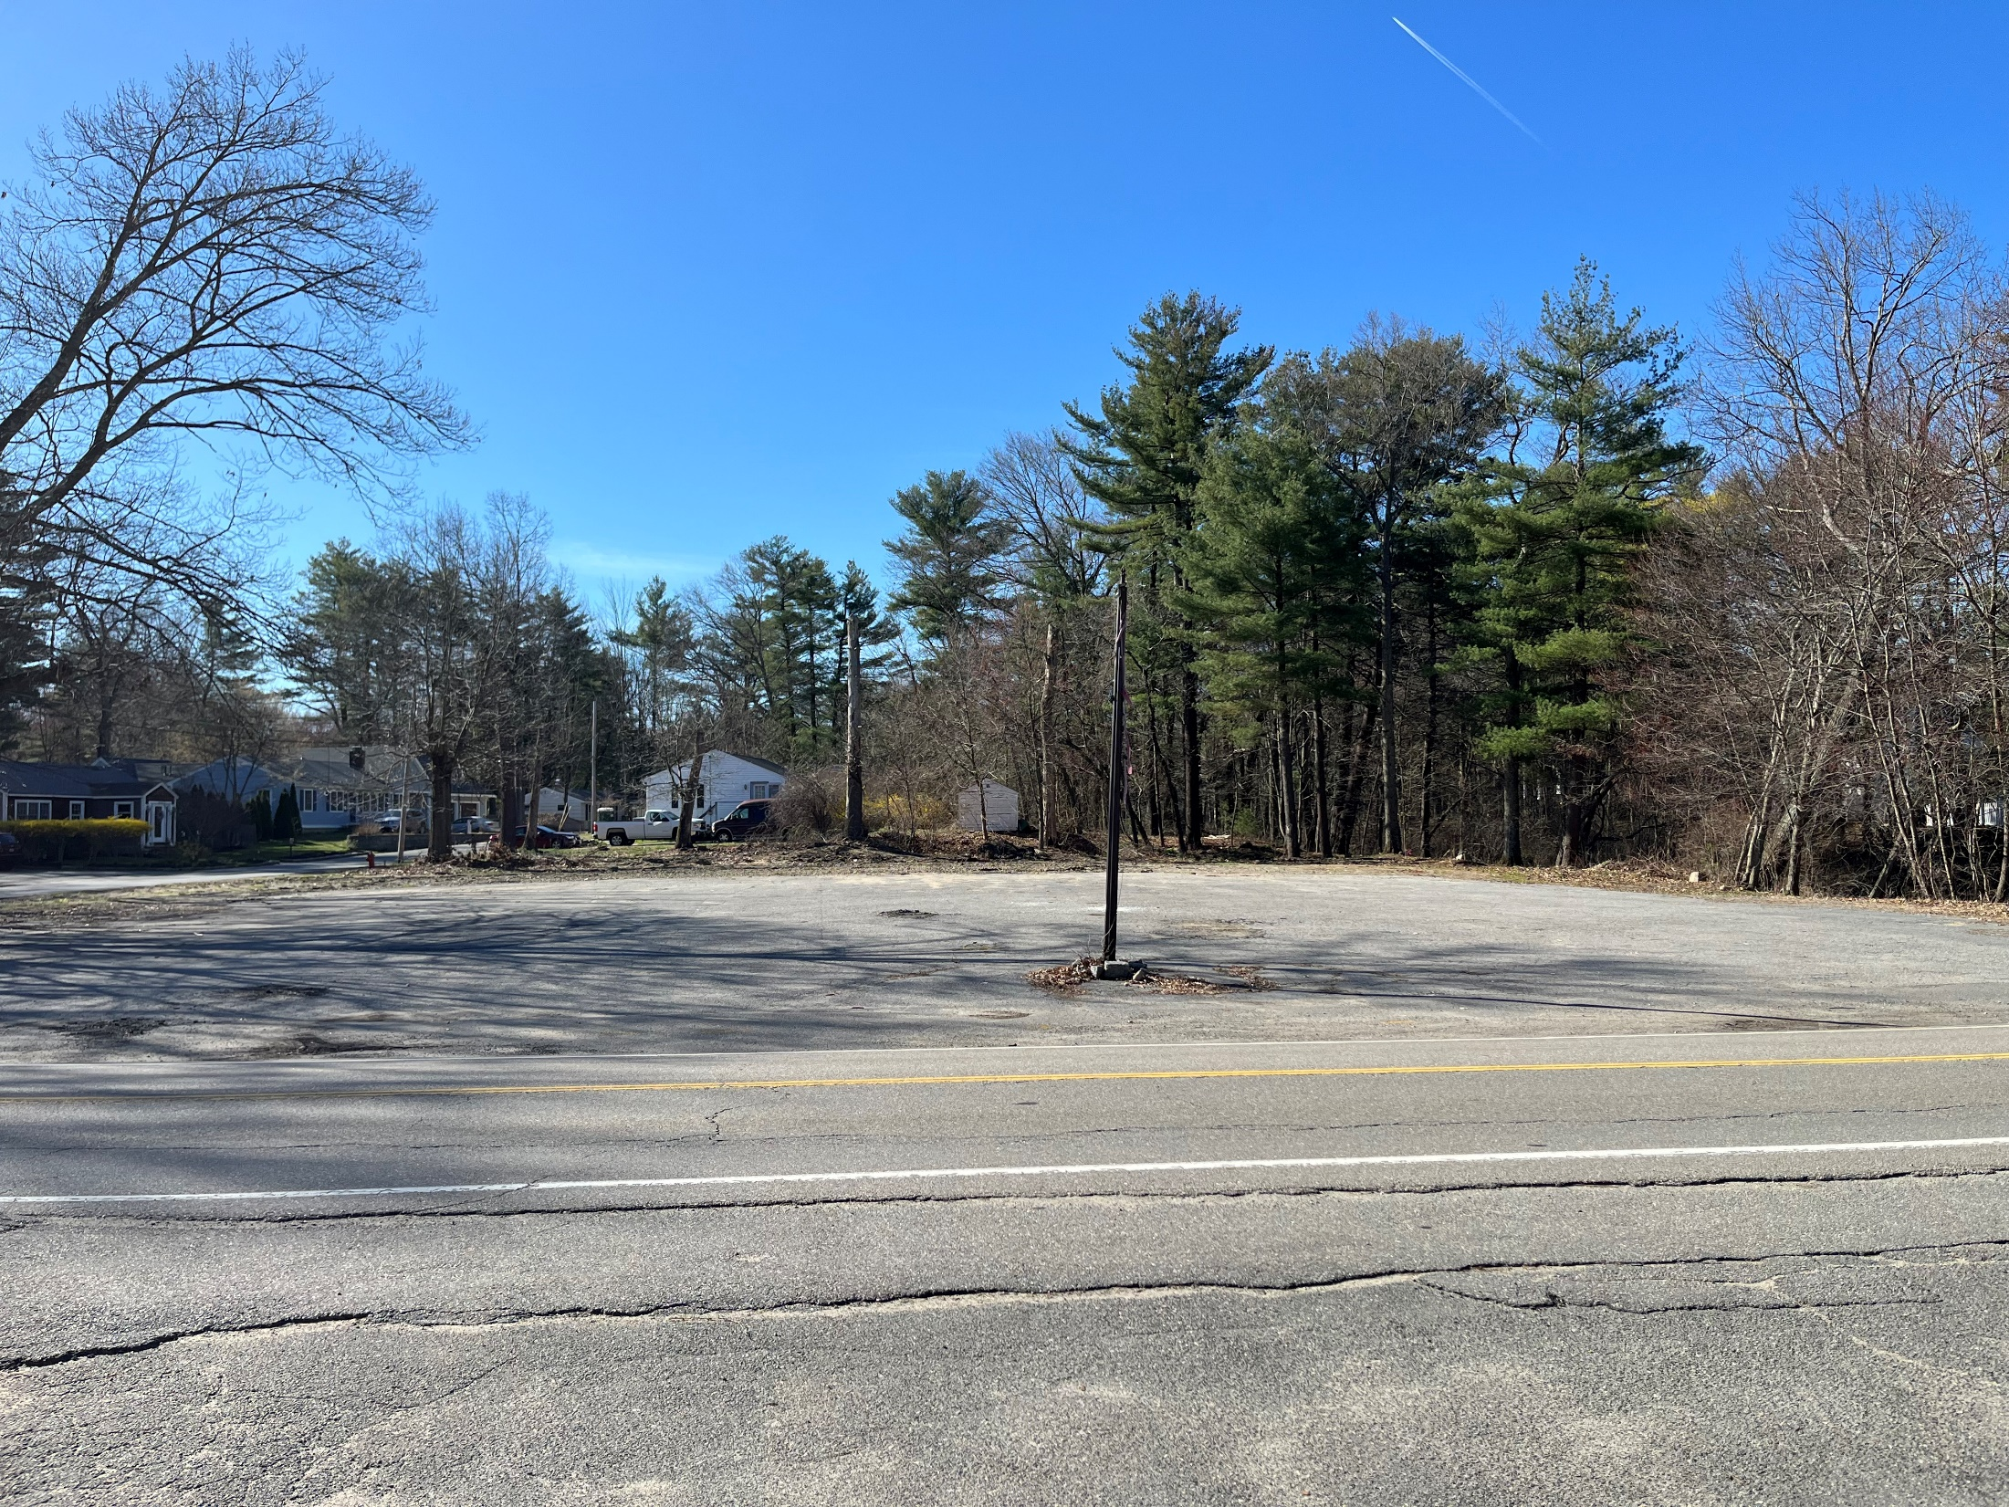
71 Sandy Pond Road (After Demo)

Slide 4
71 Sandy Pond Road Property Summary
Lot Size: 2.29 Acres
Location: Corner of Sandy Pond Road and Snake Hill Road; Diagonally across from the Town Beach and Sandy Pond Waterfront
Original asking price: $900,000 (including house)
Purchase and Sale: $700,000 (with demo of house by owner)
Appraisal: $350,000 (as of Feb. 3, 2024; land only)
Historically the property had a single residential house on it.
Environmental Due Diligence completed on March 18, 2024 by Cooperstown Environmental -- No evidence of Potential Environmental Concerns
(complete report available on Town website at www.ayer.ma.us/townmeeting) :

Slide 5
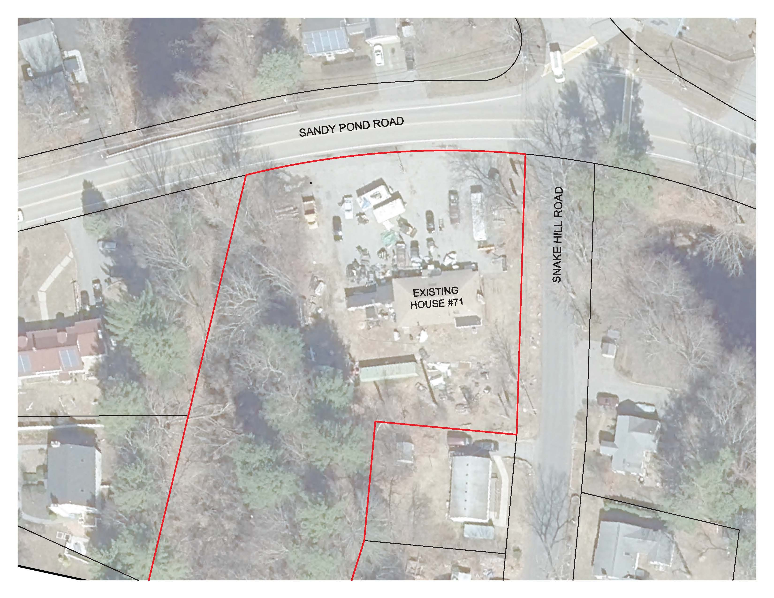
Existing Conditions (Before Demo)

Slide 6
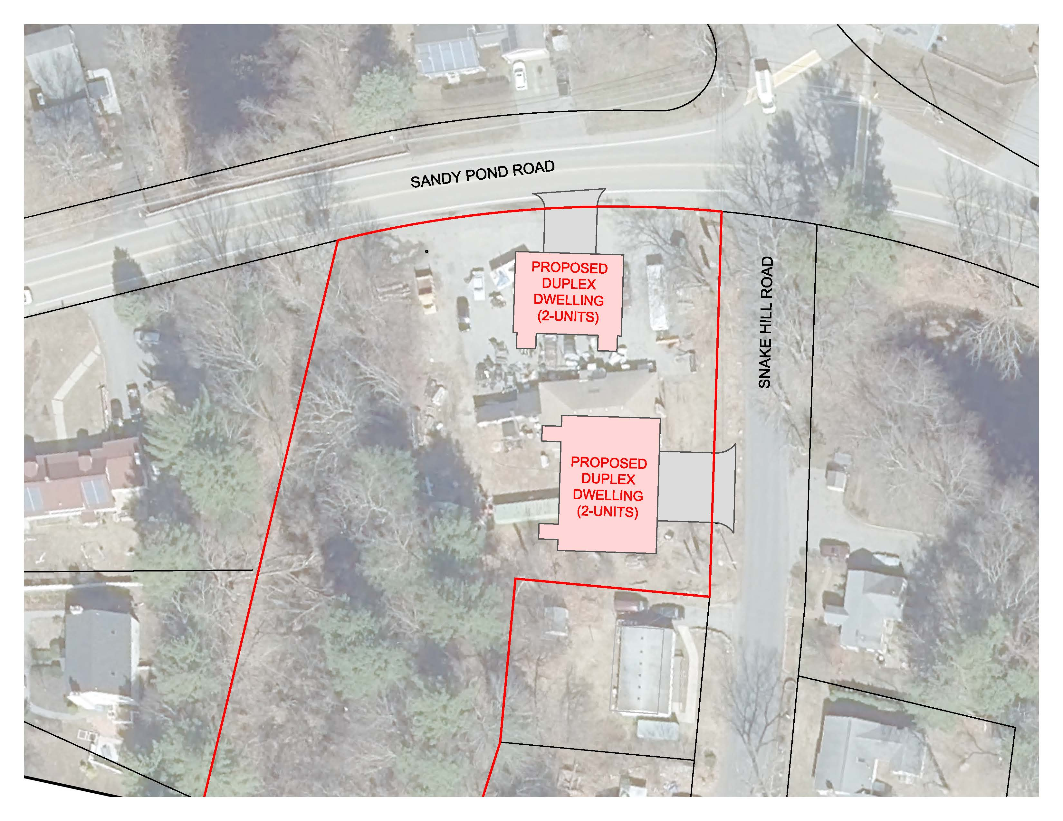
Potential Development Prior to Town P&S

Slide 7
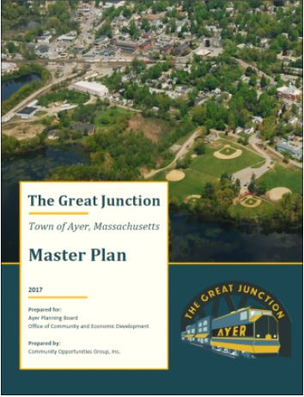
Town Goals
Ayer’s Master Plan:
“Sandy Pond beach is among Ayer’s most valuable open space resources.”
“Finding a long-term parking solution for and maintaining a safe level of usership will be long-term needs for Sandy Pond Beach.”
“The availability, location, and safety of parking facilities impacts the viability of residential and commercial districts, and is an issue most acutely felt in Ayer in the Downtown area, and also at Sandy Pond Beach during the summer season.”
“Prioritize the expansion of open space and/or public access easements around ponds and streams in Ayer to facilitate public access for recreational use such as kayaking launches and hiking trails.”

Slide 8
Town Goals
Ayer’s Open Space and Recreation Plan:
“…One of the main water access issues is the size and limited amount of available parking at the Sandy Pond Town Beach. Sixty-eight (68%) percent of survey respondents chose Sandy Pond as one of their top three places in Ayer, yet there is only one small public beach and no public boat access. Town residents not living on Sandy Pond are forced to launch their boats illegally. Both the town and the state are pursuing rectifying this recreation gap through on-going land acquisition deals that may have been completed by the time this Plan is finalized. Community members have also voiced concerns over the dangerous parking situation and general crowdedness of Sandy Pond Beach during the summer. Ayer needs to prioritize increasing public accessibility to its water resources, as also identified in the state’s SCORP [Statewide Comprehensive Outdoor Recreation Plan].”
Action Items 4.32, 4.33, and 4.42:
“4.33: Conduct a feasibility study on creating a public boat ramp for Flanagan and Sandy Ponds”
“4.32: Identify potential opportunities to gain easements or town ownership to secure access to Flanagan and Sandy Ponds for small boat craft”
“4.42: ADA compliant bathhouse is constructed at Sandy Pond Beach, along with additional play structures and an expanded dock system.”

Slide 9
Town Support for the Purchase of 71 Sandy Pond Road
The acquisition by purchase of 71 Sandy Pond Road has received the following Town of Ayer Support:
Ayer Select Board
Ayer Parks Commission
Ayer Community Preservation Committee
Ayer Town Planner
Ayer Director of Community and Economic Development
Ayer DPW Director

Slide 10
Project Background
November 2023:
Private Property Owner approaches the Town regarding any interest from the Town to purchase 71 Sandy Pond Road
Select Board authorizes the Town Manager to commence negotiations for a potential purchase and sales agreement
Owner proceeds with plans to develop the property for residential purposes
December 2023:
Select Board approves Purchase and Sales agreement for purchase of 71 Sandy Pond Road for $700,000 contingent upon the house and structures being demolished and removed by owner; leveled to street grade; satisfactory environmental assessment and Town Meeting approval.

Slide 11
Project Background (Continued)
February 7, 2024:
Town Manager on behalf of the Select Board submits funding eligibility application to the Community Preservation Committee to consider funding half of the land purchase with $350,000 from CPA Funds under the Open Space Category.
Community Preservation Committee votes unanimously to recommend the project application for a Public Hearing to be held on March 6, 2024.
March 6, 2024:
Community Preservation Committee holds Public Hearing on the application for $350,000 in CPA Funds toward the purchase of 71 Sandy Pond Road and votes unanimously to recommend a Warrant Article for Town Meeting.

Slide 12
Funding for the Purchase of 71 Sandy Pond Road
$700,000 Total Price for Purchase per Purchase and Sales
Negotiated down from the original asking price of $900,000
Appraisal of land value as of February 3, 2024: $350,000 (Independent appraisal completed by Howard S. Dono & Associates on March 11, 2024
($350,000) To come from CPA Funds for Open Space subject to Town Meeting Approval [Article 24]
($350,000) To come from the Town’s American Rescue Plan Act (ARPA Funds)* as voted and
approved by the Select Board on March 19, 2024
*Note: ARPA funds are under the jurisdiction of the Select Board and must be committed by December 31, 2024.
The use of CPA Funds and ARPA Funds for this purchase results in no direct local tax impact to the Ayer taxpayer.

Slide 13
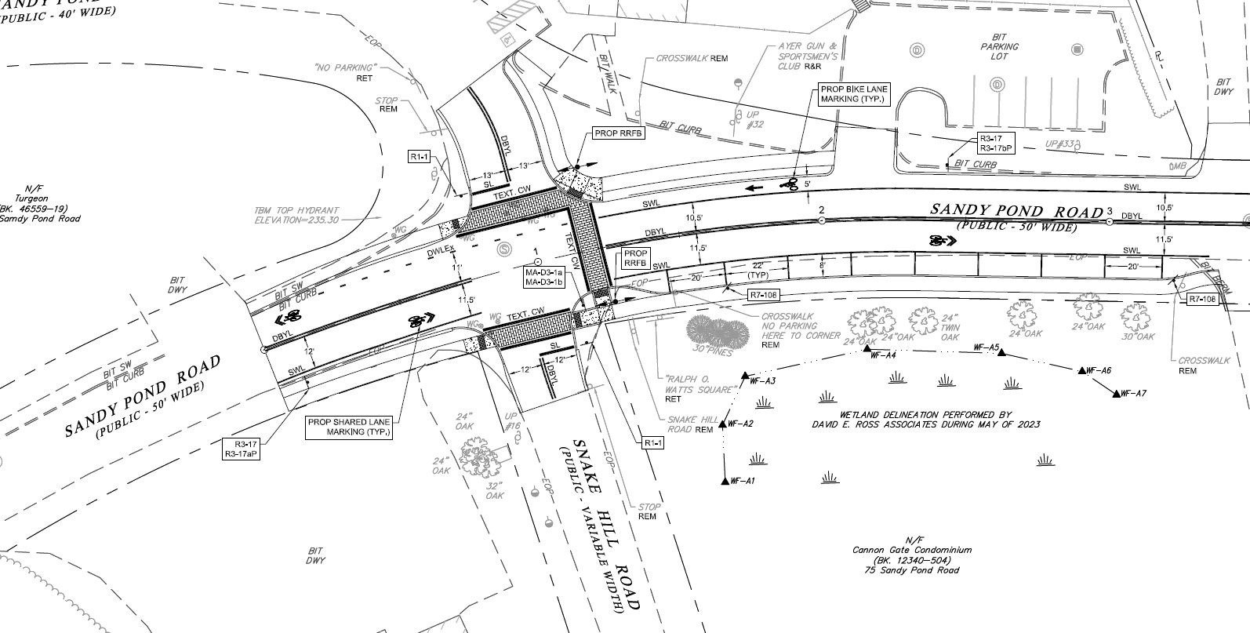
Other Considerations
Sandy Pond Road Complete Street Project (2024 Construction)

Slide 14
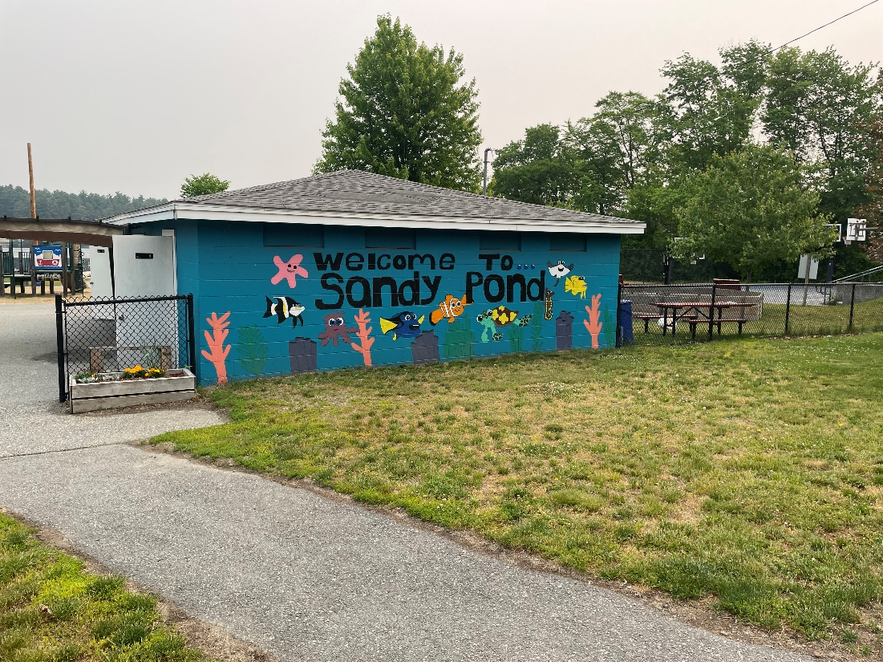
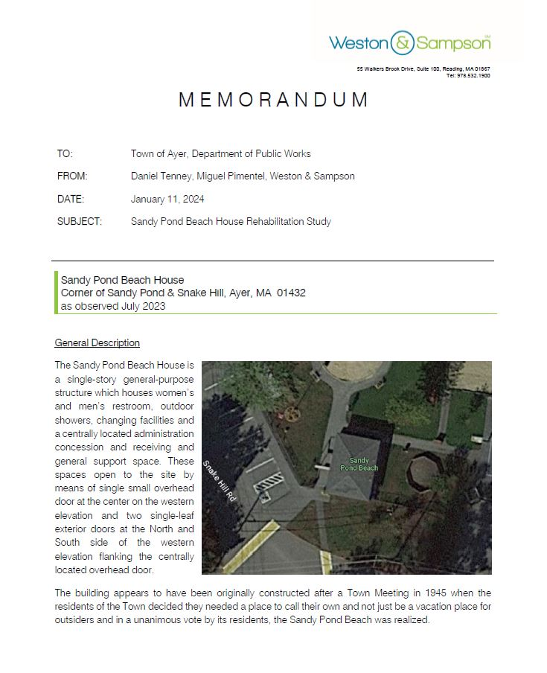
Other Considerations
Sandy Pond Beach House Improvements
Beach House Rehab Study 2024
FY26 Capital Budget Request for Improvement Project
Complete Streets Project and 71 Sandy Pond Road factor into Beach House decisions

Slide 15
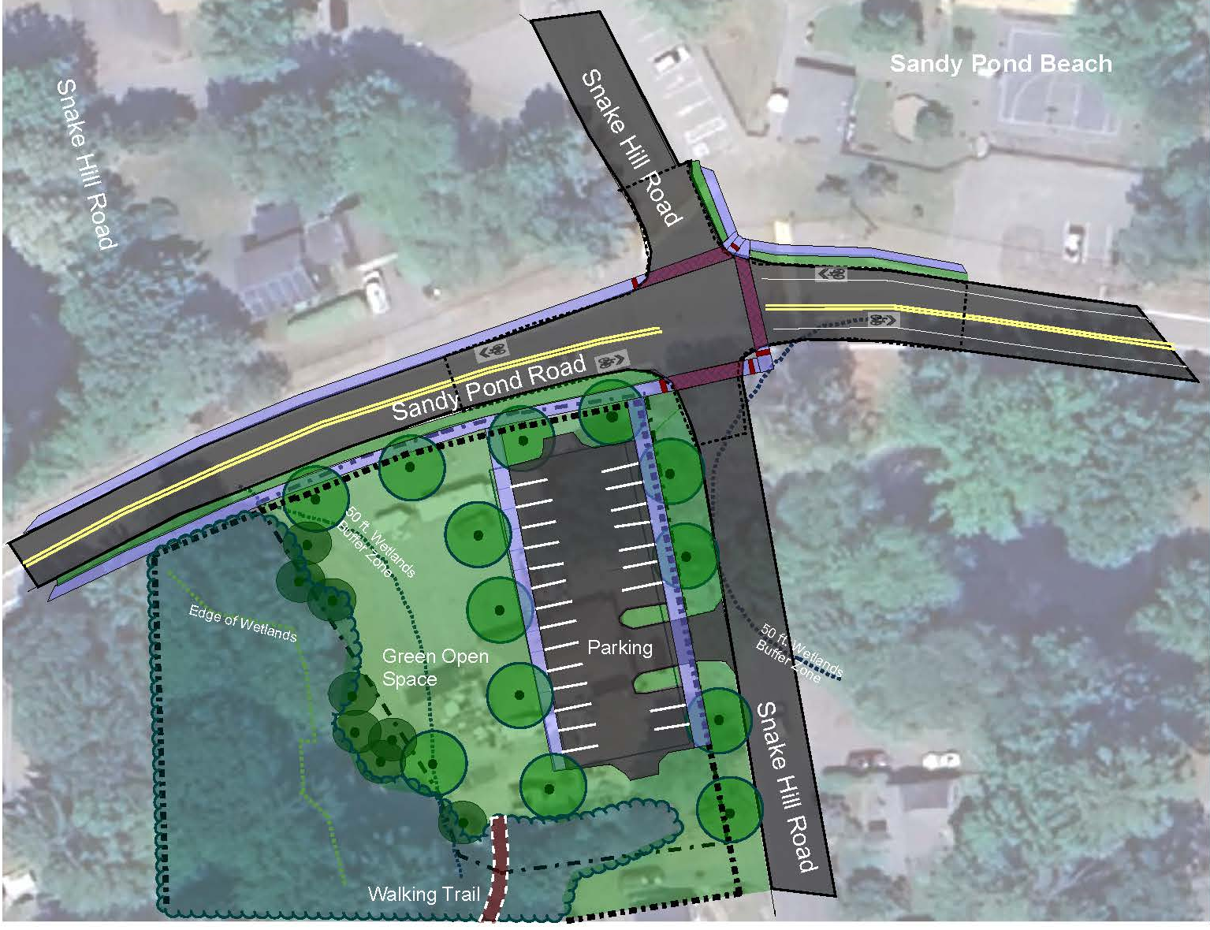
Conceptual Plan (Note: Public Planning process required for final use of property)

