Slide 1
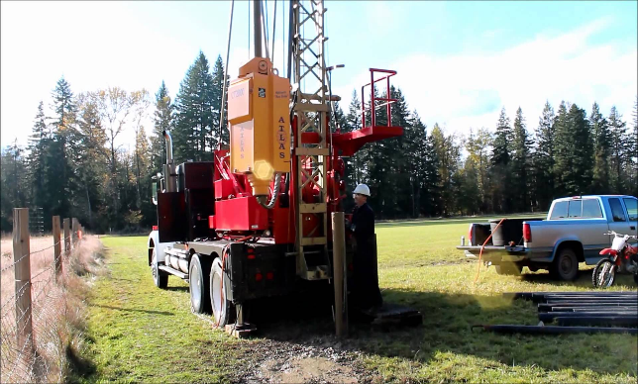
Article 24 – Transfer Request New Well Source Approval Project
Previously approved funding is unable to cover cost for new well source investigation (significant drilling involved increased due to inflation, commodities increases)
Test well data indicates Spec Pond location is favorable for municipal water supply, there are no other viable groundwater sources through historic investigations

Slide 2
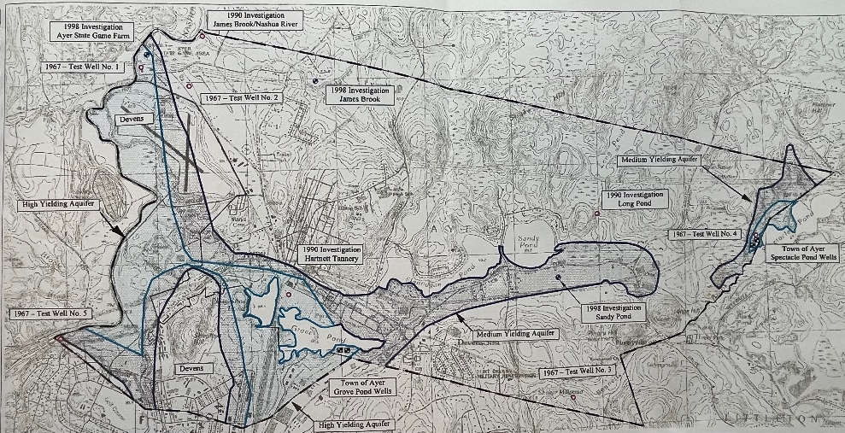
Article 24 – Transfer Request New Well Source Approval Project
Water Master Plan and Public Water Supply Investigations since 1967
Deemed Not Viable
James Brook / Game Farm Area
Long Pond Area
Shaker Mill Pond Area
Bligh Street Area
West Main Street near Nashua River
Ershire Conservation Area (north of Oak Ridge Drive)
Potentially Viable Sources
Spectacle Pond (Current Site)
Current Site Under Investigation

