Slide 1
Article 29 – West Main Street Bridge Easements
Existing bridge is partially on two private properties and no record of an easement
Proposed bridge will also be partially on same properties and an easement is required
This Article authorizes the Select Board to acquire the easement(s)

Slide 2
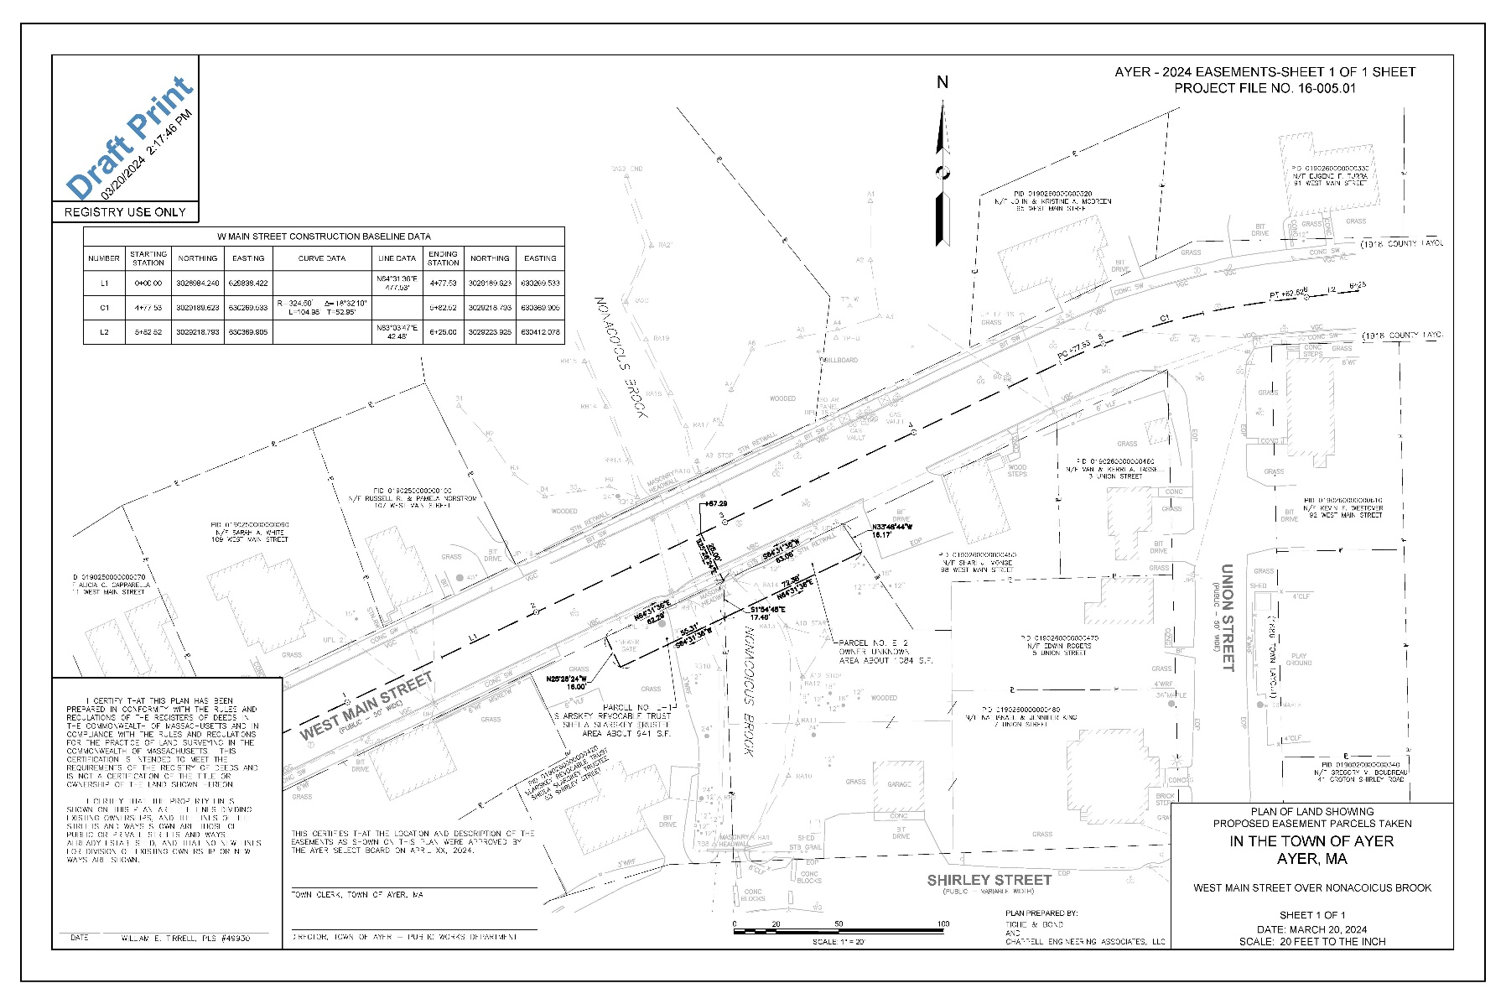
Article 29 – West Main Street Bridge Easements

