Slide 1
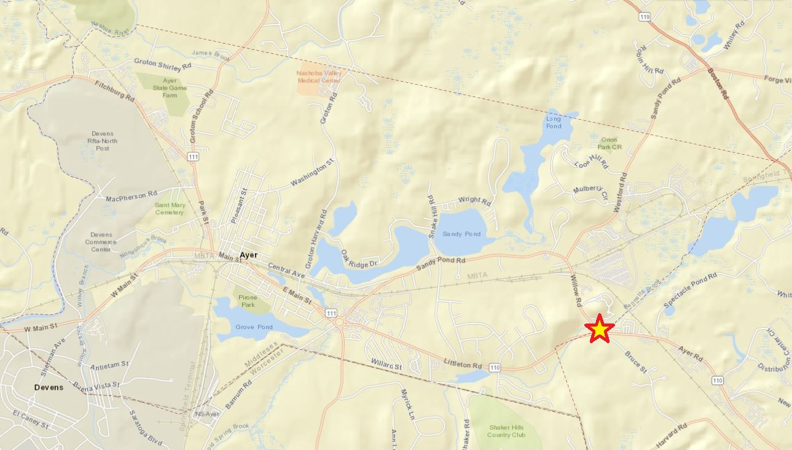
Article 30 – Extension of Sewer on Willow Road for 254-260 Ayer Road in Littleton
Location:
Willow Road at Littleton Road

Slide 2
Article 30 – Extension of Sewer on Willow Road for 254-260 Ayer Road in Littleton
What’s Proposed:
Private developers extending the Town’s sewer main on Willow Road to service 184-192 Littleton Road in Ayer and 254-260 Ayer Road in Littleton (the “Gas Station”)
Current sewer extent on Willow Road is in the vicinity of Longview Circle

Slide 3
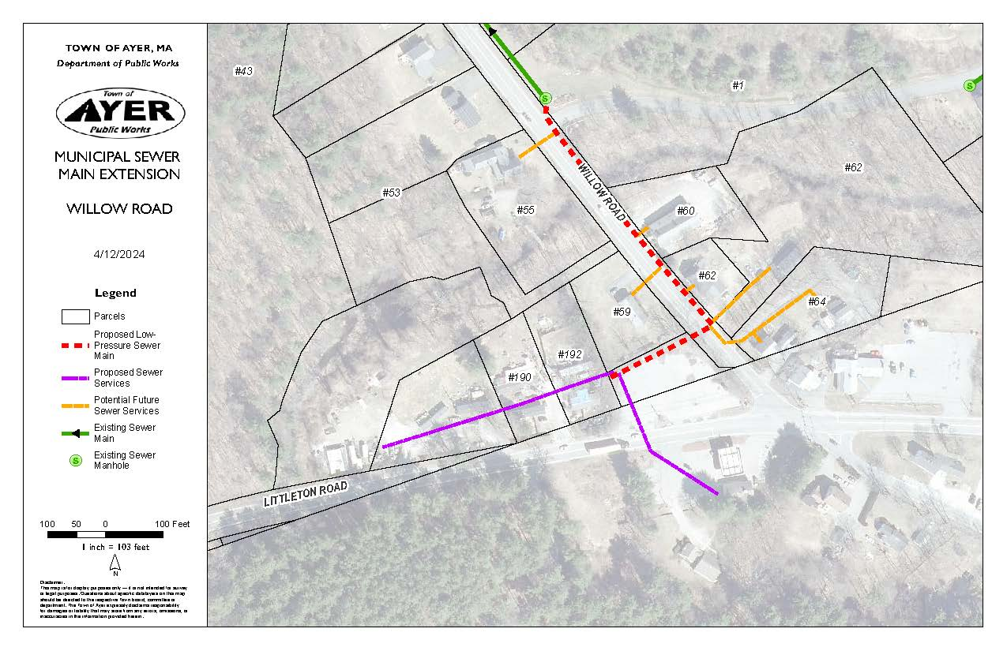
Article 30 – Extension of Sewer on Willow Road for 254-260 Ayer Road in Littleton

Slide 4
Article 30 – Extension of Sewer on Willow Road for 254-260 Ayer Road in Littleton
Sewer Availability:
2022 Agreement with Devens WWTP includes 350,000 gallons per day capacity
350,000 gallons per day – this number was developed based on the Town’s future projections
Known development
Population growth
Factor for unknown
Currently discharge minimum of 50,000 gpd to Devens, depending on Infiltration/Inflow conditions

Slide 5
Article 30 – Extension of Sewer on Willow Road for 254-260 Ayer Road in Littleton
Sewer Availability (continued):
Approximately 250,000 gallons per day of the 350,000 gallons per day is reserved for known developments
Remaining 100,000 gallons per day is for population growth and a factor for unknowns, of which this request would come from
Gas station request is 1,220 gpd

Slide 6
Article 30 – Extension of Sewer on Willow Road for 254-260 Ayer Road in Littleton
Other Considerations:
The Sewer extension, paid/installed by the Developer, would provide a sewer main on Willow Road, allowing for the connection of properties currently on septic
Poor percolation, DPW has received requests for sewer connection
Bennetts Brook E. Coli impairment
Out of Town Connection pays highest sewer rate

