Slide 1
Fire Department Staffing FY2025

Slide 2
What is SAFER?
Staffing for Adequate Fire and Emergency Response
Grant assists in increasing the number of firefighters to help communities meet industry minimum standards
Grant recipients must demonstrate an increased compliance with NFPA 1710 or 1720 assembly and deployment standards
3-year program with no local match covering salary and average benefits package
Ayer was award it’s grant in August 2021 with increased staffing in February 2022

Slide 3
SAFER Grant Focus is Improved Fire Fighter Safety
Standards Followed
Metrics Evaluated
As a department we strive to follow NFPA 1710 for our first arriving engine (4 personnel)
provides the safest environment for our fire fighters to operate
Enhances the service level provided to the community
NFPA 1720 response and assembly standards are also followed as a combination department
A combination career / on-call department provides the most efficient and cost-effective level of service
Company Staffing (Crew Size)
Engine = minimum 4 on duty
Turnout Time =
60 sec EMS
80 sec Fire
First Engine Arrive on Scene Time
240 sec (4 min)

Slide 4
SAFER Grant Timeline:
2010 – Internal evaluation of need for additional staffing begins
2013 – 1st SAFER application submitted FY2012 grant
2016 – Bargained use of per diem firefighters
2019 – Bargained side letter for establishing a grant committee
2020 – 2nd SAFER application submitted FY2019 grant
2021 – 3rd SAFER application submitted FY2020 grant
2021 – Grant was awarded $992,680
2021 – Selectboard voted to accept grant
2025 – Grant funding through February 12, 2025

Slide 5
SAFER Award

Slide 6
Current Fire Department Staffing
Chief, Deputy Chief, Fire Prevention Lieutenant working administrative weekday schedule
4 fire fighters per group working a 24-hour shift Captain, Lieutenant, 2- Firefighters
13 Member Call Department, Respond as needed Captain, Lieutenant, 10- Firefighters, 1 Paramedic

Slide 7
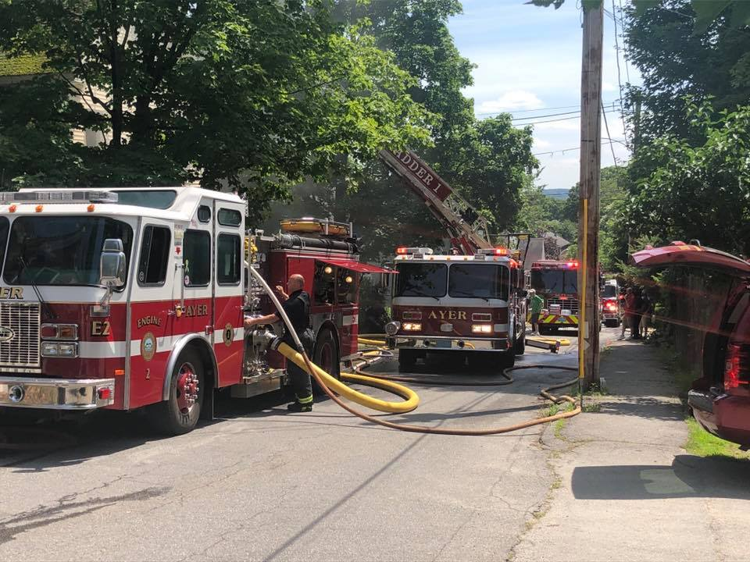
On duty shift deployment
1 Engine – Crew of 4 Personnel
2 Ambulances – 2 personnel per truck
1 Engine & 1 Ambulance with 2 personnel each
All the above options for initial response by on duty personnel can be augmented with On-Call fire fighters and recall of off duty career fire fighters.

Slide 8
Why Maintain Staffing Levels?
Department & Community Benefits
Maintains existing service levels
Safer work environment
Addresses staffing challenges
Increasing call numbers
Number of simultaneous calls
Fewer career staff living in the community
Housing cost is driving employees to live further away
Less availability of call members
Increase in demand for training hours (NFPA, OSHA, OEMS)
Less free time to volunteer due to other commitments
Jobs that do not accommodate response during the day or late at night

Slide 9
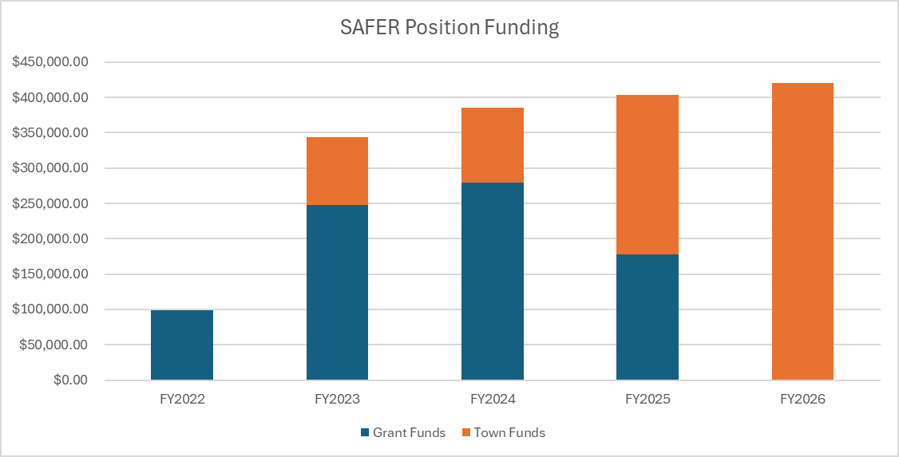
What Is The Cost?
FY2023 - $96,000
FY2024 - $106,000
FY2025 - $118,776
FY2026 - $190,000

Slide 10
Questions?

