Slide 1


Ayer Shirley Regional School District RSC Certified FY 2024 Proposed Budget for April 24, 2023 Ayer STM
Monday, April 24, 2023
Dr. Adam Renda, Superintendent
William Plunkett, Director of Finance
Notes:
ar

Slide 2
ASRSD FY24 Foundation Budget

Slide 3
ASRSD FY24 Chapter 70 Summary

Slide 4

Foundation Enrollment & RLC by Town

Slide 5
FY24 Ch.70 Apportionment of RLC

Slide 6
ASRSD Per Pupil Spending Comparisons

Slide 7
Proposed ASRSD FY24
Assessments to Ayer & Shirley

Slide 8
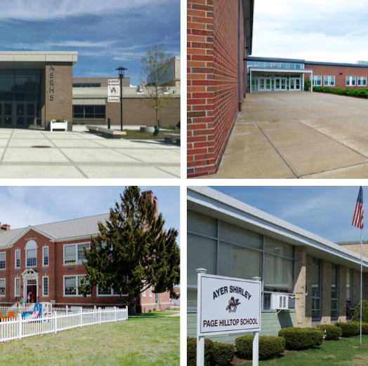
Questions?

