Slide 1
AYER
LIBRARY
Town Meeting 2024

Slide 2
FY23 vs FY22
45%
INCREASE IN VISITS
508%
INCREASE IN STUDY ROOM USE
7%
INCREASE IN MATERIALS CIRCULATION
224%
INCREASE IN PROGRAM
ATTENDANCE
261%
INCREASE IN PROGRAMS

Slide 3
How are we doing
9 months into FY24?

Slide 4
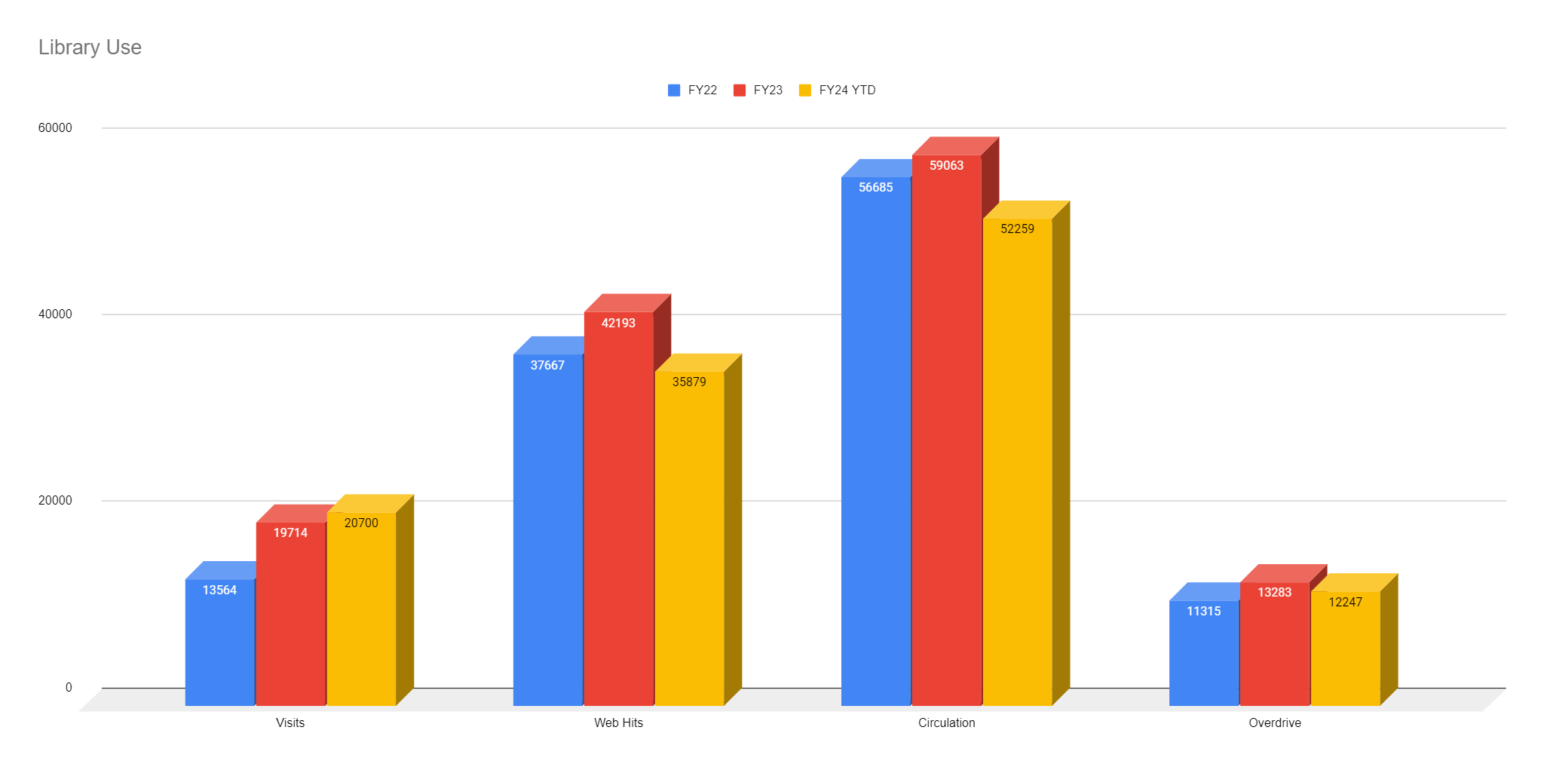

Slide 5
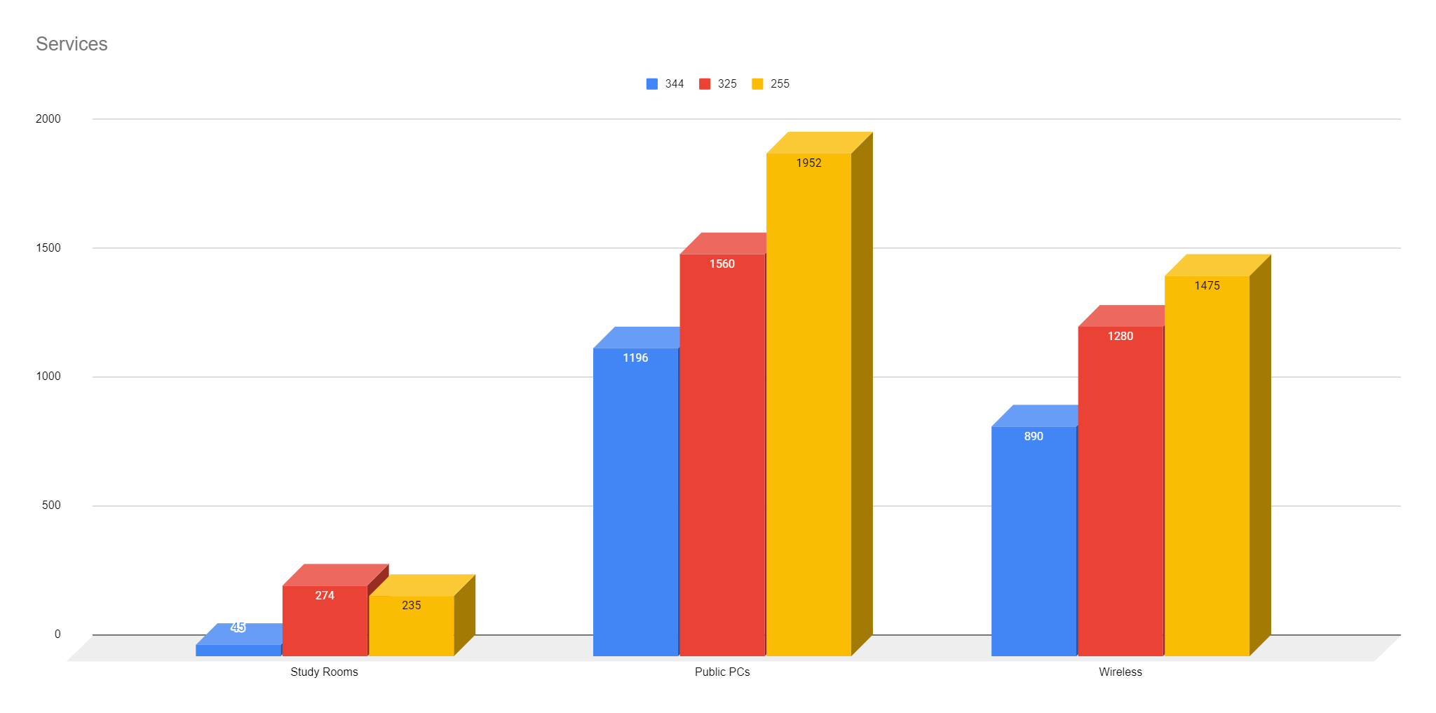

Slide 6
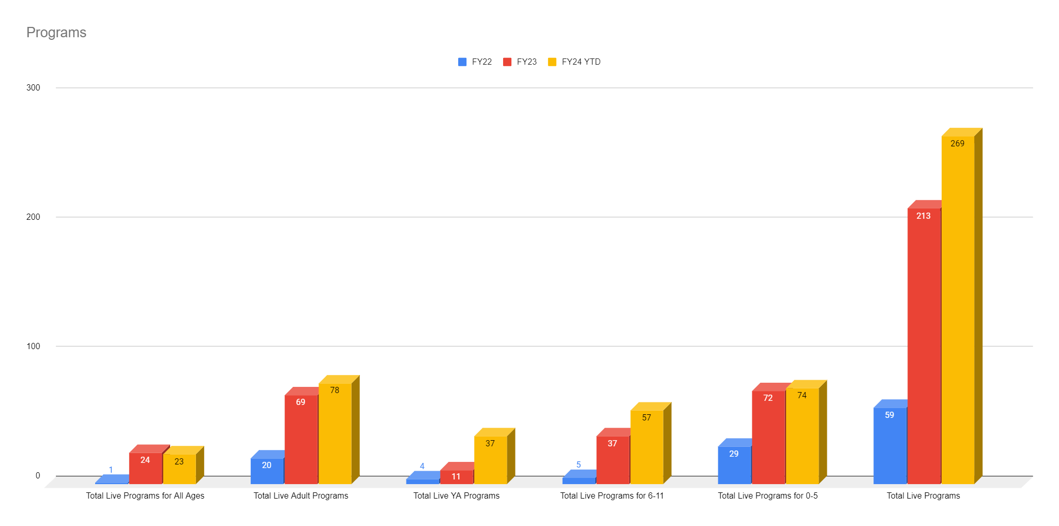

Slide 7
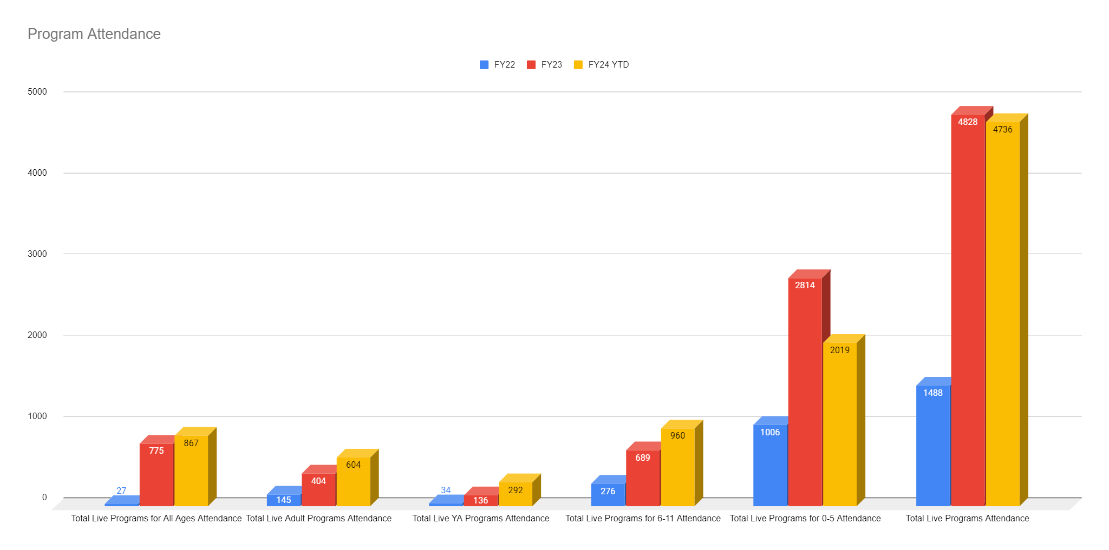

Slide 8
FY24 vs FY25
LIBRARY BUDGET REQUEST
1.16%
INCREASE IN
LIBRARY FUNDING

