Slide 1
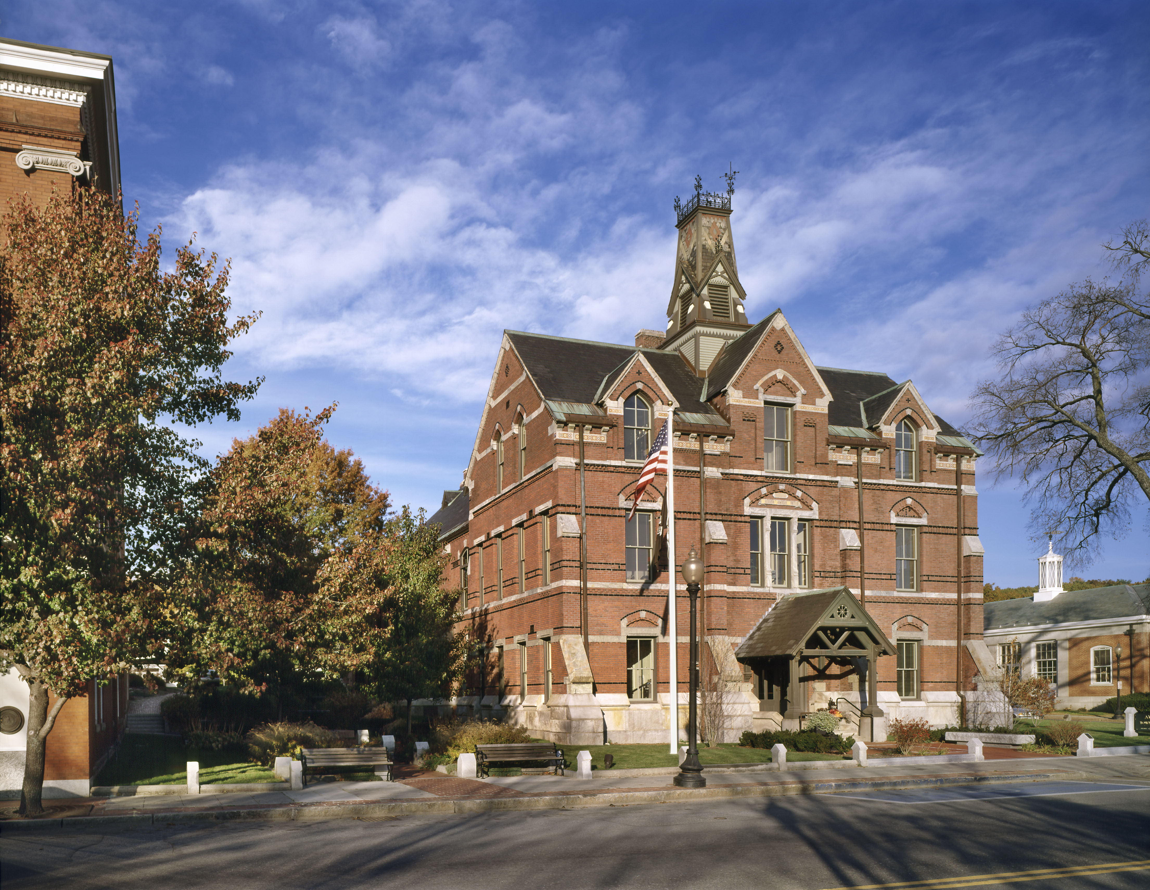
Article 4: FY 2025 Omnibus Budget Town Meeting Presentation

Slide 2
FY 2025 Budget Strengths
The Town is in a Position of Fiscal Stability and Financial Strength:
2023 Certified Free Cash: $1,677,665
2023 Stabilization Fund: $3,143,988
2023 Capital Stabilization Fund: $4,742,416
2023 Standard and Poor (S&P) Bond Rating**: Aa2
*Balances as of June 30, 2023
**The S & P Rating Includes Findings of: Strong Local Economy; Strong Management; Strong Financial Policies and Practices. Strong Financial Reserves.

Slide 3
Balanced Budget
Revenue
$36,560,514
Expenses & Savings
$36,560,514
State Aid $1,023,109
Tax Levy $30,192,265
Local Receipts $2,386,500
Free Cash $1,677,665
Capital Stabilization $228,000
Enterprise Fund Impact $1,162,840
Cherry Sheet Charges ($109,865)
$36,560,514
Omnibus Budget $18,962,257
ASRSD Assessment $14,372,112
NVRTHS Assessment $1,074,675
OPEB (GASB45) Funding $300,000
Stabilization Funding $1,234,740
Other Articles $616,730
$36,560,514
Includes $1.2M to Stabilization and $300K to OPEB Liability

Slide 4
General Fund Expenditures
Revenue

Slide 5
Omnibus Budget – Revenue *does not include enterprise impact

Slide 6
Omnibus Budget – Revenue
Category | FY ‘24 Recap | FY ‘25 | Increase/(Decrease) | Percentage
State Aid | 1,066,036 | 1,023,109 | (42,927) | (4.03%)
Tax Base | 27,233,381 | 28,537,361 | 1,303,980 | 4.79%
Debt Exclusions | 1,341,838 | 1,654,904 | 313,066 | 23.33%
Local Receipts | 2,519,445 | 2,686,500 | 167,055 | 6.63%
Other | 364,200 | 228,000 | (136,200) | (37.40%)
Free Cash | 1,936,459 | 1,677,665 | (258,794) | (13.36%)
Cherry Sheet | (104,762) | (109,865) | 5,103 | 4.87%
Overlay | (283,706) | (300,000) | 16,294 | 5.74%
Total | $34,220,202 | $35,397,674 | 1,177,472 | 3.44%

Slide 7
Omnibus Budget - Expenses

Slide 8
FY 2025 Operating Expenses by Category

Slide 9
FY ‘25 Major Drivers
Category | FY ‘24 | FY ‘25 | Increase/Decrease | Percentage
Education | 14,691,738 | 15,446,787 | 755,049 | 5.14%
Fire Department | 2,289,484 | 2,503,562 | 214,077 | 9.35%
Health Insurance | 2,269,859 | 2,459,267 | 189,408 | 8.34%
Information Technology | 183,073 | 299,491 | 116,418 | 63.59%
Debt Service | 1,075,060 | 1,196,910 | 121,848 | 11.33%

