Slide 2
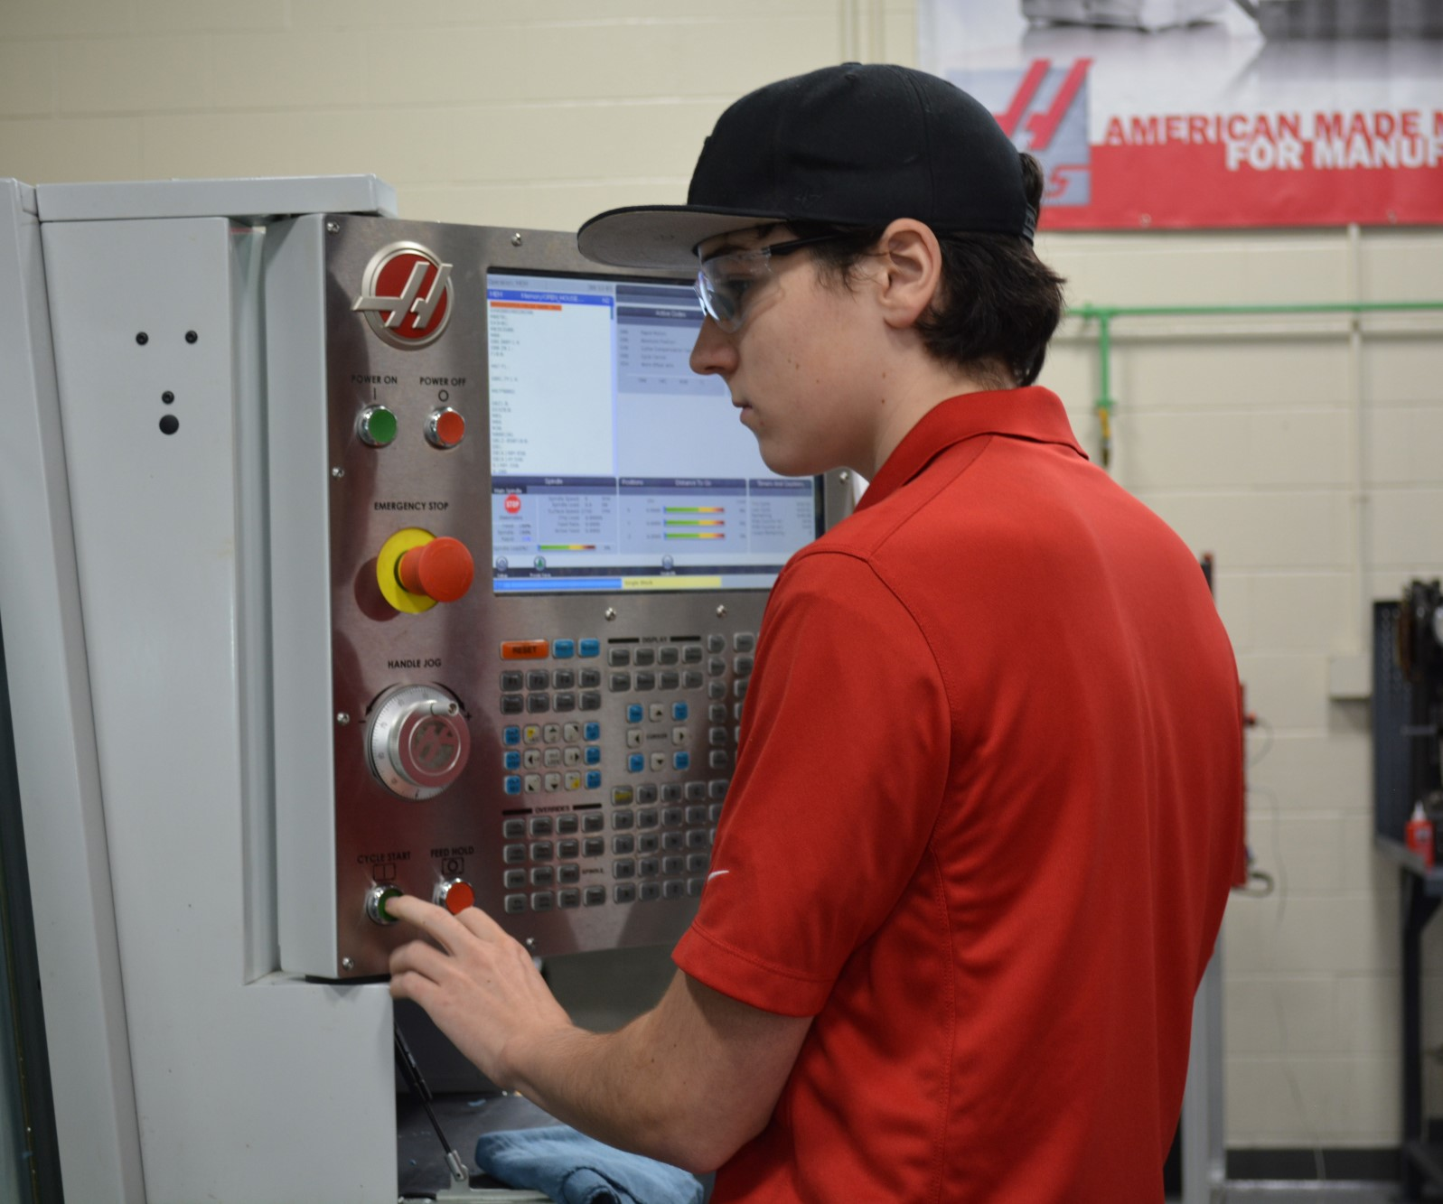
Technical Programs - High School Offerings
Construction & Transportation Cluster (41% of students) Automotive Collision Repair, Automotive Technology, Carpentry, Electrical Technology, and Plumbing Technology
Health and Services Cluster (31% of students) Cosmetology, Culinary Arts, Hospitality Management, Marketing, Early Childhood Education, Health Assisting, Dental Assisting, and Veterinary Assisting
Arts and Technology Cluster (28% of students) Programming and Web Development, Television and Media Production, Design and Visual Communications, Advanced Manufacturing, Engineering Technology, Robotics, and Biotechnology
Notes:
Talking points
Programs aligned with labor market needs
Provides at least 900 hours of instruction in students’ trade areas
Most offer over 1,500 hours
Advisory Boards
Instructors with industry experience and teaching credentials
Cooperative and Internship placement opportunities

Slide 3
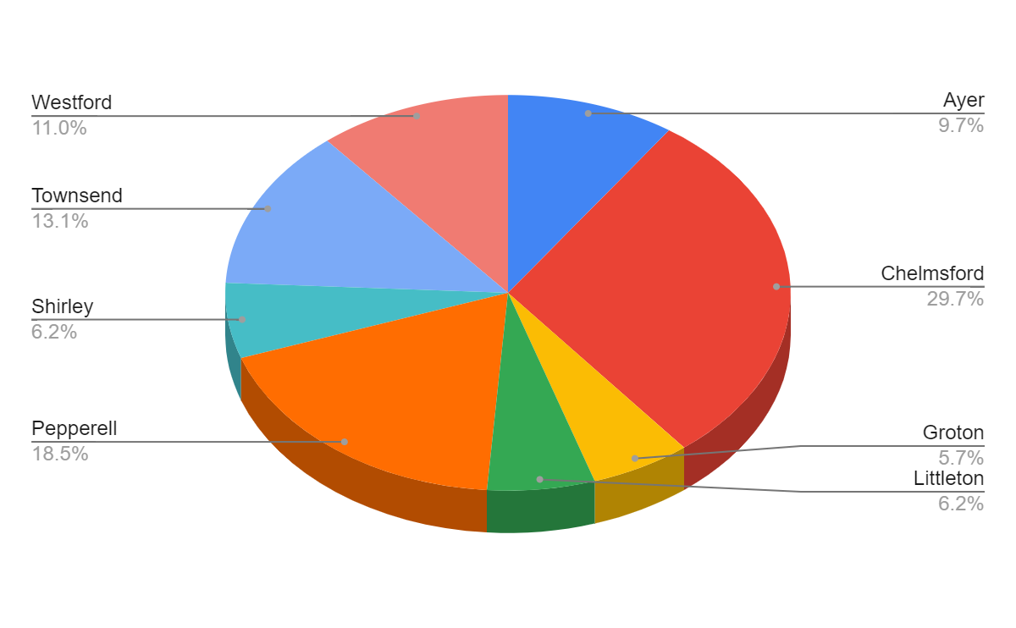
Enrollment by Town (FY24)
Enrollment Change from FY23
+8 Ayer +5 Chelmsford -4 Groton +3 Littleton +10 Pepperell -5 Shirley +4 Townsend +6 Westford +27 District Students

Slide 4
FY 2024 Proposed Budget by State Function Code
General Fund Expenses |  | FY23 Voted | FY24 Proposed | Change $ | Change % | Notes
1000 Administration |  | 784,113 | 822,523 | 38,410 | 4.9% | Contractual increases, software
2000 Instruction* |  | 8,188,422 | 8,734,491 | 546,069 | 6.67% | Step/lane changes, +2 staff, tech program supplies
3000 Pupil Services |  | 1,905,182 | 2,011,310 | 106,128 | 5.57% | Transportation & other contractual increases
4000 Operations and Maintenance |  | 1,527,374 | 1,716,199 | 188,825 | 12.36% | Contractual, utility & supply cost increases
5000 Benefits and Fixed Charges |  | 2,936,576 | 3,022,993 | 86,417 | 2.94% | Required increases
7000 Acq., Improve & Replace Assets |  | 350,000 | 375,000 | 25,000 | 7.14% | Increased capital need
8000 Debt Retirement and Service |  | 626,075 | 602,000 | -24,075 | -3.85% | Decreasing debt
9000 Programs with other School Districts |  | 6,164 | 14,400 | 8,236 | 134% | Estimated school choice out
Total General Fund Budget |  | 16,323,906 | 17,298,916 | 975,010 | 5.97%
Instructional Costs funded by School Choice fund |  | 315,246 | 332,588 | 17,342 | 5.50%
Total Budget (including School Choice fund) |  | 16,639,152 | 17,631,504 | 992,352 | 5.96%
*FY23 has been restated to remove instructional costs funded by School Choice in Function 2000, consistent with the current year presentation.
Notes:
Updated 1.30.23 MAB

Slide 5
FY 2024 Revenue Plan
Non-Assessment Revenue: |  | FY23 Voted | FY24 Voted | Difference | % Change
Chapter 70 School Aid |  | 3,900,777 | 4,701,934 | 801,157 | 20.54%
Chapter 71 Regional Transportation Reimb. |  | 519,458 | 618,617 | 99,159 | 19.09%
Certified Excess & Deficiency |  | 780,026 | 438,816 | -341,210 | -43.74%
Total Non-Assessment Revenue |  | 5,200,261 | 5,759,367 | 559,106 | 10.75%
Assessment Allocation by Category:
Minimum Contribution |  | 9,138,788 | 9,846,166 | 707,378 | 7.74%
Transportation/Capital Equipment |  | 783,782 | 791,383 | 7,601 | 0.97%
Additional (Offset)/Assessment |  | 575,000 | 300,000 | -275,000 | -47.83%
Subtotal Non-Debt Assessments |  | 10,497,570 | 10,937,549 | 439,979 | 4.19%
Debt (Expansion/Renovation) |  | 626,075 | 602,000 | -24,075 | -3.85%
Total Member Assessment |  | 11,123,645 | 11,539,549 | 415,904 | 3.74%
Notes:
Updated 1.26.23 MAB

Slide 6
Fiscal Year 2024 Voted Assessments by Member Town (Voted 3/7/23)
Town | No. of District Students | Students per Town Percentage | Town's Minimum Contribution | Transportation/ Capital Equip | Additional Assessment | Sub-total Assessment | Debt Service | Assessment 2023-2024
Ayer | 69 | 9.65% | 973,253 | 76,371 | 28,951 | 1,078,575 | 58,095 | 1,136,670
Chelmsford | 212 | 29.65% | 3,357,610 | 234,648 | 88,951 | 3,681,209 | 178,495 | 3,859,704
Groton | 41 | 5.73% | 665,553 | 45,380 | 17,203 | 782,136 | 34,520 | 762,656
Littleton | 44 | 6.15% | 678,828 | 48,700 | 18,462 | 745,990 | 37,046 | 783,036
Pepperell | 132 | 18.46% | 1,509,393 | 146,102 | 55,384 | 1,710,879 | 111,139 | 1,822,018
Shirley | 44 | 6.15% | 512,192 | 48,700 | 18,462 | 579,354 | 37,046 | 616,400
Townsend | 94 | 13.15% | 940,349 | 104,042 | 39,441 | 1,083,832 | 79,144 | 1,162,976
Westford | 79 | 11.05% | 1,208,988 | 87,440 | 33,146 | 1,329,574 | 66,515 | 1,396,089
 | 715 | 100.00% | 9,846,166 | 791,383 | 300,000 | 10,937,549 | 602,000 | 11,539,549

Slide 7
Total Assessment Comparison (FY23 Voted & FY24 Voted)
 | # of Students | Town's Minimum Contribution | Transportation/ Capital Equip | Additional Assessment | Sub-total Assessment | Debt Service | Total Assessment
FY23 | 688 | 9,138,788 | 783,782 | 575,000 | 10,497,570 | 626,075 | 11,123,645
FY24* | 715 | 9,846,166 | 791,383 | 300,000 | 10,937,549 | 602,000 | 11,539,549
Change | +27 | 707,378 | 7,601 | (275,000) | 439,979 | (24,075) | 415,904
7.74%
3.74%
Driven by state funding formula
Notes:
Updated 3/7/23

Slide 8
Ayer Assessment Comparison (FY23 Voted & FY24 Voted)
 | # of Students | Students per Town Percentage | Town's Minimum Contribution | Transportation/ Capital Equip | Additional Assessment | Sub-total Assessment | Debt Service | Total Assessment
FY23 | 61 | 8.87% | 834,974 | 69,492 | 50,981 | 955,447 | 55,510 | 1,010,957
FY24 | 69 | 9.65% | 973,253 | 76,371 | 28,951 | 1,078,575 | 58,095 | 1,136,670
Change | +8 | +0.78% | 138,279 | 6,879 | (22,030) | 123,128 | 2,585 | 125,713
12.44%
Driven by state funding formula
Notes:
Updated 3.7.23

