Slide 2
Ayer - Technical Program Enrollment | % of Students
Construction & Transportation Cluster Automotive Collision Repair, Automotive Technology, Carpentry, Electrical Technology, and Plumbing Technology | 50%
Health and Services Cluster Cosmetology, Culinary Arts, Hospitality Management, Early Childhood Education, Health Assisting, Dental Assisting, and Veterinary Assisting | 33%
Arts and Technology Cluster Programming and Web Development, Television and Media Production, Design and Visual Communications, Advanced Manufacturing, Engineering Technology, and Robotics | 17%

Slide 3
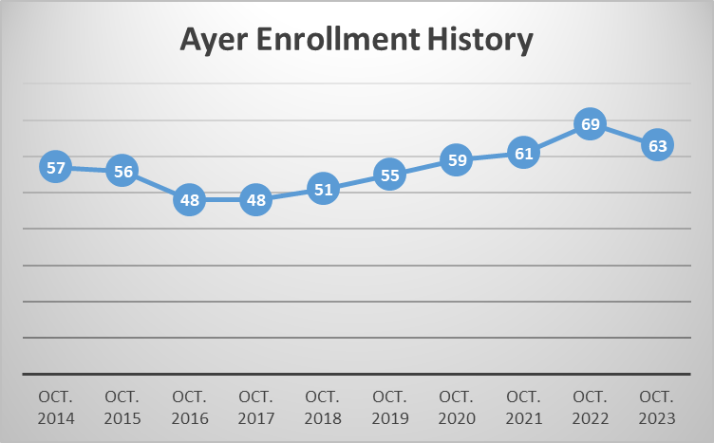
Enrollment History by Town
In 2022, Ayer had its highest enrollment at NT with 69 students.
Notes:
Updated MB 1/25

Slide 4
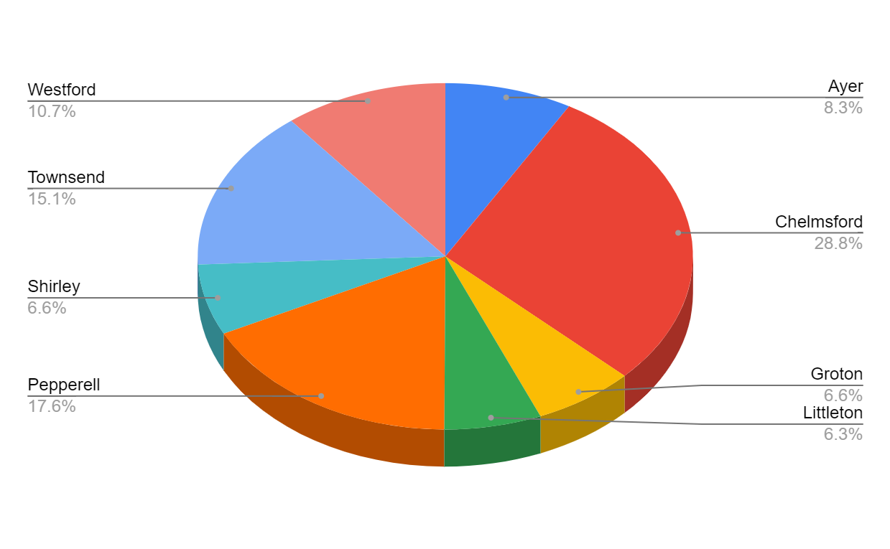
10/1/23 Town Enrollment Percentage
-6 Ayer
+6 Chelmsford
+9 Groton
+4 Littleton
+1 Pepperell
+6 Shirley
+20 Townsend
+2 Westford
+42 District Students
Notes:
UPDATED - MB 1/25

Slide 5
FY25 Budget Drivers
Increase in special education student needs
Additional special education staffing needs including case management, direct teaching support, paraprofessional support, & other BCBA and RBT support staff
Staffing contractual increases, including staff step and lane changes
Transportation costs, including special education transportation
Increase in cost of technical program instructional materials & equipment, building maintenance
Phase II Fire Suppression System replacement project
Increases in other vendor contracts and fixed costs

Slide 6
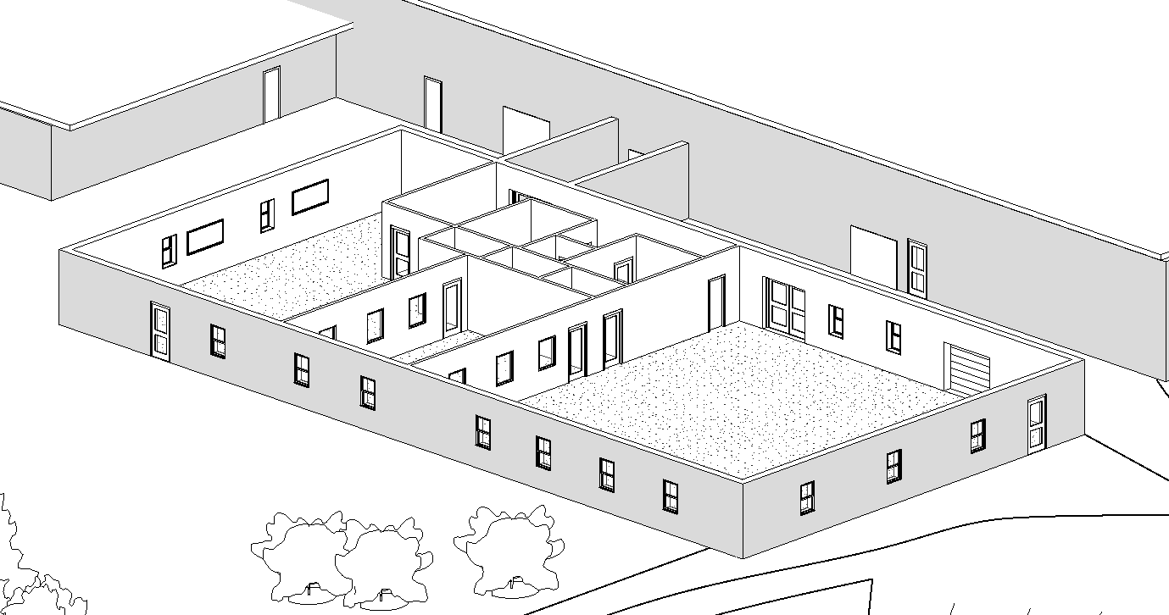
FY25 Anticipated & Future Savings
Technical program equipment and capital needs offset as a result of highly competitive Workforce Skills Capital Grant awards!
Recent Workforce Skills Grant Funding
Plumbing ($250,000)
Cosmetology ($500,000)
Veterinary Science & Electrical Technology ($2.5 million)
Engineering, Programming, & Robotics ($3.75 million)
Approx 7000 sq ft
Adjacent to
Adv Mfg

Slide 7
FY22 Per Pupil Expenditure Comparison
Technical School | Per Pupil Cost | Ranking (out of 29)
Minuteman | $34,177 | 1
Shawsheen | $26,175 | 6
Assabet | $24,814 | 11
Northeast | $24,070 | 15
Greater Lowell | $23,526 | 18
Montachusett | $22,714 | 22
Nashoba Tech | $21,587 | 26

Slide 8
FY 2025 Proposed Budget by State Function Code
General Fund Expenses |  | FY24 Voted | FY25 Proposed | Change $ | Change %
1000 Administration |  | 822,523 | 885,676 | 63,153 | 7.68%
2000 Instruction |  | 8,734,491 | 9,547,164 | 812,673 | 9.30%
3000 Pupil Services |  | 2,011,309 | 2,299,465 | 288,155 | 14.33%
4000 Operations and Maintenance |  | 1,716,199 | 1,791,901 | 75,702 | 4.41%
5000 Benefits and Fixed Charges |  | 3,022,993 | 2,997,199 | -25,795 | -0.85%
7000 Acq., Improve & Replace Assets |  | 375,000 | 400,000 | 25,000 | 6.67%
8000 Debt Retirement and Service |  | 602,000 | 573,150 | -28,850 | -4.79%
9000 Programs with other School Districts |  | 14,400 | 14,000 | -400 | -2.78%
Total General Fund Budget |  | 17,298,916 | 18,508,553 | 1,209,637 | 6.99%
Add. instructional Costs funded by School Choice fund |  | 332,588 | 345,562 | 12,974 | 3.90%
Total Budget (including School Choice fund) |  | 17,631,504 | 18,854,115 | 1,222,611 | 6.93%

Slide 9
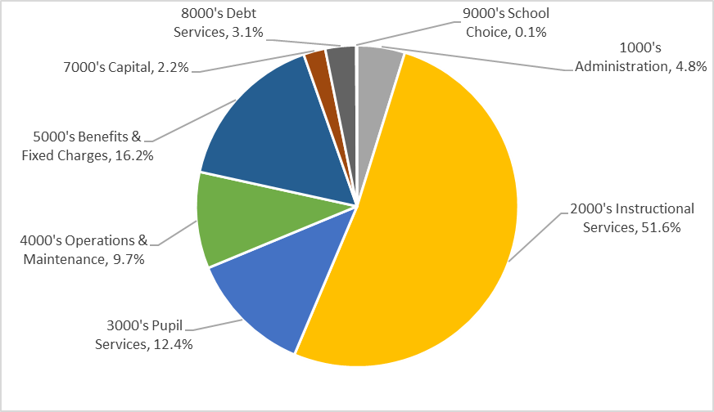
FY 2025 Proposed Budget by State Function Code
Notes:
Updated 1/30 MB

Slide 10
FY 2025 Estimated Revenue Plan
Non-Assessment Revenue: |  | FY24 Voted | FY25 Proposed | Difference | % Change
Chapter 70 School Aid |  | 4,701,934 | 4,841,689 | 139,755 | 2.97%
Chapter 71 Regional Transportation Reimbursement |  | 618,617 | 707,801 | 89,184 | 14.42%
Certified Excess & Deficiency |  | 438,816 | 461,556 | 22,740 | 5.18%
Total Non-Assessment Revenue |  | 5,759,367 | 6,011,046 | 251,679 | 4.37%
Assessment Allocation by Category:
Minimum Contribution |  | 9,846,166 | 10,717,650 | 871,484 | 8.85%
Transportation/Capital Equipment |  | 791,383 | 906,707 | 115,324 | 14.57%
Additional (Offset)/Assessment |  | 300,000 | 300,000 | 0 | 0%
Subtotal Non-Debt Assessments |  | 10,937,549 | 11,924,357 | 986,808 | 9.02%
Debt (Expansion/Renovation) |  | 602,000 | 573,150 | -28,850 | -4.79%
Total Member Assessment |  | 11,539,549 | 12,497,507 | 957,958 | 8.30%
Notes:
Updated 1/30 MB

Slide 11
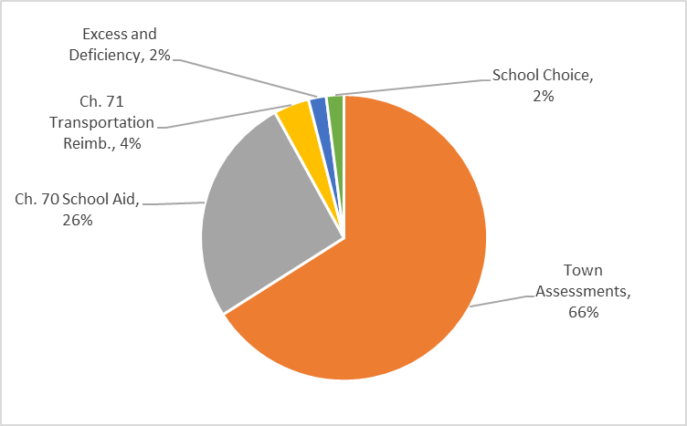
FY 2025 Estimated Revenue Plan
Notes:
Updated 1/30 MB

Slide 12
Fiscal Year 2025 Proposed Assessments by Member Town - updated 2.6.24
Town | No. of District Students | Students per Town Percentage | Town's Minimum Contribution | Transportation/ Capital Equip | Additional Assessment | Sub-total Assessment | Debt Service | Assessment 2024-2025
Ayer | 63 | 8.32% | 926,550 | 75,459 | 24,967 | 1,026,976 | 47,699 | 1,074,675
Chelmsford | 218 | 28.80% | 3,524,510 | 261,112 | 86,394 | 3,872,016 | 165,055 | 4,037,071
Groton | 50 | 6.61% | 849,159 | 59,888 | 19,815 | 928,862 | 37,857 | 966,719
Littleton | 48 | 6.34% | 781,285 | 57,493 | 19,023 | 857,801 | 36,342 | 894,143
Pepperell | 133 | 17.57% | 1,593,324 | 159,303 | 52,708 | 1,805,335 | 100,698 | 1,906,033
Shirley | 50 | 6.61% | 598,109 | 59,888 | 19,815 | 677,812 | 37,857 | 715,669
Townsend | 114 | 15.06% | 1,150,318 | 136,545 | 45,178 | 1,332,041 | 86,314 | 1,418,355
Westford | 81 | 10.70% | 1,294,395 | 97,019 | 32,100 | 1,423,514 | 61,328 | 1,484,842
 | 757 | 100.00% | 10,717,650 | 906,707 | 300,000 | 11,924,357 | 573,150 | 12,497,507
Notes:
Updated 1/30 MB

Slide 13
Total Assessment Comparison (FY24 Voted & FY25 Proposed)
 | # of Students | Town's Minimum Contribution | Transportation/ Capital Equip | Additional Assessment | Sub-total Assessment | Debt Service | Total Assessment
FY24 | 715 | 9,846,166 | 791,383 | 300,000 | 10,937,549 | 602,000 | 11,539,549
FY25 | 757 | 10,717,650 | 906,707 | 300,000 | 11,924,357 | 573,150 | 12,497,507
Change | +42 | 871,484 | 115,324 | 0 | 986,808 | (28,850) | 957,958
Driven by state funding formula
Notes:
9.27% increase in required minimum

Slide 14
Ayer Assessment Comparison (FY24 Voted & FY25 Proposed)
 | # of Students | Students per Town Percentage | Town's Minimum Contribution | Transportation/ Capital Equip | Additional Assessment | Sub-total Assessment | Debt Service | Total Assessment
FY24 | 69 | 9.65% | 973,253 | 76,371 | 28,951 | 1,078,575 | 58,095 | 1,136,670
FY25 | 63 | 8.32% | 926,550 | 75,459 | 24,967 | 1,026,976 | 47,699 | 1,074,675
Change | -6 | -1.33% | (46,703) | (912) | (3,984) | (51,599) | (10,396) | (61,995)
Driven by state funding formula
Notes:
Updated 1/30 MB
-5.45%
-5.45%

Slide 15
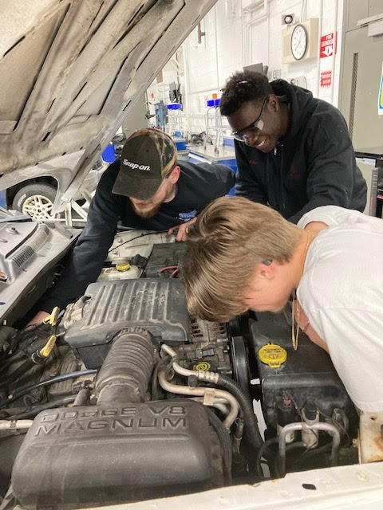
Career and Technical Initiative (CTI) Evening/Adult Programs
Fully funded state grant programs providing 200 hours of FREE workforce training to unemployed & underemployed adults
Automotive Curriculum includes: Inspection, brakes, alignment, electrical, transmissions, engines, and more! Industry credentials include: MA State Vehicle Inspector, Automotive Service Excellence (ASE), Valvoline, EPA 609, OSHA 10 General Industry, and Automotive Lift Institute
Plumbing Curriculum includes: Soldering, pipe connecting tools, threading machines (Wirsbo pex, Propress, Tracpipe, Watts pex, Shark Bites) & more! Industry credentials include: Plumbing Tier 1 (110 hours), Viega PP/MP/MPS, TracPipe and OSHA 10 Construction Safety
CNC/Machine Operator Curriculum includes: Manual mill & lathe operations, Haas CNC mill & lathes, blueprint reading, bandsaws, micrometers, height gauges, Prototrak mill, optical comparators and more! Industry credentials include: MACWIC Levels 1 & 2 and OSHA 10 General Industry
Electrical Curriculum includes: Hand & power tools, electrical code, wiring methods (lights, plugs, switches), measuring, sizing, cutting, bending, installation and more! Industry credentials include: HotWork, Ramset training, and OSHA 10 Construction Safety

Slide 16
Public Services at Nashoba Tech
Currently Open for Service!!
Automotive Tech & Collision Repair Services
Design and Visual Communications Services
Marketing program school store, online
Cosmo Cuts Salon
Programming and web services
Culinary Art’s Viking Bistro Restaurant
Notes:
UPDATED - MB

