Slide 1
Proposed Zoning Amendments April 22, 2024, Town Meeting

Slide 2
There are four (4) proposed zoning amendments:
The adoption of the updated Zoning Map reflecting the zoning changes that were approved at previous Town Meetings. (Warrant Article 25)
The adoption of amending §320-3.2. A. Establishment (ZBA) to include language showing the structure and how many members make up the ZBA. This was amendment was proposed by Town Counsel. (Warrant Article 26)
The adoption of amending §5.2 Table of Use Regulations. This was proposed by the Working Group that is trying to increase affordable housing within the Town of Ayer. (Warrant Article 27)
The adoption of amending the Inclusionary Housing Bylaw §320-10.3 Basic Requirements by adding language regarding guidelines for affordable multifamily new construction. This was proposed by the Working Group that is trying to increase affordable housing within the Town of Ayer. (Warrant Article 28)

Slide 3
Dates of meetings where this information was presented and discussed
January 19th – Affordable Housing Committee recommended to take Warrant Articles 26 & 27 to other Boards
February 6th – Select Board
February 8th – Conservation Commission
February 13th – Planning Board
February 21st – Zoning Board of Appeals
February 27th – Legal Notice for the March 12th Planning Board Public Hearing on the 4 Proposed Zoning Amendments runs for the 1st time in the newspaper.
February 28th – Ayer Housing Authority
March 5th – Legal Notice for the March 12th Planning Board Public Hearing on the 4 Proposed Zoning Amendments runs for the 2nd time in the newspaper.
March 6th – Select Board approved the 4 proposed zoning amendments as part of the warrant for TM.
March 12th – The Planning Board holds the public hearing on the 4 proposed zoning amendments. The Planning Board votes to recommend the 4 warrant articles to the April 22nd, 2024, Town Meeting.
April 2nd – The Select Board and Finance Committee approved the final Warrant Articles.
April 9th – Planning Board reviewed the finalized language for the 4 Zoning Amendment Warrant Articles

Slide 4
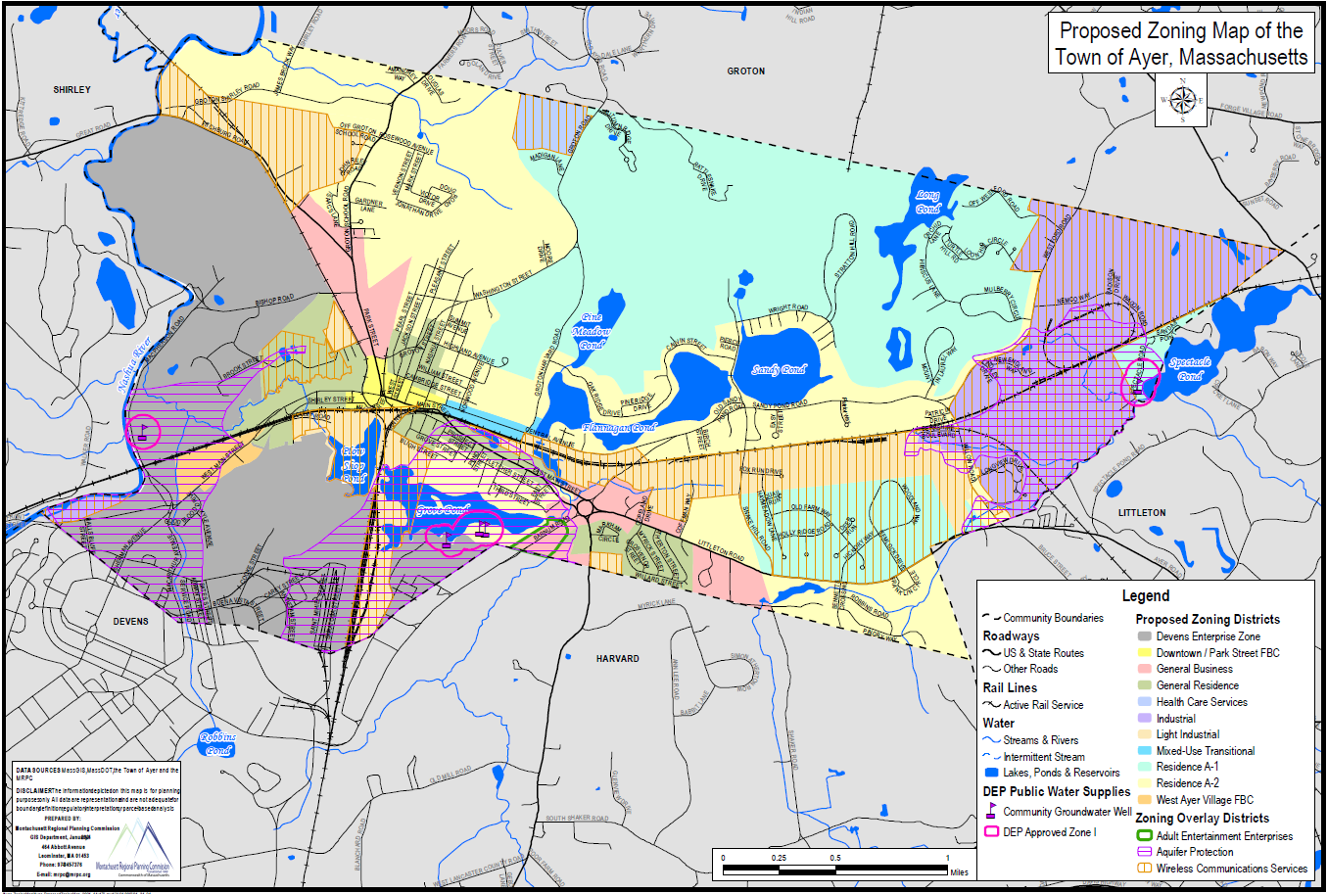
Warrant Article 25
Proposed Zoning Map

Slide 5
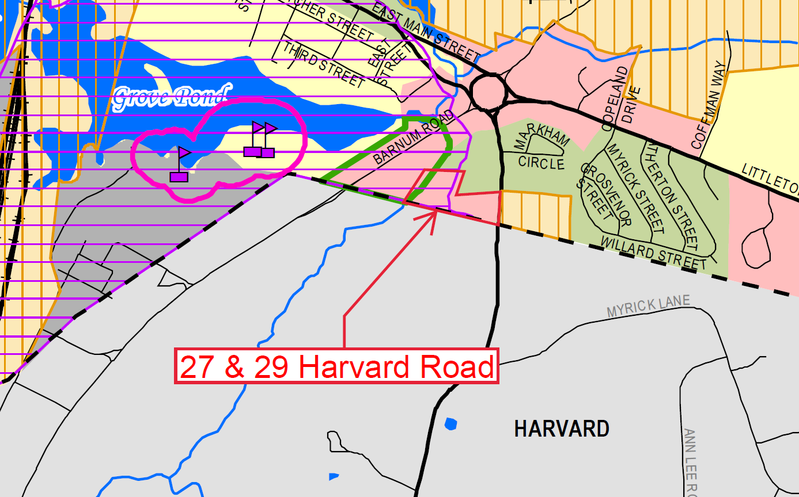
Revisions to the Zoning Map
The revisions made to the Zoning Map is shown highlighted in red.
29 Harvard Rd was rezoned from General Residence to General Business by Citizens Petition at the 10/25/21 TM.
27 Harvard Rd was rezoned from General Residence to General Business by Citizens Petition at the 4/25/22 TM.
Since the updated Zoning Map showing the rezoning was not adopted as part of these petitions, the rezoning did not legally occur. That is why we are adopting the revised Zoning Map showing the changes.

Slide 6
Proposed ZBA Bylaw Amendment (Warrant Article 26)
The current reading of §320-3.2. A. Establishment: “There is hereby established a Board of Appeals. Membership, appointments, and terms of regular and associate members shall be made in accordance with Chapter 40A of the Massachusetts General Laws.”
The proposed amendment: “There is hereby established a Board of Appeals. Membership, appointments, and terms of regular and associate members shall be made in accordance with Chapter 40A of the Massachusetts General Laws. The Board of Appeals consisting of five (5) members and two (2) alternate members, who shall be residents of the Town of Ayer, shall be appointed as provided by M.G.L. c40A §12.”
Town Counsel determined that we should specifically state how many members are on our ZBA because the state law just states that it can consist of 3 or 5 members. We have a five (5) member board with two (2) alternate members.

Slide 7
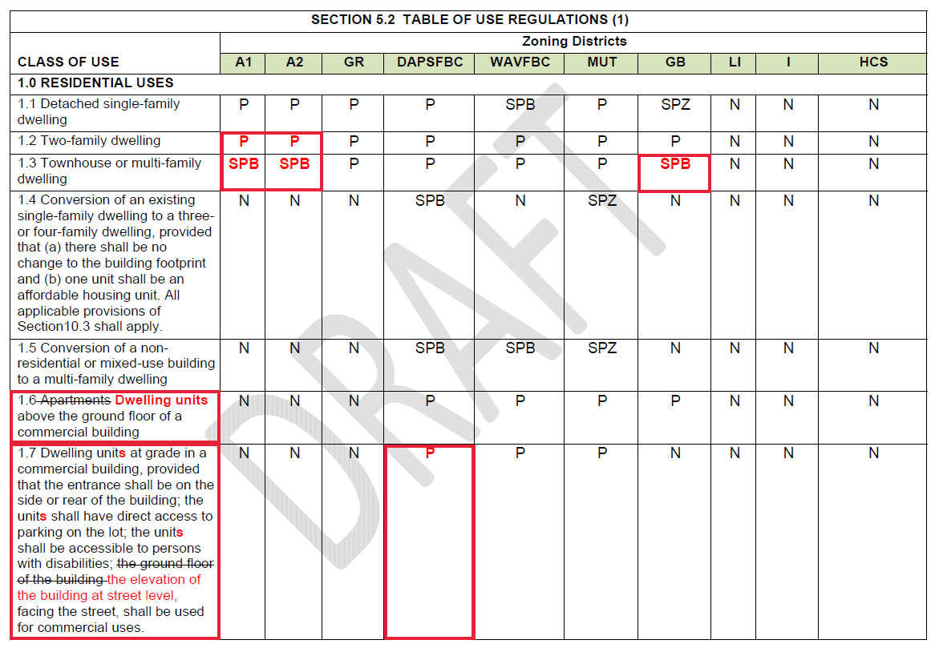
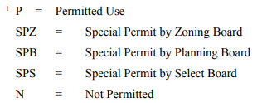
Proposed Amendments to the Table of Use Regulations (Warrant Article 27)

Slide 8
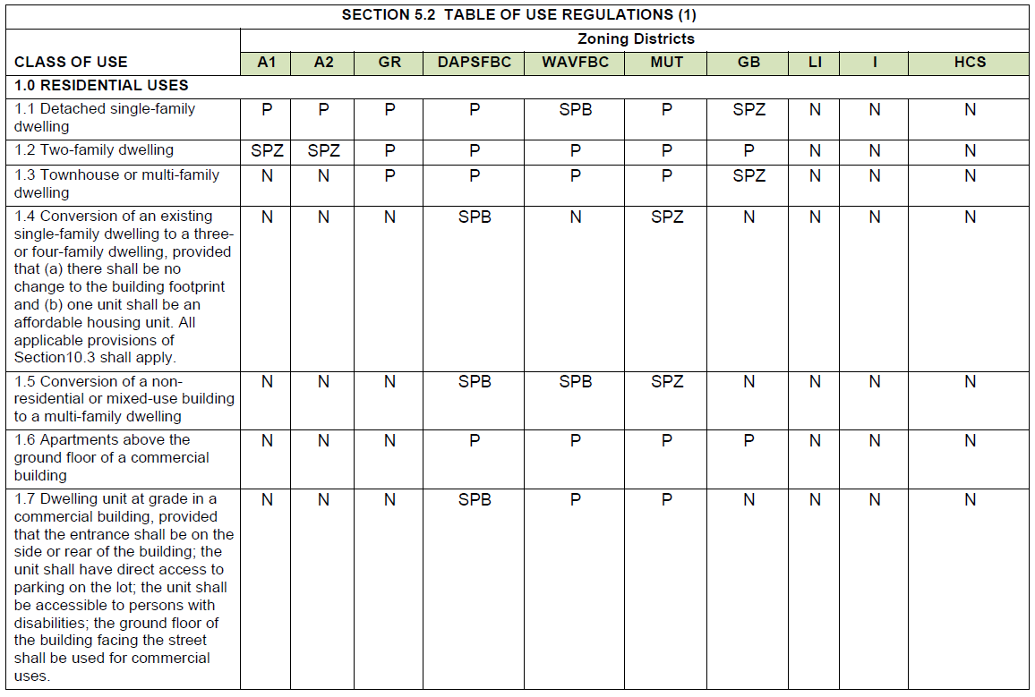
Proposed & Existing Comparison

Slide 9
Reasons for the Changes
The Town wants to encourage more affordable housing so that residents that want to downsize can sell their house and afford to stay in Town.
Two-family dwellings should be allowed by-right in the A1 & A2 zones which are specifically residential zones.
By-right in following zones GR, DPSFBC, WAVFBC, MUT, and GB
Allowing townhouse or multi-family dwellings in the A1, A2, and GB zones by Special Permit from the Planning Board will make some properties within those zones viable for multifamily construction. Projects that would propose more than 4 units would trigger the Inclusionary Housing Bylaw which would require a percentage of the units be affordable units at 80% AMI.
We proposed to change apartments to Dwelling Units because we do not have a definition for apartments, and this is more consistent with the rest of the Table of Use Regulations.
We proposed some clarification for 1.7 instead of using ground floor, we are proposing “the elevation of the building at street level”. We are also making 1.7 a permitted use in the DAPSFBC to consistent with WAVFBC which already has 1.7 as a permitted use.

Slide 10
Proposed Zoning Amendment to the Inclusionary Housing Bylaw (Warrant Article 28)
The amendment to the Inclusionary Housing Bylaw would add the following wording under §320-10.3.3. Basic Requirements:
“H. For design guidelines of preferred affordable multifamily new construction, refer to the “Massachusetts Multifamily New Construction Design Requirements & Guidelines” developed by BHDC, DND, MassHousing, and MHP.
1. The Planning Board shall have the authority to allow new construction of multifamily housing under Section 10.3 of the Ayer Zoning Bylaws to allow for the construction of new units to meet the Target Units Sizes referenced in Section 4.B “Design Guidelines for Units Layouts and Interior Dimensions”

Slide 11
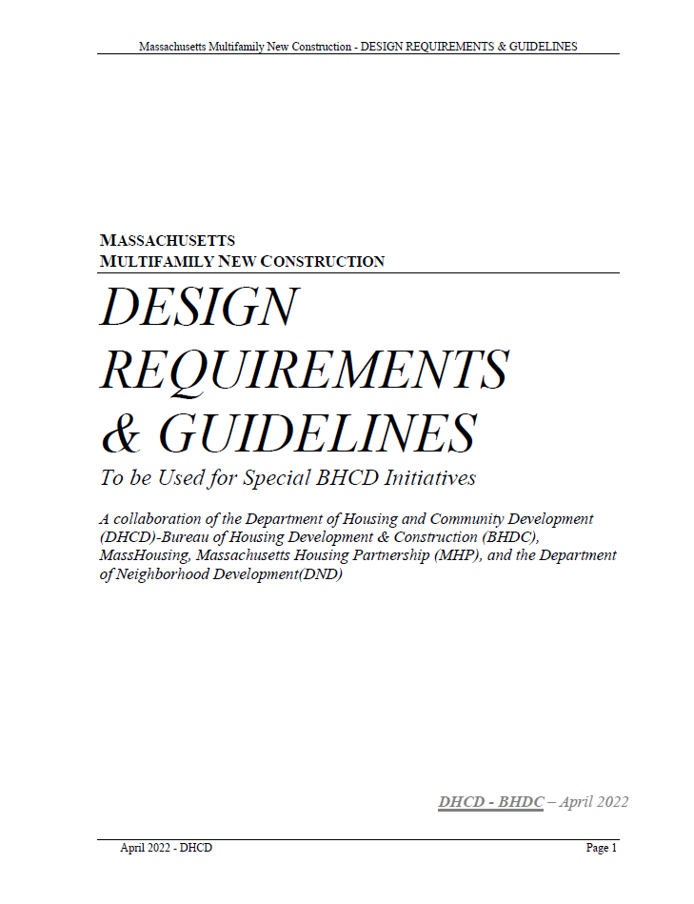
Reasons for the Proposed Amendment
§320-6.3. H. 1. ”Minimum floor area, dwelling units. All dwelling units except single-family houses shall provide a minimum habitable floor area as follows: (1) For a dwelling unit on one floor: 750 square feet.”
This requirement doesn’t allow for studio units or one-bedroom unit to be smaller than 750-sf. Studios units and one-bedroom units are typically smaller than that to make sure the unit is affordable to rent.
Massachusetts has a document that developers use when they are building multifamily new construction. The Planning Board would like follow state guidelines.
This proposal would ONLY allow projects that trigger our Inclusionary Housing Bylaw to be able to build units under the 750-sf minimum requirement.
This proposal will allow for more affordable units to be built in the Town of Ayer.
https://www.ayer.ma.us/sites/g/files/vyhlif2756/f/uploads/multifamily_new_construction_design_requirements_guideline_for_special_bhcd_initiatives.pdf

Slide 12
Thank You
Daniel Ruiz, Ayer Town Planner
druiz@ayer.ma.us
Office: 978-772-8220 x 144

