Slide 1
Warrant Article 4
The Ayer Police Department
Dispatchers Budget Line: 01231
Initial Starting Budget: $938,296.55
911 Support and Incentive Grant (Wages): (-) $354,867.00
911 Training Grant (Overtime): (-) $38,021.72
911 EMD Grant (Services): (-) $5362.50
Total (Requested Budget): $540,045.33
Town of Shirley Assessment*: $145,000**
Visual Reference of Budget With Shirley Assessment: $395,045.33*
Offsets
Budget
Supports
Budget
Notes:
Grants
- Offset / Reduces Budget
*Assessment Amount
Supports / Pays for Budget Through General Fund Receipts
Ayer Portion is for a Visual Reference only (the Assessment is Accounted for in Receipts)
**Town of Shirley Assessment
FY24 $145,000
Currently being renegotiated
2023
Total Calls: 35866
Total 911: 2726
Ayer
17022 / 47% Total Call Volume,
1637 / 60% 911 Call Volume

Slide 2
Warrant Article 4
Thank You

Slide 3
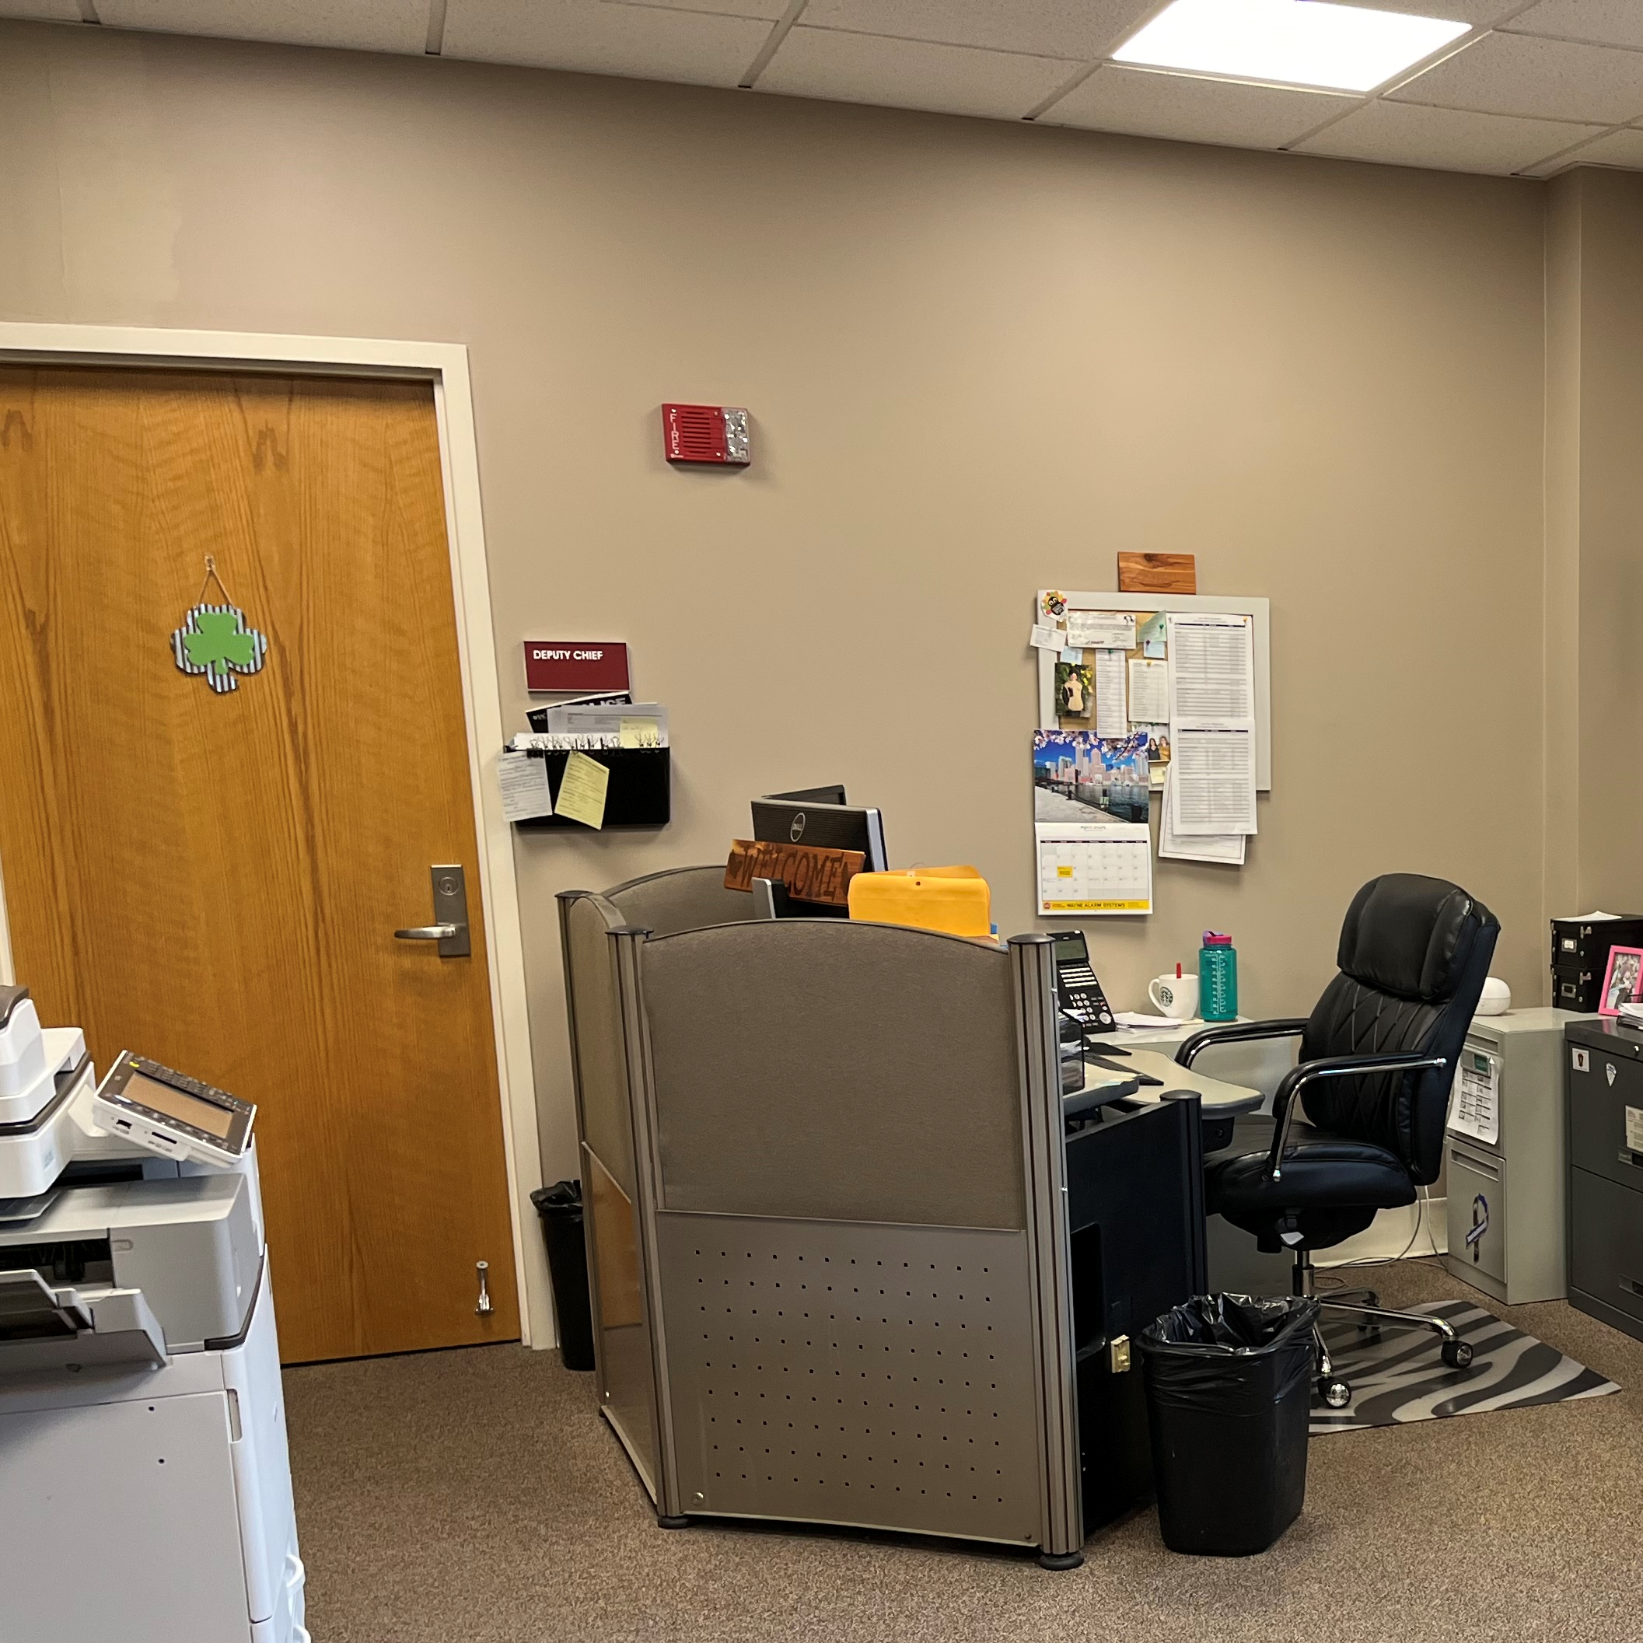
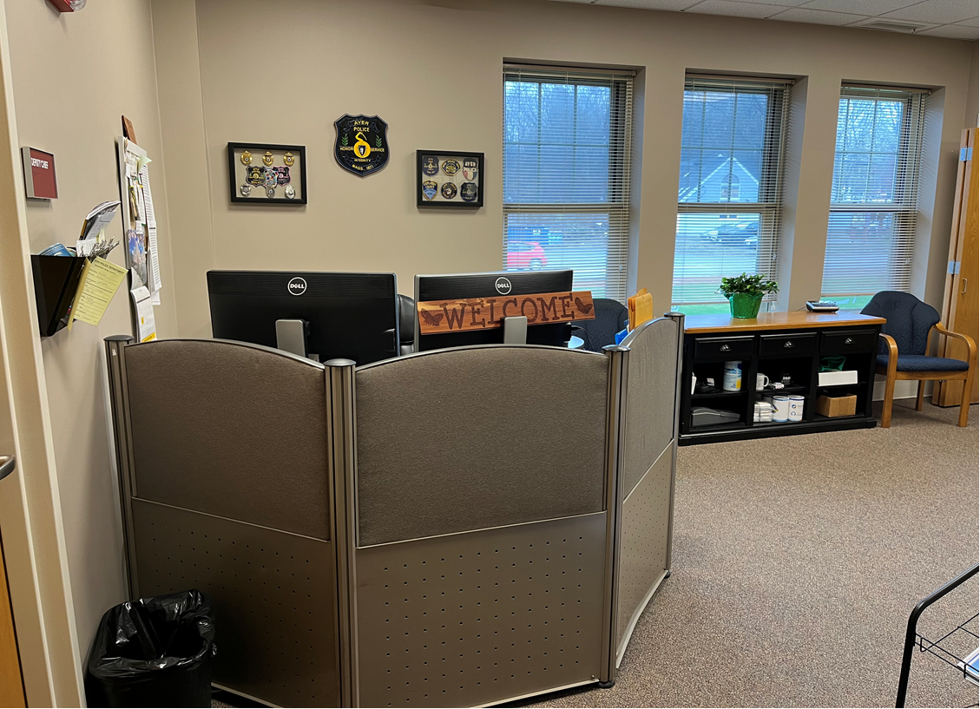
Warrant Article 11
Capital Budget Request
Update Administrative Wing Furniture
Main Office Area
Circa 1997 (27 Years Ago)
Showing Signs of Wear and Tear
Furniture is Not Ergonomically Designed
Main Office Area Is made Up of Repurposed Office Furniture
Office Spaces are Not Designed For Efficient Use of Space
File and Document Storage Challenges
Notes:
Office Manager furniture is from old dispatch furniture (from when it was upgraded)
Deputy Chiefs furniture is pieced together desk units
Document storage in all offices are cabinets stacked on top of each other

Slide 4
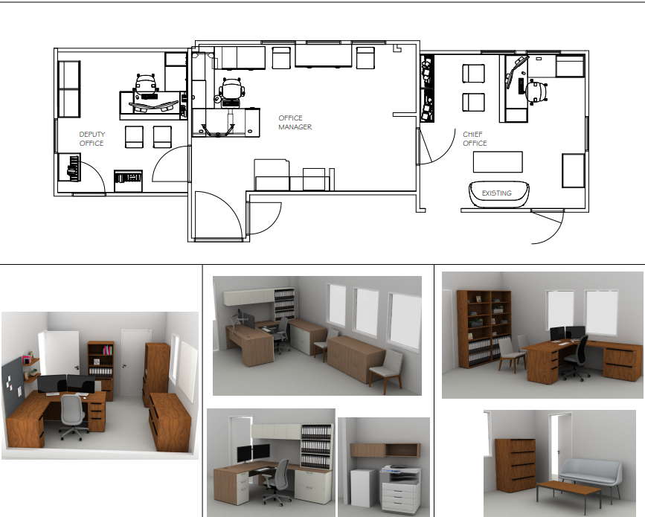
Warrant Article 11
Capital Budget Request
Update Administrative Wing Furniture
Proposed Redesign of Room
New Ergonomically Designed Furniture
Office Space has Been Designed for Efficiency
All Furniture is Professionally Coordinated
File and Document Storage System Improves Organization, Accessibility and Security
Notes:
This is in keeping in line with updating the building section by section
Patrol / Sgt Offices
Locker Rooms

Slide 5
Warrant Article 11
Capital Budget Request
Update Administrative Wing Furniture
Thank You

