Slide 1
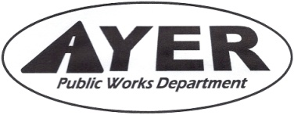
Department of Public Works Fall Town Meeting October 23, 2023
Presented by:
Dan Van Schalkwyk PE, DPW Director

Slide 2
Article 5 Street Acceptance
DPW recommends acceptance of the following subdivision roads:
Curley Circle
The Developer has completed his punch list except for the following:
Drainage improvements behind lots 1, 3, 5, 9
Finish Street Lights
MOU with SB to complete items above, $24,750 surety held
SB has 120-days from TM Vote to acquire street, Developer must complete items before then or no acquisition

