Slide 1
Ayer Master Plan Mission Statement
Ayer’s place as the “Great Junction” endows the community with its heritage, people, businesses, neighborhoods, natural and cultural resources. These assets provide the framework for Ayer to Be a diverse and inclusive community welcoming people to live, learn, work, and connect.

Slide 2
Town of Ayer Population Growth 2010-2020
TOWN | 2020 POPULATION | 2010 POPULATION | % CHANGE IN 10 YEARS
Massachusetts | 7,029,917 | 6,547,629 | 7.4%
AYER | 8,479 | 7,427 | 14.16%
HARVARD | 6,851 | 6,520 | 5.08%
GROTON | 11,315 | 10,646 | 6.28%
LITTLETON | 10,141 | 8,924 | 13.64%
SHIRLEY | 7,431 | 7,211 | 3.05%

Slide 3
What Qualifies as Low Income?
Federal Poverty Rate $14,580
Massachusetts Extremely Low-Income Rate $26,400
Ayer/Boston-Cambridge-Quincy Income Rates
Extremely Low-Income Rate $31,150
Low-Income Rate $51,950
Moderate-Income Rate $82,950

Slide 4
Ayer Household Income
$0 to $14,999 | 5.3%
$15,000 to $34,999 | 9.4%
$35,000 to $49,999 | 8.0%
$50,000 to $74,999 | 16.1%
Total Household under $74,999 | 38.8%
13.6% of Ayer Seniors (65 and older) are at or below the Federal Poverty Level
$75,000 to $99,999 | 10.5%
$100,000 to $149,999 | 24.3%
$150,000 to $199,999 | 11.0%
$200,000 or more | 15.4%
Total Household over $100,000 | 50.70%

Slide 5
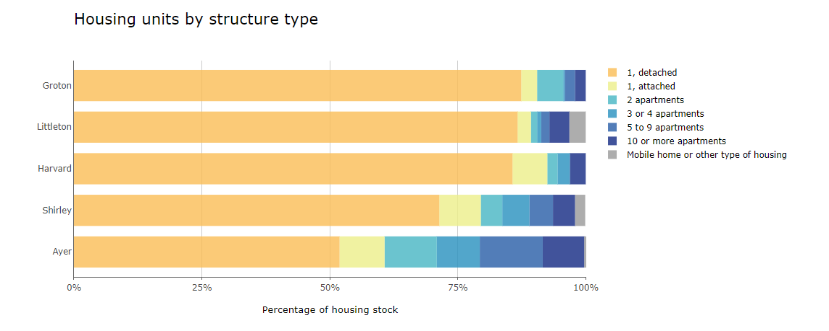
Housing Stock Comparison by Type
Ayer, Groton, Harvard, Littleton & Shirley
Mass Housing Partnership DataTown

Slide 6
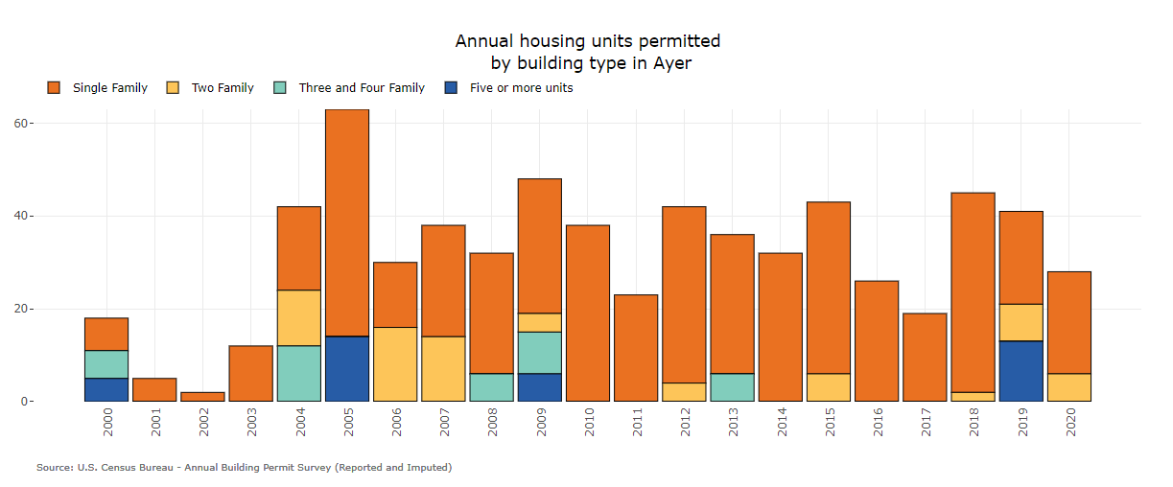
Mass Housing Partnership DataTown

Slide 7
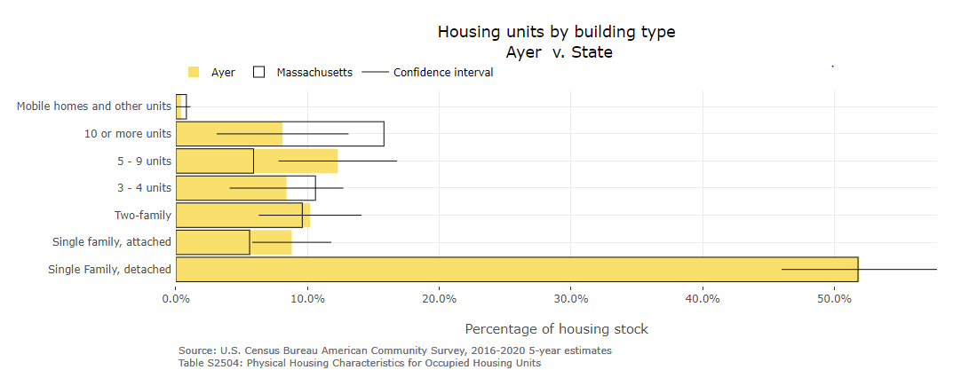
The Importance of Housing Diversity
A wide variety of housing types enables people of different means and at different stages of life to have viable housing options within a community.
Mass Housing Partnership DataTown

