Slide 1
Senior Center Building Update
March 15, 2023

Slide 2
Goals for Today
A brief recap of what’s been done so far
Where we are now
Moving forward together

Slide 3
Current Senior Center

Slide 4
Difficult to Find Limited Parking Unwelcoming Entrance
Senior Center Exterior:

Slide 5
Interior Staff Spaces
Lack of space and privacy needed for planning and collaboration
Lack of private areas for discussing finances, health, nutrition, and mental health issues, reducing requests for support

Slide 6
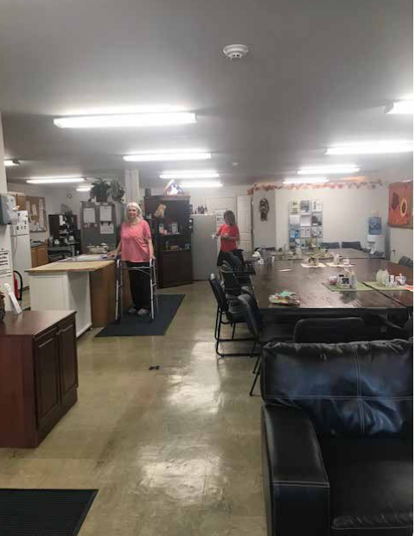
Interior Spaces
Lack of a commercial kitchen
Open kitchen detracts from comfortable dining
Living room area is limited in size and use
Bathrooms do not meet the needs of all seniors or ADA requirements
The limited size does not allow the diverse range of spaces & programs needed
The low ceilings and limited windows do not provide a warm and welcoming atmosphere
No large event spaces

Slide 7
What Seniors Want – We Heard You! Community Forum, September 2019

Slide 8
At The New Center, You Want…

Slide 10
A New “Center for Active Living”

Slide 11
Solutions
Diverse Program Space
Commercial Kitchen
Adequate Parking
Staff Areas

Slide 12
Challenge: Finding Suitable Land

Slide 13
Many Sites Have Been Considered
Sites considered size, location, availability, possible constraints & opportunities to support other town goals
Current Senior Center Location: 18 Pond Street TOO SMALL
99 Fitchburg Road SOLD
106 Park Street TRAFFIC CONCERNS
0 Brook Street PARCEL TOO SMALL
6 Groton Road OWNER NOT SELLING
115 Washington Street NOT AVAILABLE FOR YEARS
211 West Main Street ENVIRONMENTAL CONCERNS
Federated Church Site CHURCH/STATE; LOT SIZE; PROGRAMMATIC CHALLENGES
0 Park Street TRAFFIC; WETLANDS; ENVIRONMENTAL CONCERNS
Bishop Road Site TOO SMALL
0 Sandy Pond Rd OWNER NOT SELLING
59 Sandy Pond Rd SIZE; SPLIT BY WETLANDS
Grant Rd, Devens PROCEDURAL AND LOCATION CONCERNS

Slide 14
Request for Proposals Yielded No Additional Site Options

Slide 15
Back to the Drawing Board

Slide 16
Brainstorming…
Waiting for Page Hilltop
Waiting for Devens
Waiting for additional land for sale
Regionalization with ???
Collaborate to open up new land options
…Consensus

Slide 17
Partnership with Parks & Rec at Pirone Park
Parks Commission is excited to partner with seniors!

Slide 19
Partnership Benefits Seniors
Meet senior needs:
Right-sized building
Variety of programs & services
Convenient location
Ample parking
Seniors get facilities and programs that we cannot get with a stand-alone senior center.
Town-owned land = free
Scheduling: The schedules of seniors and Parks & Rec are complimentary. Each can have their own space and time when needed and collaborate when desired.

Slide 20
Potential Downsides
Lack of visibility from the road
Reduction in open space
Increased cost vs senior center alone
Rehoming existing field users – a plan is developing
Shared space (pro & con)
NOTE: Pirone Park location is contingent upon Parks & Rec request for a gym

Slide 21
Next Steps
Public input: Seniors, families, public
March 27: Selectboard update & create Building Committee
Building Committee works to:
Seek funding for conceptual plans
Oversee conceptual plan development
Additional public input
Finalize conceptual plans
Seek funding for “design development” (engineering & construction documents)
Oversee design development
Seek construction funding
Build
Enjoy!

Slide 22
What do YOU think?
Questions? Comments? Concerns?

