Slide 1
Informational:
Evaluation of a Stormwater Enterprise Fund
Ayer Stormwater Utility Advisory Workgroup

Slide 2
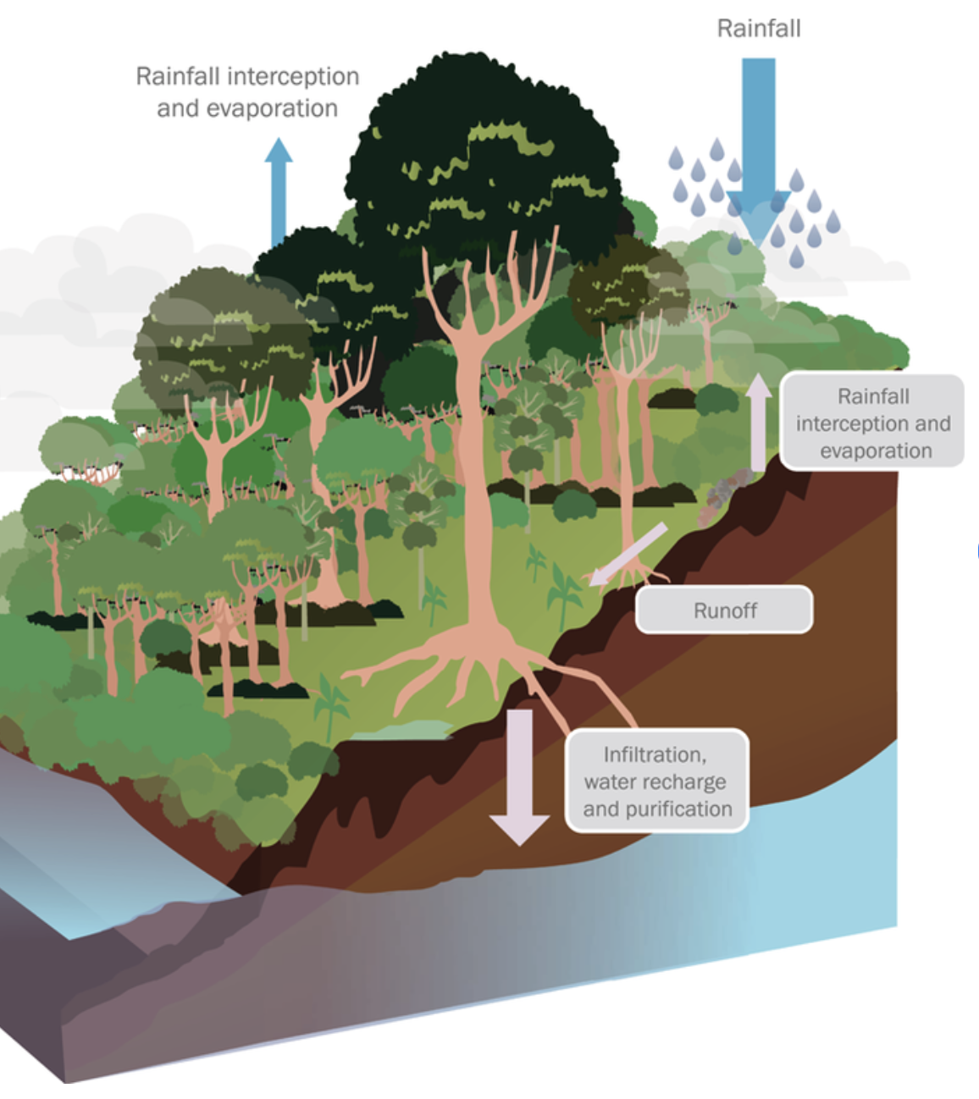
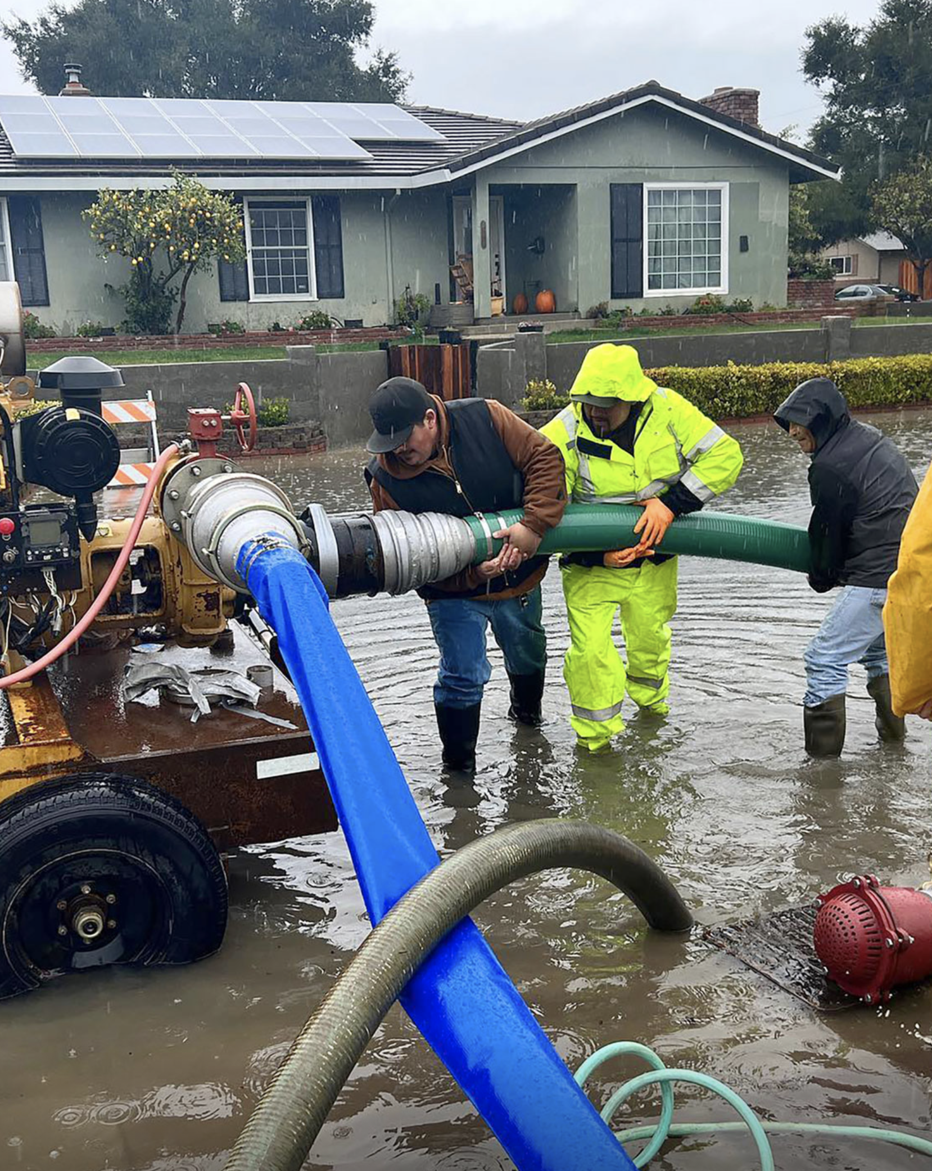
“Stormwater is just rain, right?”
vs.
Undeveloped land
Developed land
Notes:
Yes, stormwater IS rain, but…
The CONSEQUENCES of rain are profoundly different between natural, undeveloped land and developed, human-made landscapes. Undeveloped land manages water by itself, but developed land requires MANAGEMENT to protect people and property.

Slide 3
Ayer’s Responsibilities
Regulatory
Municipal Separate Storm Sewer System (MS4): Ayer is regulated by an EPA MS4 permit and must meet specific requirements and goals in its stormwater discharges and program
Infrastructure
22 miles of drainage pipe
1,082 catch basins
373 drain manholes
143 outfalls
84 culverts (totaling approximately 1 mile in length)
14 natural drainage conveyances
21 mapped treatment units and detention basins

Slide 4
Ayer’s Responsibilities

Slide 5
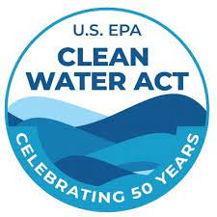
MS4 Program Overview
Since 2003, Ayer’s MS4 Stormwater Management Program has included:
Public education and outreach
Illicit discharge detection & elimination (i.e., water quality testing of the drain to find pollution)
Local oversight of construction sites
Local permitting for new development and redevelopment to control stormwater runoff
Good housekeeping and pollution prevention in municipal operations (e.g., system inspection and maintenance, street sweeping, catch basin cleaning)

Slide 6
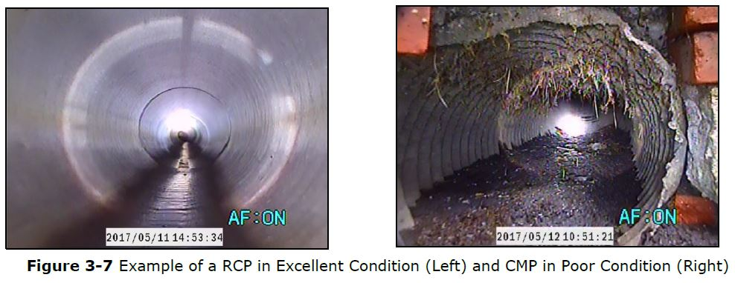
What We’ve Been Doing So Far
Historic Funding Approach
The Town has historically maintained it’s stormwater system by allocating funds in the Town’s General Fund (i.e., tax base)
Historic Maintenance Approach
The Town’s approach has been reactive, repairing infrastructure when it becomes a problem
The Town’s record information of its stormwater system is poor

Slide 7
What We’ve Been Doing So Far
Recent Events
2021-2022: Stormwater Asset Management Plan developed
Plan includes evaluation of a portion of the stormwater system to understand what is present
Plan provides an asset management-based approach (i.e., criticality) to proactively maintain the stormwater system
EPA mandates more stringent MS4 Permit in 2016, another expected within a year
Select Board and Town Meeting authorize funding to evaluate a Stormwater Enterprise Fund (aka “Utility” Fund)

Slide 8
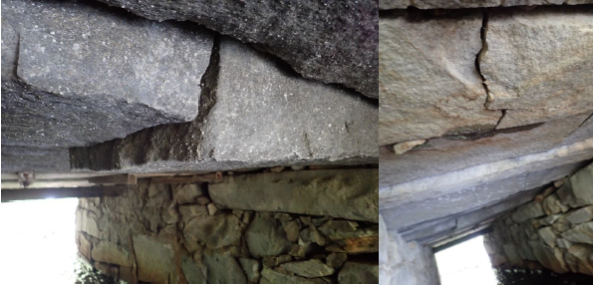
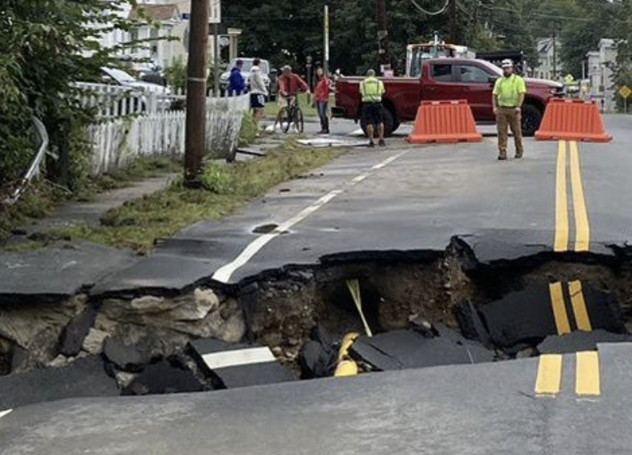
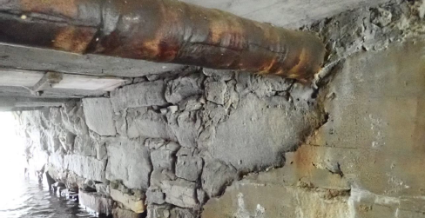
Why Now?
Risks are growing fast:
Anticipating impacts of climate change
Preserving homes and businesses
Maintaining transportation and transit
Ensuring economic continuity
Escalating infrastructure repairs
Culverts must be fixed or replaced
Culvert: Groton School Road over James Brook
Estimated Replacement Cost $3.0M
October 2023 floods devastated central MA
Notes:
In October 2023, we witnessed what a MODEST rainstorm could do: Lancaster, Leominster, Manchester, NH

Slide 9
Revenue Projections
Current budget (5-year average) = $355,000/yr
Next Five Years: significant increase in Capital and Operating
-Additional work needed to “right size” the program and revenue needs based on program goals

Slide 10
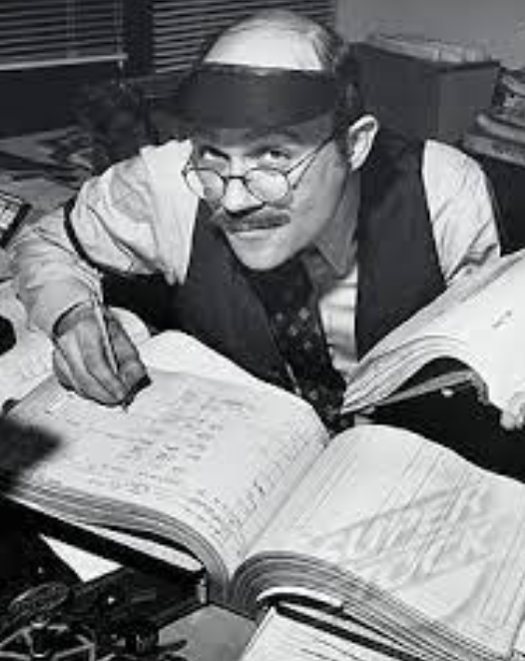
What are Ayer’s options?
Continue Funding through the General Fund (i.e., tax base)
Create an independent Enterprise Fund, similar to water and sewer utilities
Notes:
Lightly touch upon the pros and cons of each approach

Slide 11
Advantages of an Enterprise Fund
Sustainable, Long-Term Funding to Meet Program Goals
Asset Management Plan
Replacement value of Ayer’s drainage system is over $90 Million
Small MS4 General Permit
Expect more stringent requirements in the new Permit, expected for public comment this year
Benefits of a Stormwater Enterprise Fund
Stable: Dedicated revenue source for financial sustainability
Equitable & Fair: Based on stormwater impact vs. property value (taxes). Can include tax-exempt properties.
Flexible: Utility can pay for all aspects of the program
Credit Policy: Ability to provide a financial incentive for stormwater improvements on private property

Slide 12
Regional Stormwater Utilities
Not a New Concept: ~2,000 stormwater utilities in the U.S.
20+ in MA as of December 2022
Must be a clear nexus among Program Cost of Service, User Fees, and Customer Benefits
Impervious area is the most commonly used method to assess stormwater fees in the U.S.
Notes:
In Massachusetts, towns that have approved and launched an enterprise fund for stormwater include: Westford, Chelmsford, Pepperell, Shrewsbury, Newton, Reading, Milton, and many more.

Slide 13
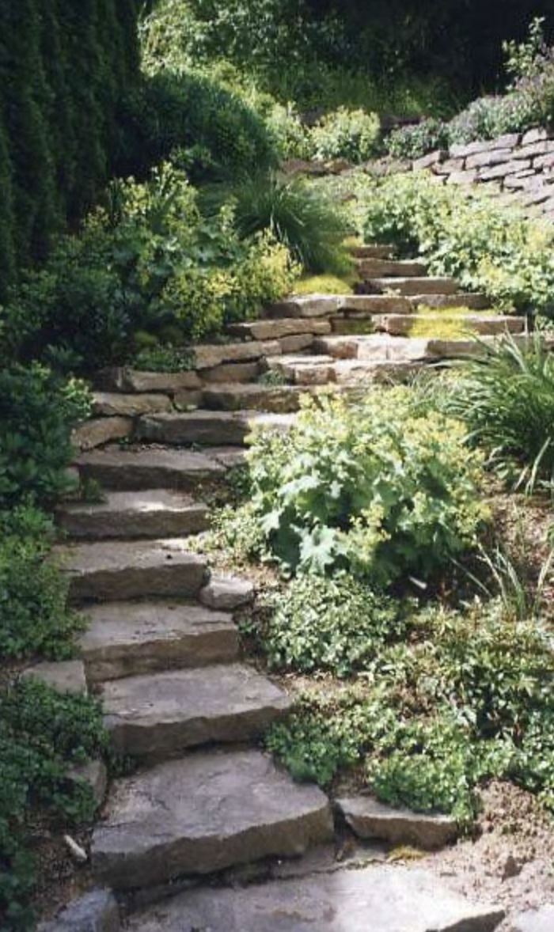
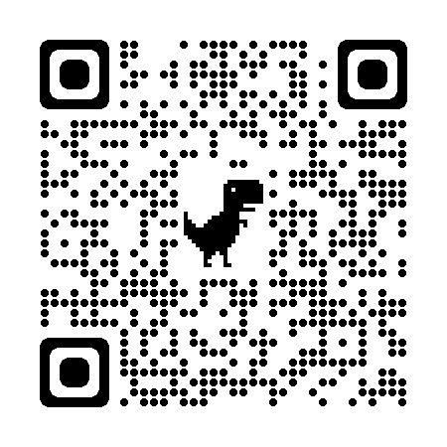
Next Steps and Timeline
Convene an Advisory Workgroup
Refine budget projections
Present rate structure alternatives for discussion
Town Counsel guidance
Bylaws, regulations & Town Warrant
Outreach plan & schedule
Develop & distribute educational materials
Stakeholder workshop
Additional meetings with the Select Board
CONSIDERATION: FALL TOWN MEETING 2024
DEVELOP CREDIT POLICY & ABATEMENT
Learn more at our website:
https://www.ayer.ma.us/storm-water-utility-advisory-workgroup
Notes:
Convene an Advisory Group: Suggested members include:
DPW Director
Town Engineer
Conservation Agent
Planning Board Member
Select Board Member
Local Business Leader
IPP Representative
TM Office Representative
Citizens & Residents (3)
Outreach Plan & Schedule
Develop & distribute educational materials
Hold a Stakeholder workshop
Identify target audience and dates
Ideally in July or August
Meeting with Select Board in early September

Slide 14
Additional Information
The Workgroup is meeting monthly in hybrid format open to the public
Additional information, including FAQs, can be found on the Workgroup’s website: https://www.ayer.ma.us/storm-water-utility-advisory-workgroup
Please join us on February 28th at 6:00PM at the Ayer Library for a presentation related to the importance of stormwater by Stefanie Covino of the Blackstone Watershed Collaborative!
Notes:
Convene an Advisory Group: Suggested members include:
DPW Director
Town Engineer
Conservation Agent
Planning Board Member
Select Board Member
Local Business Leader
IPP Representative
TM Office Representative
Citizens & Residents (3)
Outreach Plan & Schedule
Develop & distribute educational materials
Hold a Stakeholder workshop
Identify target audience and dates
Ideally in July or August
Meeting with Select Board in early September

Slide 15
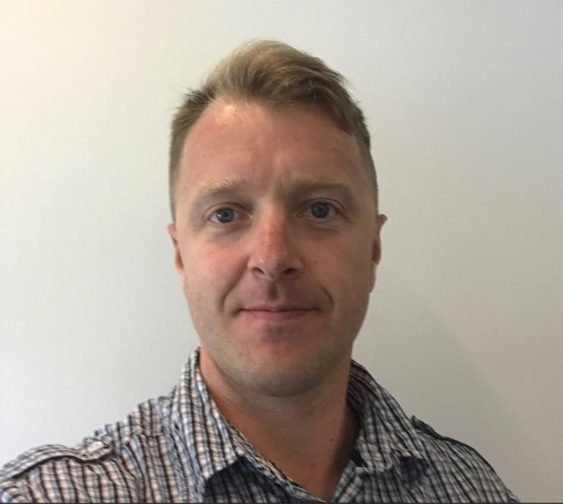
Contact
Questions for the Workgroup can be sent to Dan Van Schalkwyk:
Dan Van Schalkwyk, P.E.
DPW Director
dvanschalkwyk@ayer.ma.us
978-772-8240
Notes:
Convene an Advisory Group: Suggested members include:
DPW Director
Town Engineer
Conservation Agent
Planning Board Member
Select Board Member
Local Business Leader
IPP Representative
TM Office Representative
Citizens & Residents (3)
Outreach Plan & Schedule
Develop & distribute educational materials
Hold a Stakeholder workshop
Identify target audience and dates
Ideally in July or August
Meeting with Select Board in early September

