Slide 1
The Need for a New Senior Center
November 16, 2023

Slide 2
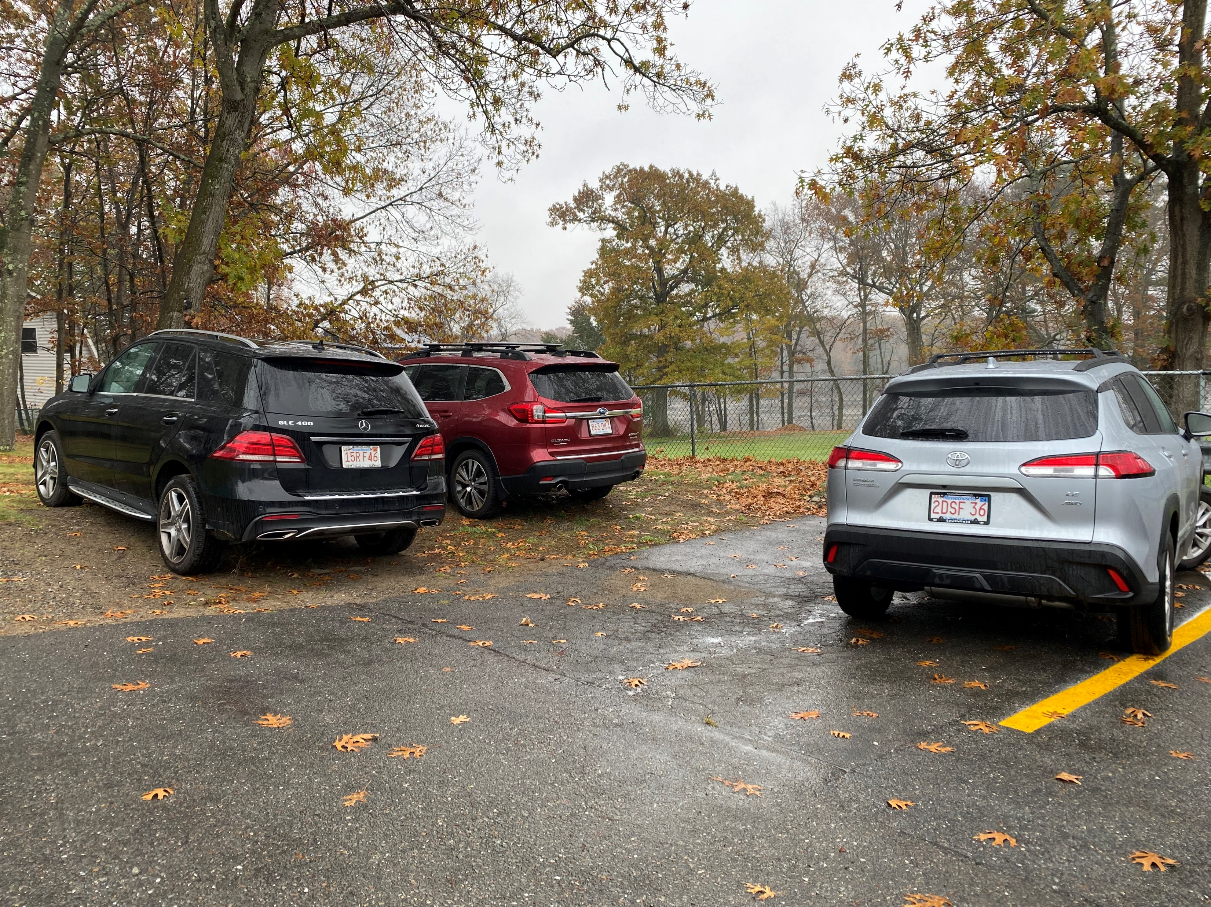
Difficult to Find Limited Parking Unwelcoming Entrance Not ADA Compliant
Senior Center Exterior
Notes:
Difficult to find: Poor street signage, tucked away in basement of housing authority. Caterers get lost, Amazon gets lost, new attendees get lost
Limited parking: Staff park in the grass or at Pirone Park, which isn’t viable in the winter
Unwelcoming entrance: Not recognizable from the side as you approach, door is not ADA compliant and walk into empty hallway. Wasn’t designed for this use.
Not ADA compliant: Narrow door that doesn’t open properly, large threshold, narrow hallway challenging for walkers and wheelchair users

Slide 3
Interior Spaces Lacking
General
Size limits the diversity and range of programs
Low ceilings and limited windows deflate atmosphere
Temperature control concerns
No large event space
Kitchen
No commercial kitchen
Open kitchen detracts from comfortable dining atmosphere
Living Room
Limited in size and use
Bathrooms
Doesn’t meet the needs of seniors
Not ADA compliant
Notes:
One program at a time means not enough hours to cater to young seniors and older seniors. Exercise example re strenuousness.
Poor air flow means hot in summer and winter
Lack of commercial kitchen makes for popular but expensive meals program
Story of senior stuck in bathroom

Slide 4
Interior Staff Spaces
Lack of space and privacy for planning & collaboration
Lack of private areas for discussing confidential senior matters
Notes:
Wall not to top = loud workspace
Lack of private areas for discussing finances, health, nutrition, and mental health issues, thus reducing requests for support
Can’t all be on the phone or seeing someone

Slide 5
“Center for Active Living”
1.5 – 2.0 acre parcel
10,000 – 15,000 sq ft building
Diverse program space
ADA compliant
Adequate parking
Commercial kitchen
Productive staff areas

Slide 6
Progress to Date
2019-2020: Senior Center Feasibility Study & the tabling of West Main St
2022: Site Selection Working Group advanced the search for land for a Senior Center
Dec 2022-Sept 2023: Exploration of a combined Senior Center and Community Center at Pirone Park (not viable)
Sept 2023: Select Board appointed the Senior Center Site Selection and Building Committee

Slide 7
Challenge: Finding Suitable Land
Many sites considered
Public Request for land

Slide 8
Many Sites Considered
Evaluated based on size, location, availability, possible constraints and opportunities
Current Senior Center Location: 18 Pond Street Too Small
99 Fitchburg Road Sold
0 Park Street TRAFFIC; Wetlands; Environmental Concerns
106 Park Street Traffic Concerns
0 Brook Street Parcel Too Small
6 Groton Road Owner Not Selling
115 Washington Street Not Available For Years
211 West Main Street Environmental Concerns
Federated Church Site Church/State; Lot Size; Programmatic Challenges
Bishop Road Site Too Small
0 Sandy Pond Rd Owner Not Selling
59 Sandy Pond Rd Size; Split By Wetlands
Grant Rd, Devens Procedural And Location Concerns
McPherson Road, DPW Land Potential Environmental Concerns

