Slide 1

FY25 Through FY29 Capital Improvement Program
Engineering, Highway and Stormwater Requests
Ayer Department of Public Works
Presented
November 30, 2023

Slide 2
DPW Capital Improvement Plan Objectives
The Ayer DPW continues to be committed to the ongoing maintenance and repair of capital assets, recognizing the critical value of civic infrastructure to the economic, aesthetic and functional viability of the Town.
The Five-Year Capital Improvement Plan includes projects that continue major rehabilitation of Town assets and new investments in capital infrastructure.

Slide 3
Capital Project Criteria
Proposed Ayer DPW Capital Improvement Program is based on:
  Regulatory Requirements
  Public Safety and Public Health
  Maintaining Level of Service (Asset Management Based Approach)
  Reducing Operations Costs
  Integration With Other Town Projects
  Implementing resiliency and sustainability in infrastructure
  Grant Funding Opportunities
  Promoting Economic Development
  IMPROVING THE COMMUNITY

Slide 4
DPW Capital Challenges
Aging Infrastructure
  Reliable water supply is critical to our community
  Water pipes 120 years old
  Sewer pipes 70 years old
  Drainage pipes are various ages, materials and sizes
  Bridges and culverts deteriorating
  WWTP built in 1982
  DPW Highway Garage built in 1970
  Main Street was reconstructed in 1985
Road & sidewalk improvements funded with Chapter 90, annual capital budget and other grants
American Rescue Plan Act (ARPA) and Infrastructure Investment and Jobs Act are potential opportunities for Ayer

Slide 5
DPW Capital Challenges
PFAS Contamination of water supply has had a significant impact on the DPW capital and operating budgets as well as staff time
Wastewater Discharge Permit issued by EPA with New Limits and Collection System Requirements – effective November 1, 2022
  WWTP Upgrades
  Collection System and I/I Improvements
2018 Stormwater Permit was issued by EPA, new Permit soon
  Outfall Improvements
  Drainage Infrastructure
DPW applies for grants to reduce costs
DPW performs in-house engineering and value engineering to reduce costs & save money

Slide 6
DPW Capital Challenges
Current economic conditions
  Inflation / Cost Increases
  Supply Chain
  Difficulty Hiring
  Bidding Climate

Slide 7
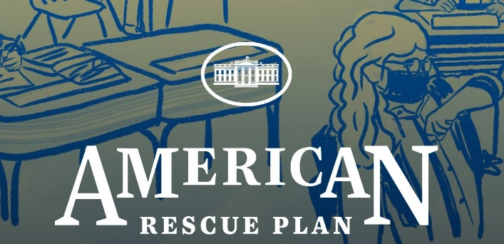
American Rescue Plan Act (ARPA)
Potential uses of ARPA funds:
Uses are now very broad, previously was limited
Total Ayer ARPA Funds = $2,449,840*
Current Unallocated balance = $1,144,669.35
History of Allocation:
Up to $600,000 – Spectacle Pond Transmission Replacement COMPLETE ($39k under)
Up to $700,000 – Westford Road Sewer Replacement COMPLETE ($450k under)
Up to $600,000 – Sandy Pond Road Sewer I/I
Up to $300,000 – Grove Pond Clearwell Project
Up to $150,000 – Senior/Community Center Project design/engineering/due diligence
*Must be committed by December 31, 2024 and spent by December 31, 2026

Slide 8
Infrastructure Investment and Jobs Act (IIJA)
Which projects qualify for funding?
Roads, Bridges, & Major Projects: $110B
Passenger and Freight Rail: $66B
Safety and Research: $11B
Public Transit: $39.2B
Broadband: $65B
Airports: $25B
Ports and Waterways: $17.4B
Water/Wastewater/Stormwater Infrastructure: $54B
Power and Grid: $65B
Resiliency: $46B
Low-Carbon and Zero-Emission School Buses & Ferries: $7.5B
Electric Vehicle Charging: $7.5B
Reconnecting Communities: $1B
Addressing Legacy Pollution: $21B

Slide 9
Outside Funding of Note
SS4A (Safe Streets for All) – MRPC has grant to produce an action plan for its communities, resulting in future implementation grants
MassDOT Small Bridge Grants – to be discussed in future slide
Green Community Energy Grant – Energy efficiency projects at DPW buildings
MassEVIP – Grant submitted for EV infrastructure at DPW
US Army for PFAS Treatment at Grove WTP
Complete Streets - $500k for Sandy Pond Rd Project
Continue to follow available grants and use resources such as Congresswoman Trahan’s Office and monthly informational meetings from Commonwealth

Slide 10
What Did We Do Last Year?
Replaced poor condition water main on Third Street
Completed West Main Street Reconstruction (MassWorks Grant)
Completed Stormwater Asset Management Plan
Substantially constructed Main Street light replacement
Designed and bid I/I rehab of Sandy Pond sewer trunk main
Obtained grant and designed Sandy Pond Road Complete Street
Replaced sidewalks, curbing and repaved portions of Pheasant Circle, Loon Hill Road, and Bennetts Crossing
Began evaluation of Stormwater Utility Fund
Substantially construction of Phase 3 Wastewater Treatment Plant upgrade
Designed and bid Wright Way Pump Station upgrades
Completed emergency sewer trunk main repair on Main Street
Implemented a 4-way stop at Central Ave and Groton Harvard Road
Notes:
Replace poor condition water main on Third Street
Procured and contracted with an engineering firm to design and bid the Washington St Storage Tank rehabilitation
Awarded a contract to install new valves at the Main and Central Pump Stations
Procured and purchased a new mobile generator for Water and Wastewater Divisions
Awarded a contract to replace the two boilers at the Wastewater Treatment Plant
Awarded a contract to rehabilitate a sections of W. Main Street and Sandy Pond Road for I/I control
Received parts to replace valves at one of two Grove Pond Greensand Filters
Completed the replacement of an Impeller and Volute at Main Pump Station
Significant completion of the Phase 3 Wastewater Treatment Plant upgrade

Slide 11
What Did We Do Last Year?
Designing Main Street TIP Project
Performing design of Barnum Road Bridge repair
Implementation of Tree Management Plan
Operated Woodlawn Cemetery, conducted 15 burials in 2023 and sold 13 lots since April 2022
Assisted Parks Department with Kiddie Junction Playground replacement
Assisted Conservation Commission with Flannagan Pond Public Access Study

Slide 12
Ongoing
Capital

Slide 13
West Main St Bridge Brief Update
Current Status of Funding:
  MassDOT Small Bridge Grant 2022 = $500,000
  MassDOT Small Bridge Grant 2023 = $500,000
  Local Appropriation 2023 = $3,000,000
  Remaining Prior Local Appropriations = ~$1,000,000
  Total Funding = ~$5,000,000 (Note: any outside funds will reduce amount of local funds borrowed for project)
  Awaiting potential earmark from Congresswoman Trahan’s office
  Continue to seek outside funding sources

Slide 14
West Main St Bridge Brief Update
Current Status of Bidding:
  Two required items before bid
    Utility Coordination
    Re-Permit Environmental
  Utility Coordination:
    Several meetings since Spring with utility companies, at a point where close to final and will deal with additional coordination as we continue with bid
    Of note, coordination was never completed prior to 2020 bid. Utilities are significant and complex: Overhead electric, fiber, communications, fire – underground communications (14 conduits), gas (one high pressure and two low pressure), water, sewer, drain
  Re-Permit Environmental:
    Submission of re-permitting ongoing, awaited results of utility coordination incase need to include changes
  Bid timeframe
    Bid likely advertise in December/January, open in February/March, construction April/May start

Slide 15
DPW General Fund Capital Plan
Engineering Division

Slide 16
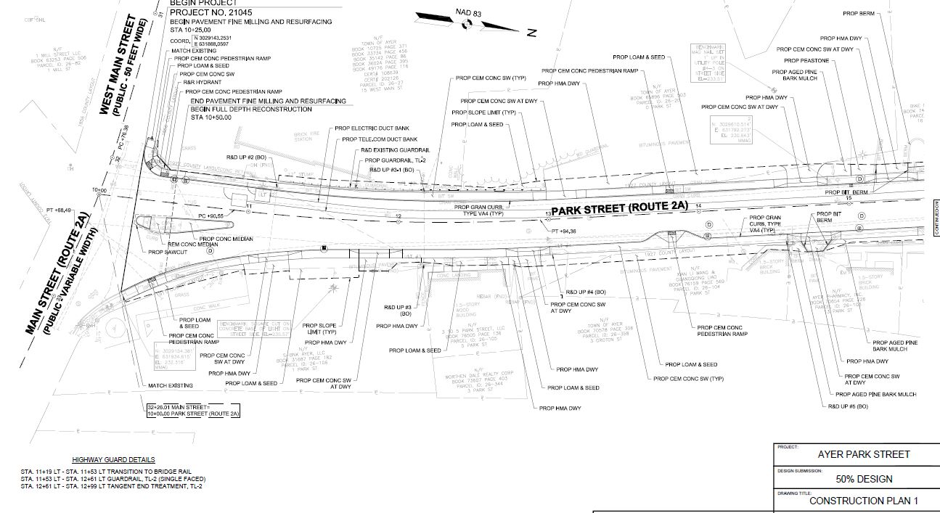
Park Street Improvement Project
Final Design

Slide 17
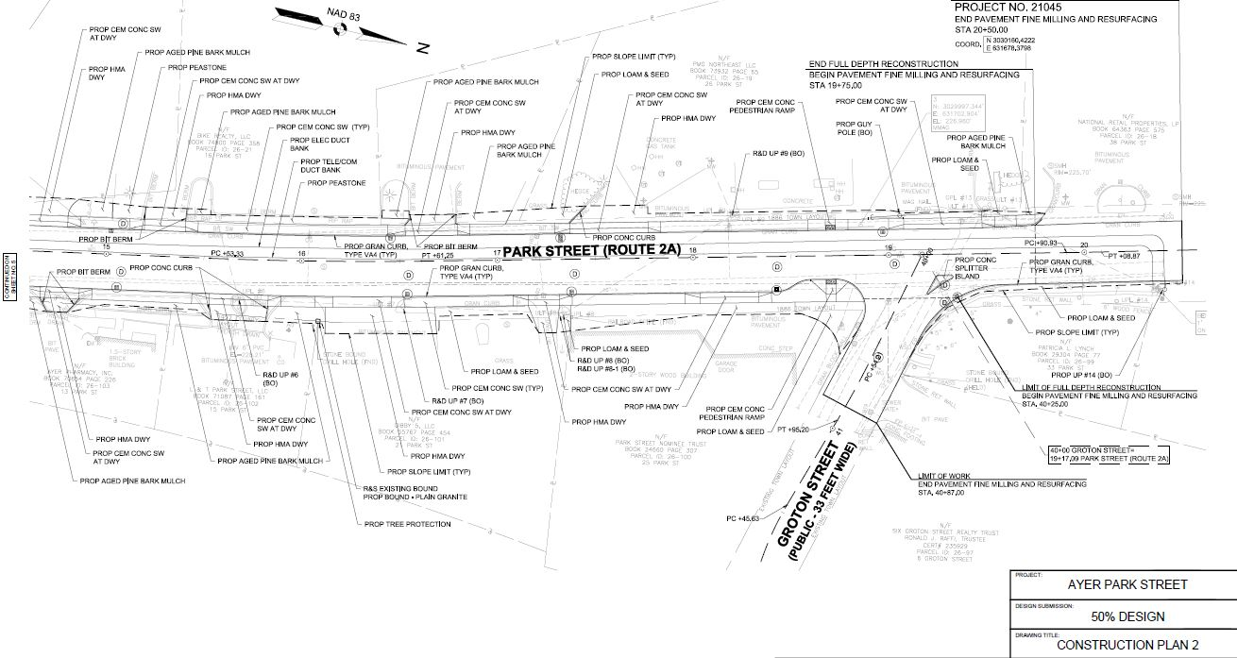
Park Street Improvement Project
Final Design

Slide 18
Park Street Improvement Project
Final Design
Current Status:
  Project includes undergrounding of electric/other overhead, reconstruction of water, sewer, drain, and new streetscape
  Project limit is from Main Street to Groton Street (Form Based-Code)
  Town received Housing Grant and completed 50% design
AOCED applying for MassWorks Grant for construction funds, Town required to pay for design
Price
  Awaiting proposal from design consultant, estimated price from original proposal.

Slide 19
DPW General Fund Capital Plan - Highway Division

Slide 20
Road Paving $95,000
Road Paving funding is currently from MassDOT Chapter 90 and Town Capital Appropriation
Annual Chapt 90 amount = $240K
Ayer Pavement Management Model (Predictor)
  Town wide PCI = 72 (out of 100)
  Predictor Pavement Model indicates a budget of $325,000 will raise PCI to 80 (acceptable) by 2029 and then likely maintain via Chapter 90
Additional funding will allow us to keep up with the Town needs
Paving/preservation projects include Third St, West Main Street, Shaker Road, Cambridge Street

Slide 21
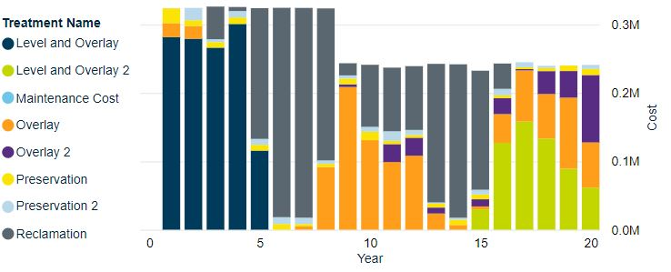
Road Paving $95,000

Slide 22

Municipal Tractor / Sidewalk Snow Blower
DPW has two (2) municipal “tractors” that are used for mowing, sidewalk plowing/blowing, and sidewalk sweeping.
The equipment includes:
• 2009 M-B MSV (Multi Service Vehicle)
• 2017 Trackless MT-7
These tractors get a lot of use in the summer and winter. Unfortunately, M-B stopped producing their sidewalk equipment and no longer produces parts for the M-B MSV, therefore, any significant part failure will likely cause the M-B to no longer be useable.

Slide 23
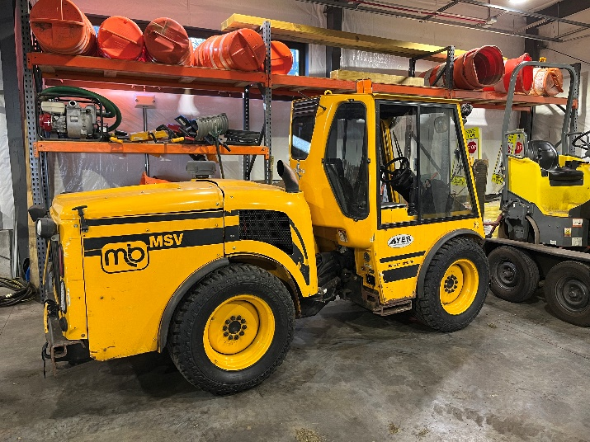
Municipal Tractor / Sidewalk Snow Blower
Maintain level of service and speed at which sidewalks are cleared after snow. Have redundancy.
Also used for sweeping and flail mowing, removing snow from parking lanes and widening roadways narrowed by snowbanks
Price
  Original price was based on 2017 quote escalated. Obtained new budgetary quote.
  Recommend changing request from $175,000 to $190,000

Slide 24
DPW General Fund Capital Plan
Stormwater Capital Plan

Slide 25
Stormwater Capital Concerns
Stormwater Asset Management Plan Completed November 2022
  MVP High Priority Item
  Grant funded
  Data-driven process to maintain stormwater utility
  Proactive vs reactive
Process included desktop review, limited/select field reconnaissance, asset management ranking and analysis
Stormwater records were poor, now we have a good handle on what we have and how to deal with it

Slide 26
Stormwater Capital Concerns
Several High Priority replacements (high criticality)
Begin with design/permitting – seek outside funding opportunities (BIL)
Prices are based on the Stormwater Asset Management Plan OPCC developed by consultant

Slide 27
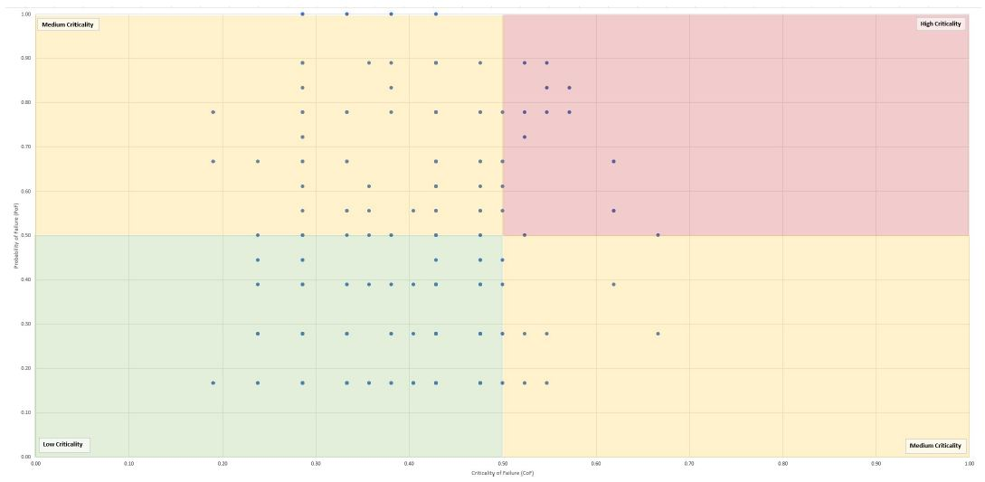
Criticality - Pipes

Slide 28
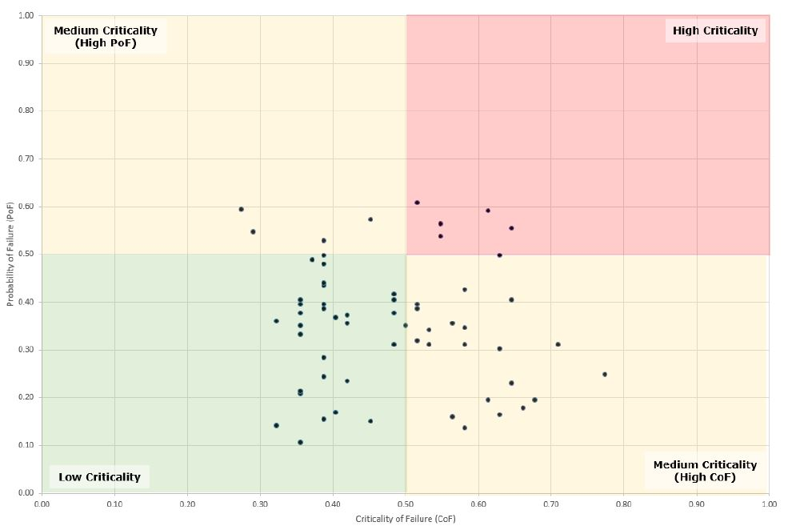
Criticality
Criticality – Culverts

Slide 29
FY25 Stormwater
Plan for FY25:
  Standard Year of replacements and maintenance, no significant culvert replacement, allows time to seek outside funding sources
  Of note: The Town is evaluating a Stormwater Utility Fund (Enterprise) as a means of revenue for stormwater in the future

Slide 30
DPW General Fund Capital Plan
Cemetery Capital Plan

Slide 31
FY25 Through FY29
Capital Improvement Program
Water & Wastewater Requests
Ayer Department of Public Works
Presented
November 30, 2023

Slide 32
Proposed 5 Year CIP
Water Division

Slide 33
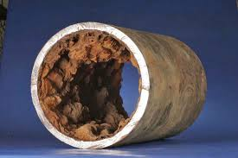
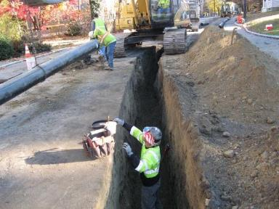

Annual Water Main Replacements
Annual Capital request to replace aging water mains with poor rating
Budget for $300K per year (approx. 2000 ft.)
FY25 projects include Cambridge St.
In-house engineering to maximize pipe replacement value
Continue to apply for grant funding and explore rehabilitation options

Slide 34
Washington St Water Tank Painting
1.5 Million Gallon Ground Storage Tank
Constructed in 1995
Coatings generally last 15-20 years
Inspection of tank in November 2022
Surface protection as part of routine tank maintenance
Initial Engineer Estimates were higher than expected
Scope of services recommended has modified the estimates
  Exterior Overcoat
  Interior Chemical Cleaning
  Additional items to address deficiencies (grout, signage, swing gate)
  Recommend no additional funding

Slide 35
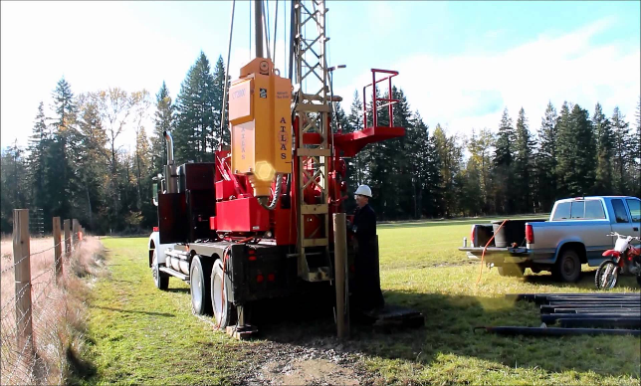
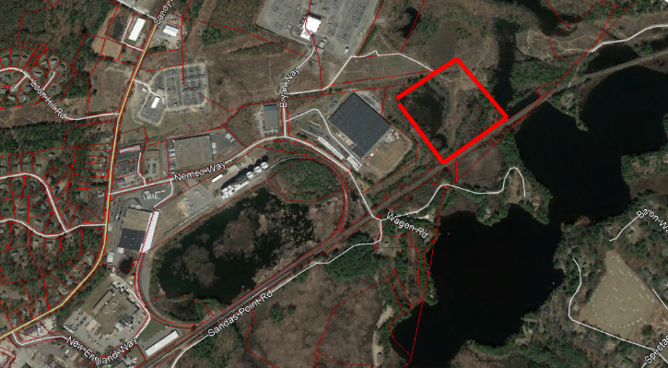
Spec Pond Well 3 Pumping Station and Transmission Main
Following the New Source Approval in land area owned by DPW
Next steps is design and construct a pumping station and Transmission main to Spectacle Pond Treatment Facility

Slide 36
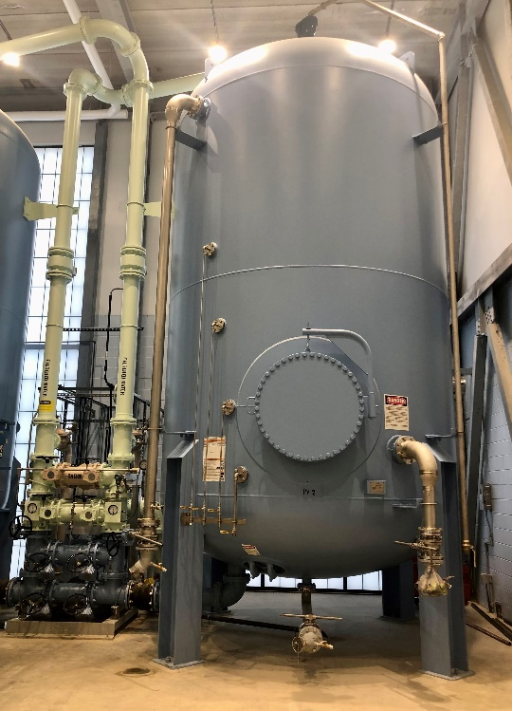
Spec Pond GAC Media Replacement
GAC treatment for PFAS compounds has been working since activation in 2022.
Two Vessels operate in series; first vessel handles the majority of the contamination and the second vessel “polishes.”
Media is becoming spent; evidence is PFAS detections between vessels. Finished water after Vessel 2 is still Non-Detect.

Slide 37
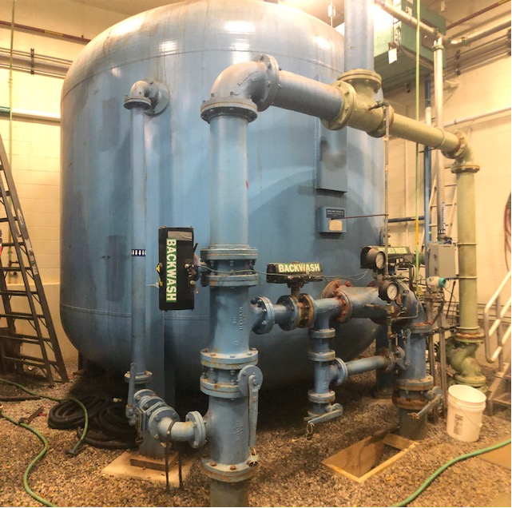
Grove Pond Greensand Valve Replacements
All operating and controlling valves are original to the plant, 1996
30 valves in total of various sizes; 4”-8”
This is a continuing project from FY 24 appropriations.
Replacing in a stepped approach shall ensure proper maintenance and control of the Greensand Filter Vessels.

Slide 38
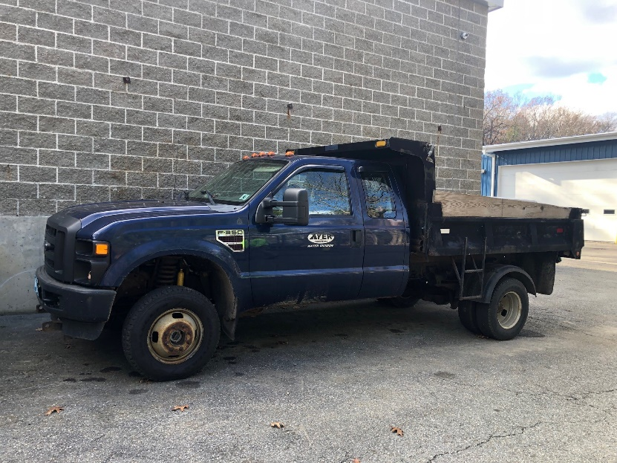
6-Wheel Dump Truck
Replaces a 2008 Ford F350 6-Wheel Dump Truck with 72,000 miles.
Recent repairs:
Complete exhaust, dump motor, lots of welding, front end parts, power steering pump lines, body control module (whole electrical system was rotted).
Used for Water Construction and Snow Operations.

Slide 39
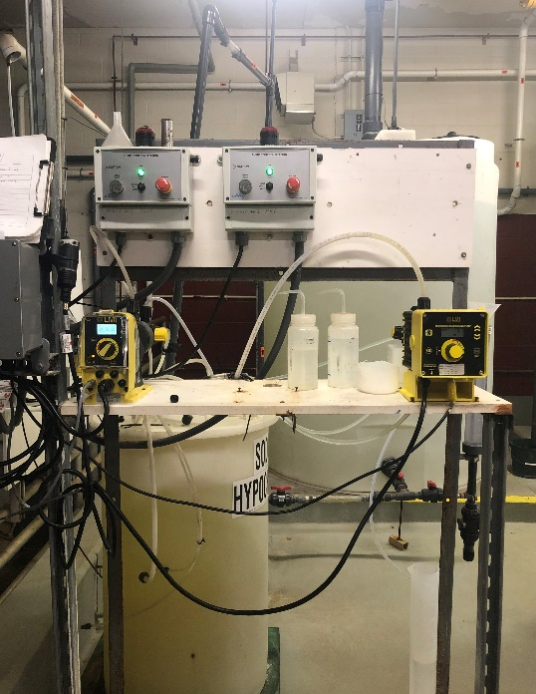
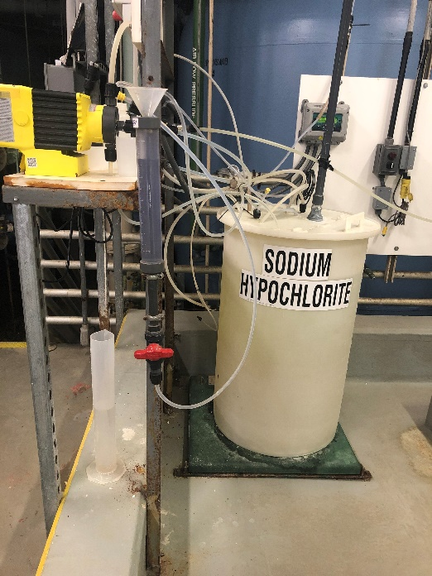
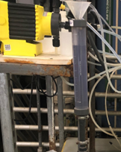
Spec Pond Chemical Skid
Replaces components of the chlorine chemical feed system that pumps chlorine into the treatment system.
Last done in 2011
Preventative maintenance

Slide 40
Proposed 5 Year CIP
Wastewater Division

Slide 41
Inflow / Infiltration Repairs
2018 I/I investigation evaluated most of the pipes in the system
Problems included high inflow, roots, structural damage
I/I can add over 1 million gallons of flow to WWTP
The EPA NPDES permit for the Town has requirements to reduce I/I
Next critical areas to be addressed are sections of West Main St., Main St., and Central Ave.

Slide 42
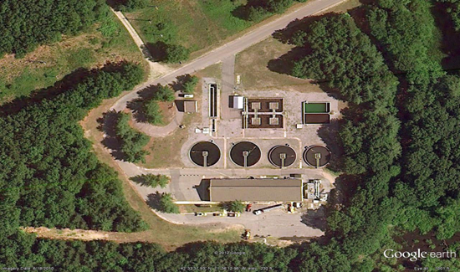
Wastewater Treatment Plant Upgrades
Phase 3 (Solids Handling) nearly complete.
  Gravity Belt Thickener, Polymer System, Plant Water System, Aeration Blowers, WAS/PS/TWAS pumps, Basement HVAC, SCADA Upgrades
Phase 4: More Process Upgrades:
    RAS Pumps, Scum Box Mixer, Replace Diffusers, Replace Secondary Clarifier Mechanisms, Add Aeration to Aeration Tank (AT) Effluent Channels, AT Effluent Gate, Sandblast and Coat Primary Clarithickener Mechanisms, SCADA Upgrades

Slide 43
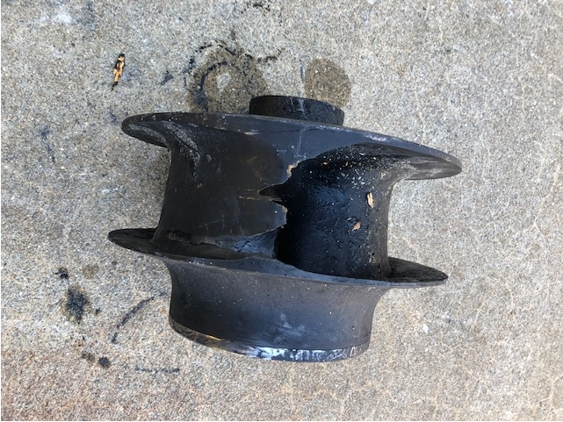
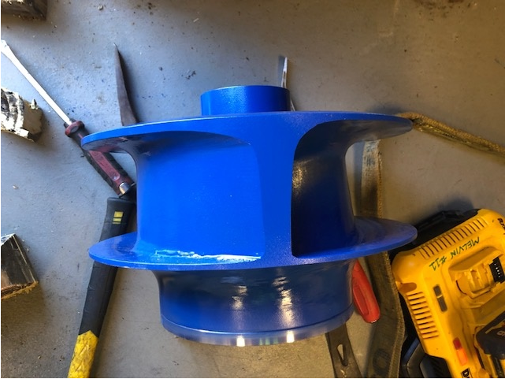
Pump Impeller/Volute Replacement at Main and Central
These are parts that wear with use and need replacement
Main Pump 2 was replaced as an emergency in FY 22
Main Pump 3 was replaced in FY23
Worn, Replaced
New

Slide 44
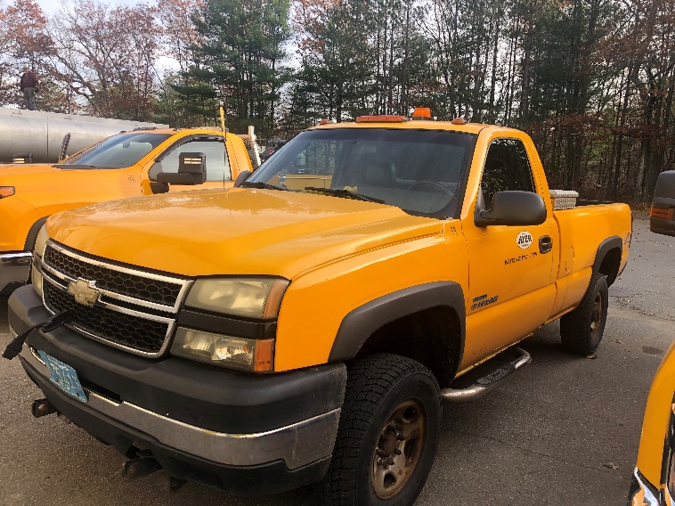
Pickup Truck
Replaces a 2007 Silverado 2500HD with 138,000 miles
Recent and Needed Repairs:
Cracked frame, carbon monoxide leak into cabin, lots of rust to the underbody, power steering pump, tires, break lines, instrument cluster, trailer hitch unstable, air bag and check engine lights on, hole in driver floorboard, front differential axle needed.
Used to operate the Collection System,
WWTP and plowing operations.

Slide 45
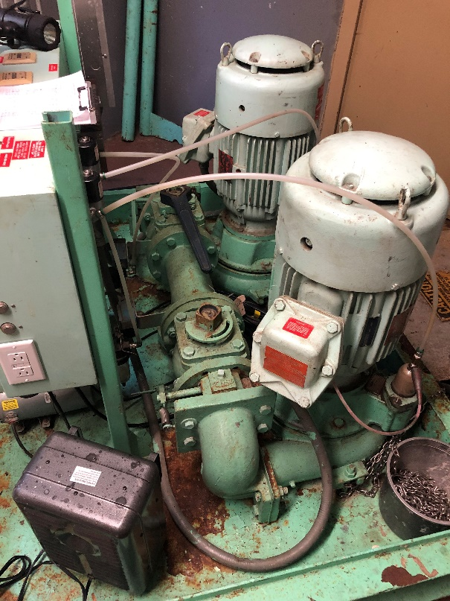
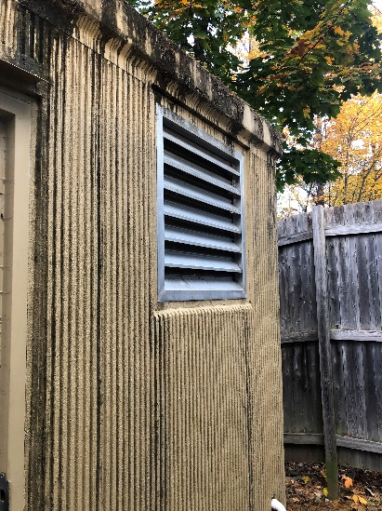
Sewer Pumping Station Upgrades
Ayer has 20 Wastewater Pump Stations of various sizes and designs.
Pictured is Bennetts Brook Pump Station that is in need of equipment upgrades.
Wright Way Pump Station is in urgent need of replacement. Some money has been allocated but recent engineering estimates have determined that additional funds are needed.
Upgrades are needed to keep wastewater moving and prevent health and safety issues.

Slide 46
Pump Station Generator Connections
A new Trailor Mounted Generator has been purchased, the cost being split between Water and Sewer.
The next step is to install Connections for the Generator to plug into. However, the cost is high and the DPW would like to take a phased approach.
The two assets that are most critical are Wastewater’s Main and Central Pump Stations. The current generators have the highest risk of failure and redundancy is important.

Slide 47
Solid Waste Enterprise Fund –
Capital Requests

Slide 48
Thank You for Your Consideration of These Important Town Infrastructure Projects
Dan Van Schalkwyk, p.e. Kimberly Abraham
Director of public works Water and sewer superintendent

