Slide 1
Town of Ayer Initial Presentation of the FY 2025 Omnibus Budget
Robert A. Pontbriand, Town Manager Carly M. Antonellis, Assistant Town Manager Barbara M. Tierney, Finance Manager – Treas/Tax Coll
January 24, 2024 Public Presentation to the Ayer Select Board and Finance Committee

Slide 2
BUDGET PROCESS AND BUDGET CALENDAR
The municipal budget cycle starts on July 1 and ends on June 30. This is referred to as a fiscal year. For example, Fiscal Year ’25 begins on July 1, 2024, and runs to June 30, 2025. The Town of Ayer begins budget preparation in October/November for the following July 1.
October | November | December | January | February | March | April | May
Town Manager sends Capital Planning Directive Union Negotiations Begin Rate Review Committee meets to discuss CY 23 Transfer Station Rates Fall Special Town Meeting 10/23/2023 | Capital Budget Requests Due Town Manager sends Operating Budget Directive Tax Classification Hearing | Capital Planning Committee begins to review requests Operating Budgets due from Departments | 1st DRAFT of Budget sent to SB and Finance Committee Town Manager meets with Departments to review requests 1st Budget Presentation Annual Town Meeting Warrant Opened | Rate Review Committee meets to discuss FY ‘24 Ambulance, Water, and Sewer Rates Major Budget Drivers such as health insurance, energy/fuel costs, and school assessments begin to take shape | Union Negotiations End SB holds Public Hearing on FY ‘24 Water and Sewer Rates ATM Warrant Closes 3/29/2024 at 12:00 PM | ATM Warrant Reviewed and Approved 4/2/2024 Community Preservation Commission Estimated Revenues Received Annual Town Meeting 4/22/2024 | Annual Town Election 5/14/24
We are here

Slide 3
Town of Ayer Budget Successes
The Town of Ayer begins the FY 2025 Budget Process from a Position of Fiscal Stability and Financial Strength
Fund | Balance
2023 Certified Free Cash | $1,677,665
2023 Stabilization Fund | $3,143,968
2023 Capital Stabilization Fund | $4,741,166
2023 Other Post-Employment Benefits (OPEB) Fund | $4,740,613
2023 Standard and Poor (S & P) Bond Rating | Aa2 Stable Outlook
S & P Rating Includes Findings of: Very strong economy. Strong management with good financial policies and practices. Healthy Reserves.

Slide 4
Stabilization Fund Balances

Slide 5
Capital Stabilization Fund Balances

Slide 6
Town of Ayer Budget Successes
DPW secured $1 million in MassDOT Grants for the West Main Street Bridge
Unused Tax Levy Capacity has grown from $2,449 in FY 2012 to $3,851,329 in FY 2024
Solar New Metering Agreement initiated in FY 2013 has saved over $1.5 million or 42% in energy costs due to the solar net metering credits.
Facilities Department obtained $151,530 Green Communities Grant for various Town-wide energy efficiency projects.
DPW obtained $500,000 Complete Streets Grant for Sandy Pond Road
Over $400,000 in
State 9-1-1 Grants for
Police and Dispatch

Slide 7
Summary of DRAFT#1 of the FY 2025 Omnibus Budget
DRAFT #1 Submitted to the Select Board, Finance Committee and ayer.ma.us/budget on January12, 2024
Does not include the School Assessments (ASRSD and NVTHS)
Does not include Union/Non-Union Contracts (Negotiations in Process)
Does not include any Cost-of-Living Adjustment (COLA)
Remains a work in progress through the Budget Process
DRAFT #1 Budget Total: $19,056,771.33
Increase from FY 2024 Budget: $1,141,440.33
% Increase from FY 2024: 6.37%
DRAFT #1 is subject to revisions and adjustments as the Town moves through the Budget Process. Subsequent DRAFTs of the FY 2025 Budget will be posted on the Town’s website at: ayer.ma.us/budget

Slide 8
FY 2025 Budget Drivers
Increased Health Insurance Costs (15% Estimate) $340,740
Debt Service 11% increase (Includes W. Main St. Bridge and Fire Pumper Truck) $121,848
Fire Department Integration of SAFER Grant Costs into Town Budget $118,000
Information Technology (I.T.) $116,418
Ayer Library Budget Request $45,109
General Insurance Cost Increases (10% Estimate) $31,368
TOTAL: $773,483

Slide 9
Revenue Overview
TAX LEVY | $ 30,262,429
STATE AID-Estimated | $ 1,076,696
LOCAL RECEIPTS-Estimated | $ 2,506,420
FREE CASH | $ 1,677,665
 | $ 35,523,210

Slide 10
Wage Analysis
Police and Fire | 58.61%
DPW and Other Public Safety | 13.44%
Human Services | 2.50%
Culture & Recreation | 6.75%
General Government | 18.70%

Slide 11
Expense Analysis
WAGES | 48.78%
BENEFITS | 27.12%
DEBT | 6.28%
OTHER EXP | 17.82%

Slide 12
Next Steps in the FY 2025 Budget Process
Town Manager and Finance Manager to continue to meet with Department Heads to refine budgets
Nashoba Valley Technical High School Assessment to be released on Feb. 1st
Ayer Shirley Regional School FY 2025 Budget to be Presented to SB/Fin Com Feb. 6th
Union and Non-Union Contract Negotiations to Conclude in February/Early March
SB Public Hearing on Setting the Water and Sewer Rates End of March/Early April
Annual Town Meeting to take place on Monday, April 22, 2024

Slide 13
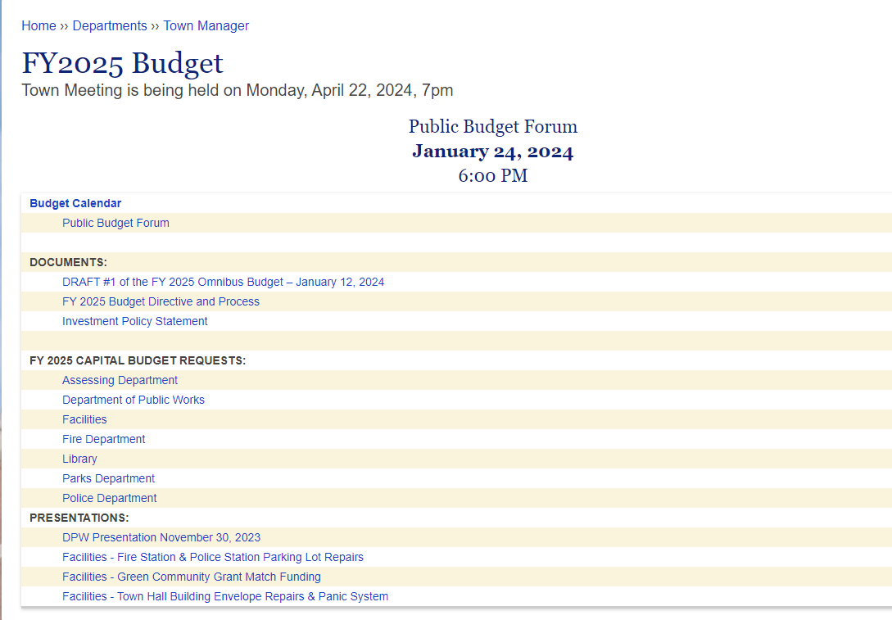
Questions and Further Information
For more information about the FY 2025 Budget:
Visit the Town Manager’s “2025 Budget Page” on the Town’s Website at
www.ayer.ma.us/budget
Contact the Town manager at (978) 772-8220 or TM@ayer.ma.us

